Slide 1
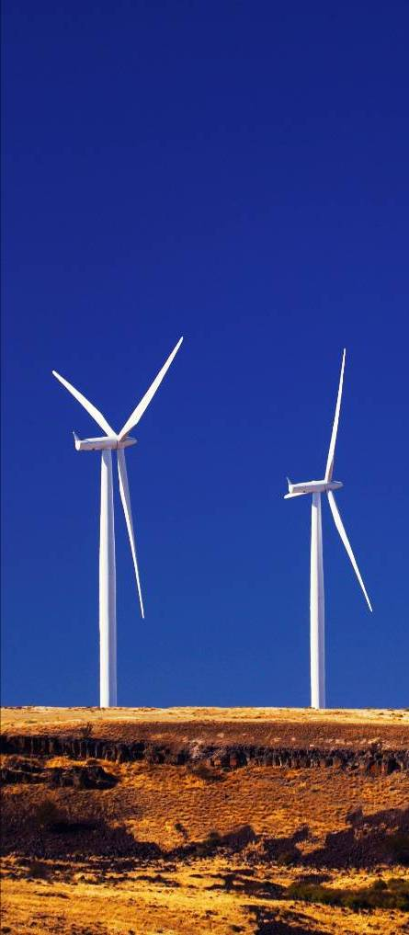

Siemens Energy, Inc.
Welcome to Wind Turbine Component
Transportation & Logistics
Part 2 – Vessels & Ports
Sally Chope, Transportation & Logistics Director
Notes:
1

Slide 2
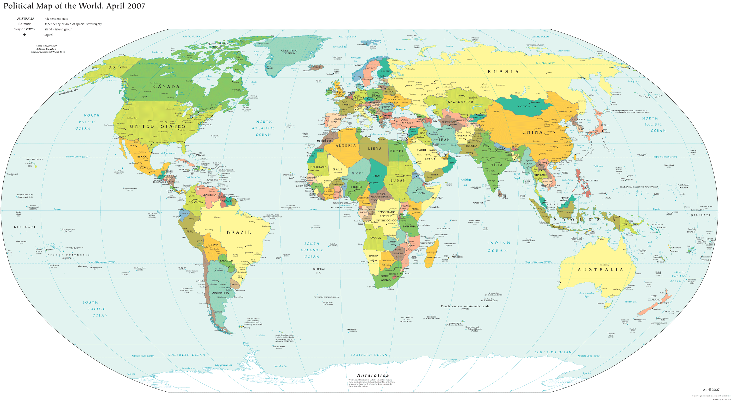
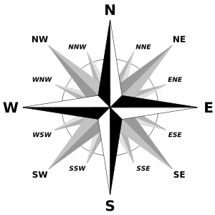
Global reach
VANCOUVER, WA
DULUTH, MN
AARHUS, DK
STOCKTON, CA
BALTIMORE, MD
POHANG, KR
LONG BEACH, CA
SAN DIEGO, CA
HOUSTON, TX
CORPUS
CHRISTI, TX
SHANGHAI, CN
PONCE, PR
KAHULUI, HI
PHU MY, VN
FORTAZELA, BR
Key:
POI
DIRECTION
POE

Slide 3
Vessel basics
There are several types of vessels
Container vessels
Break-bulk vessels
Ro Ro vessels
Lo Lo vessels
Bulk vessels
Barges
Types of service they provide:
Liner vessels
Charter vessels
Tramp vessels
U.S. flag vessels
Jones Act vessels

Slide 4
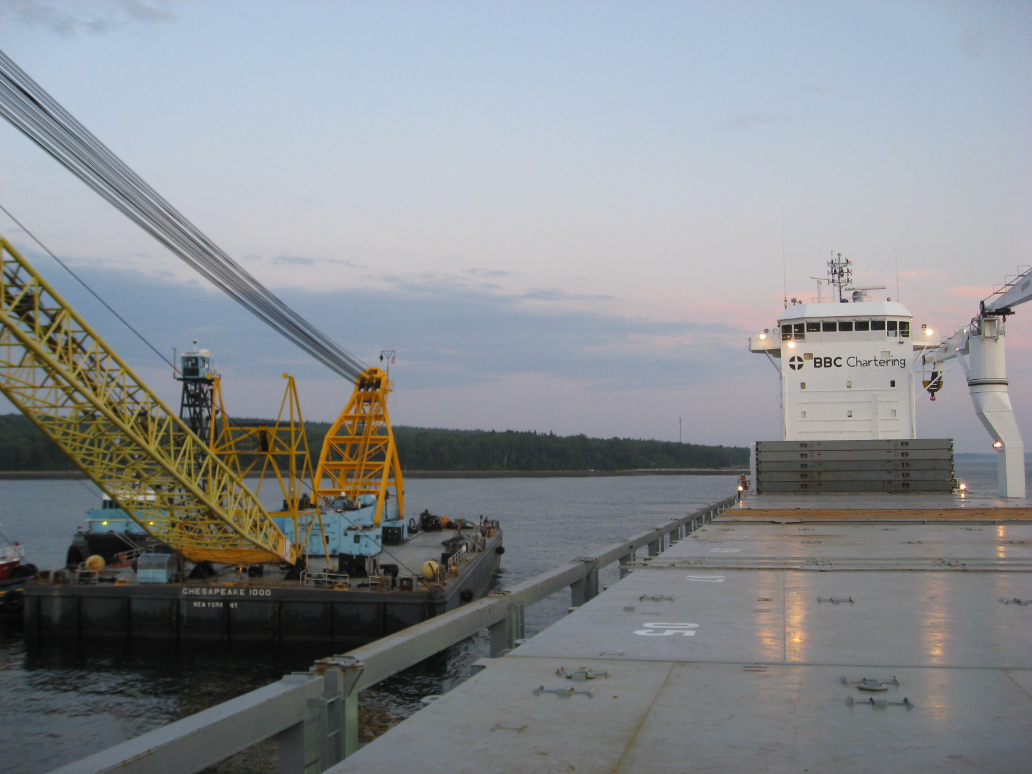
Floating crane approaching vessel being pushed by tugboat

Slide 5
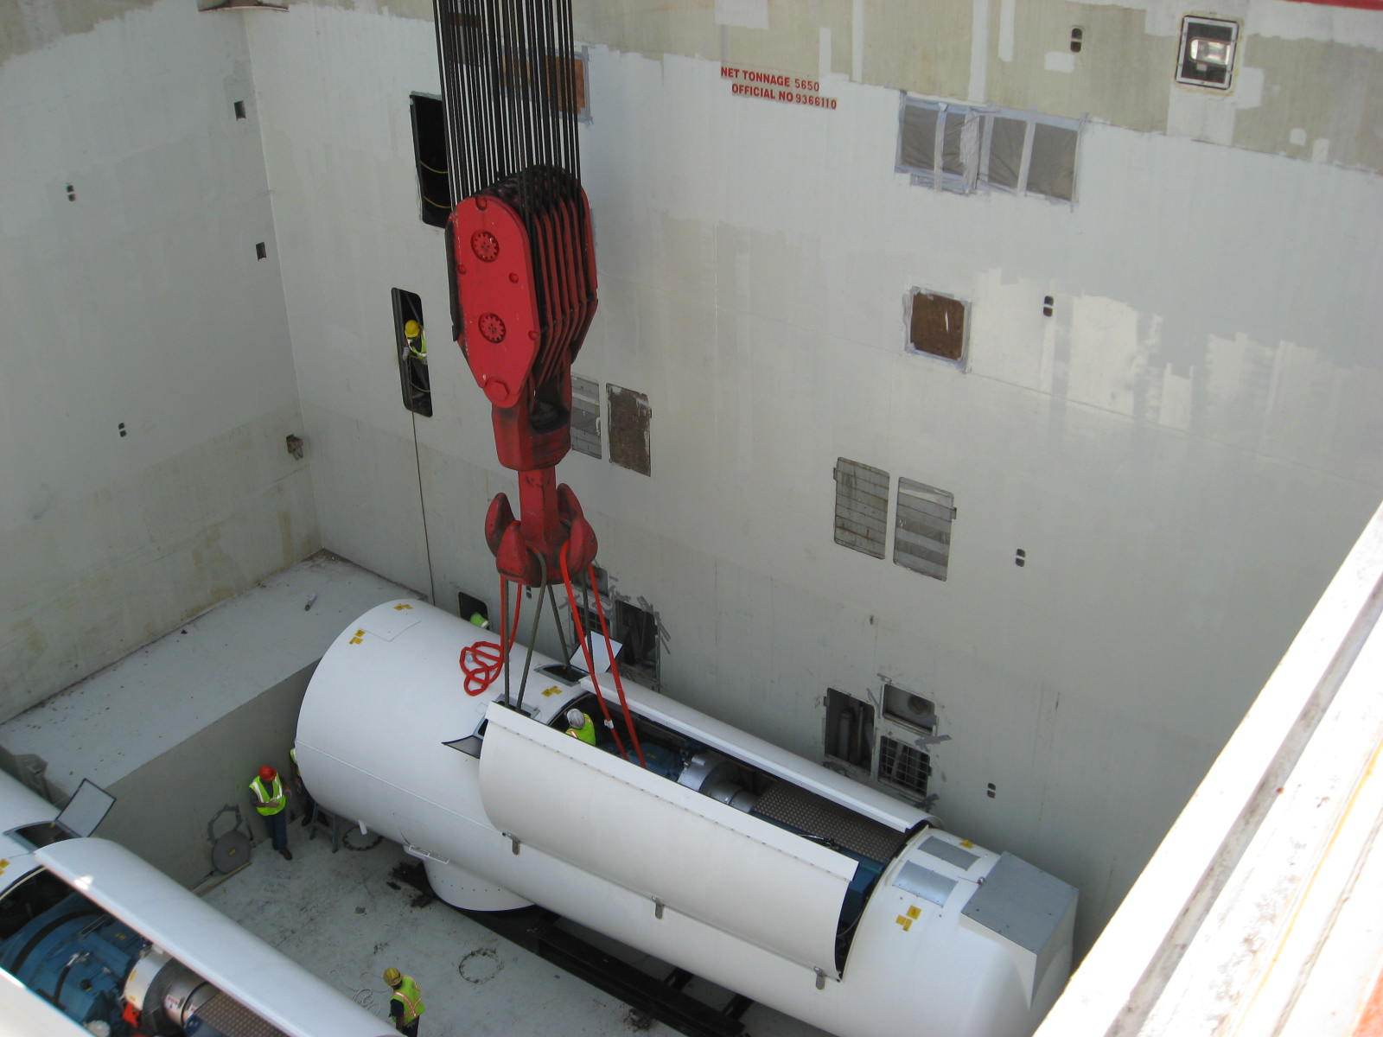
Vessel hatch is opened, rigging is attached to lifting points and off-load begins

Slide 6
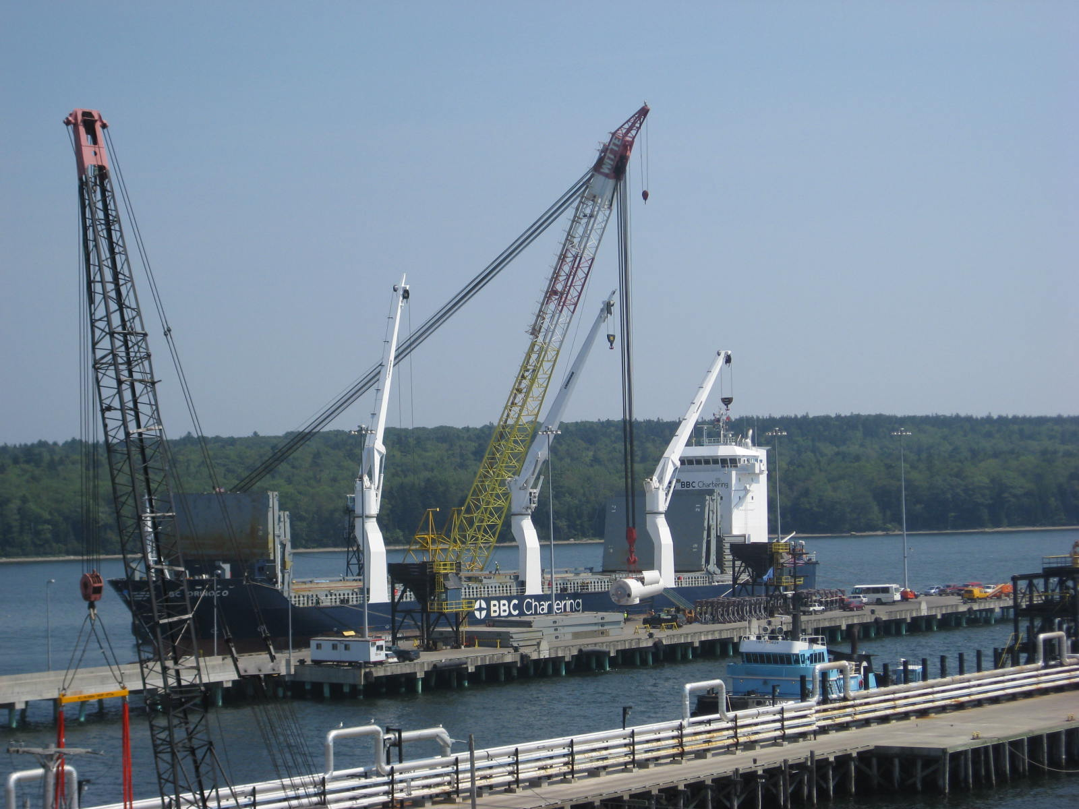
Nacelle off-loads to floating pier

Slide 7
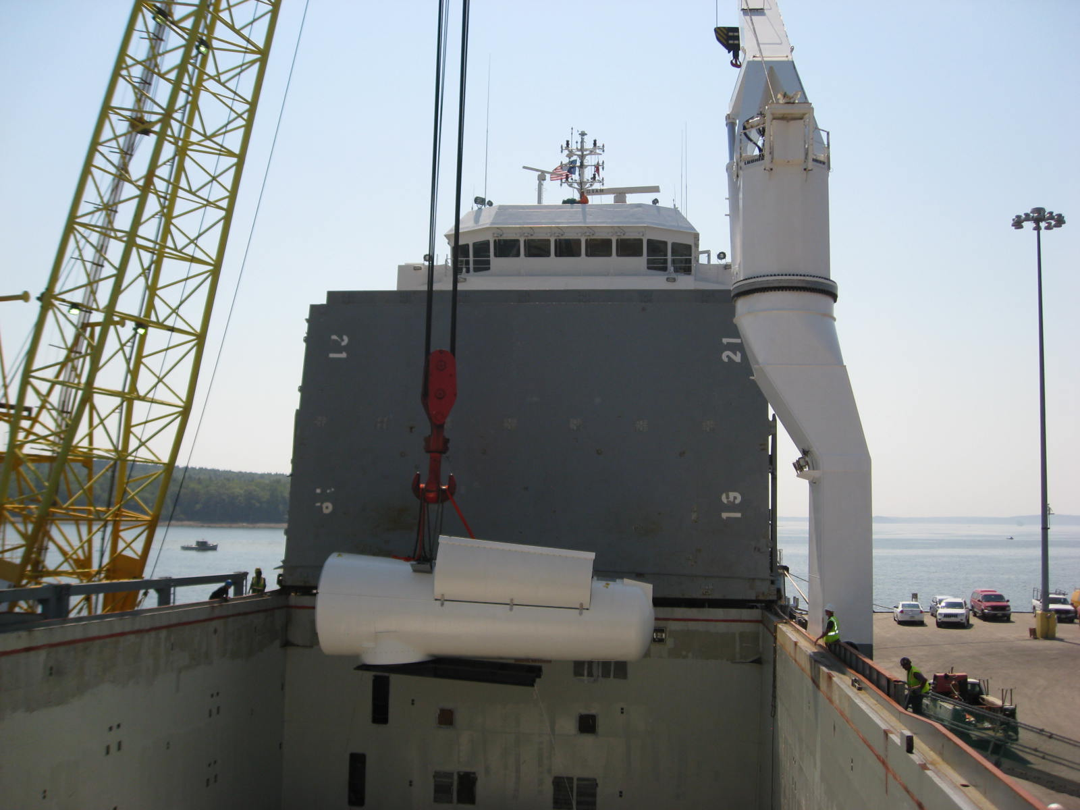
Nacelle begins to clear hold

Slide 8
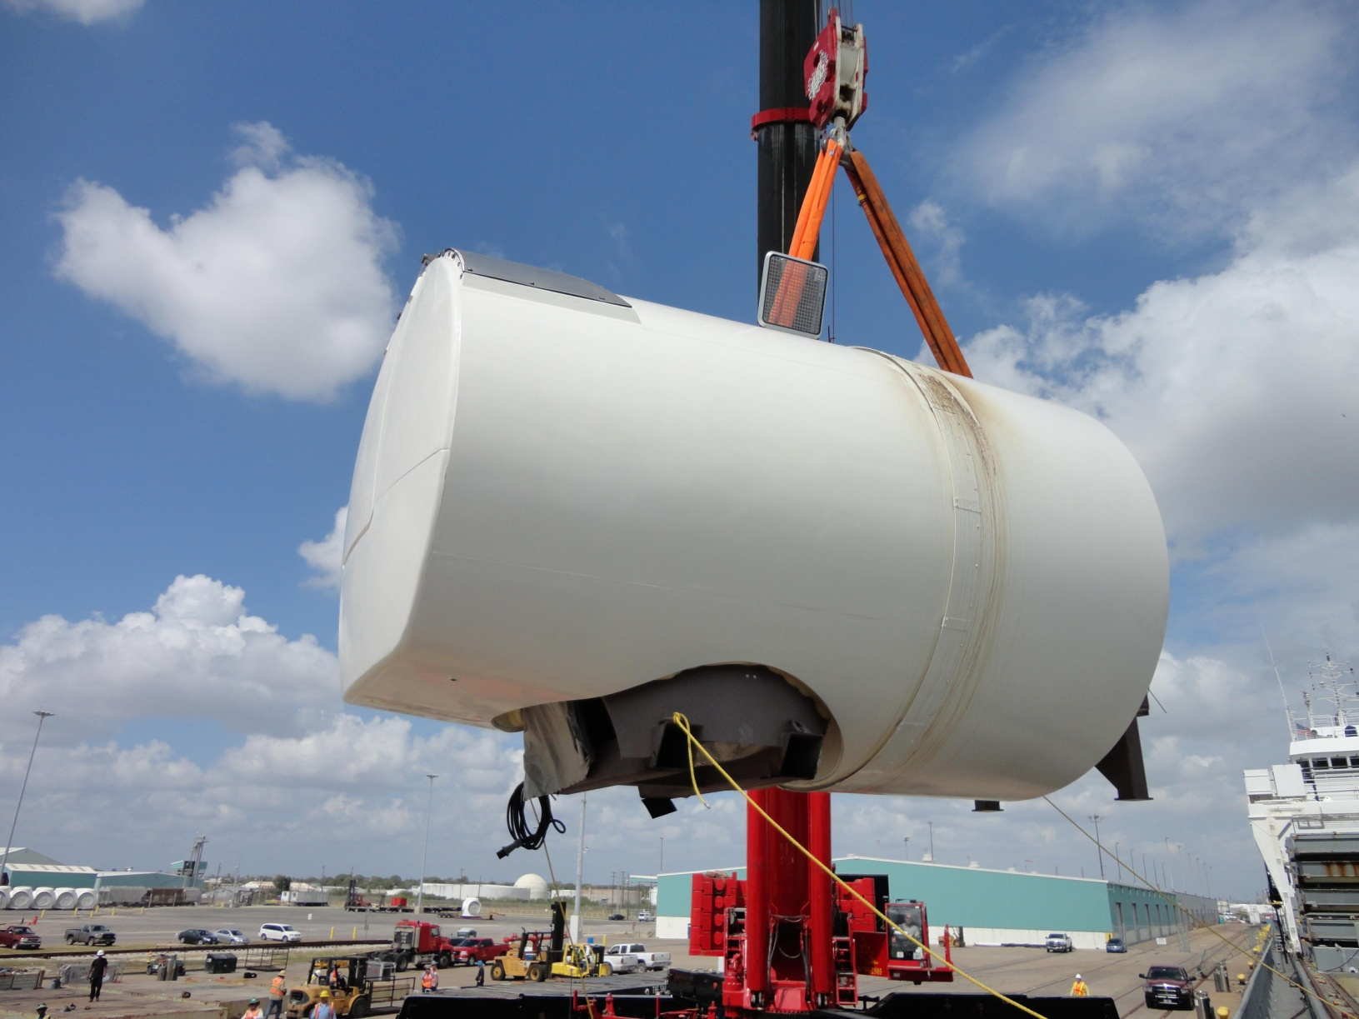
Direct drive nacelle arrives in Port of Corpus Christi

Slide 9
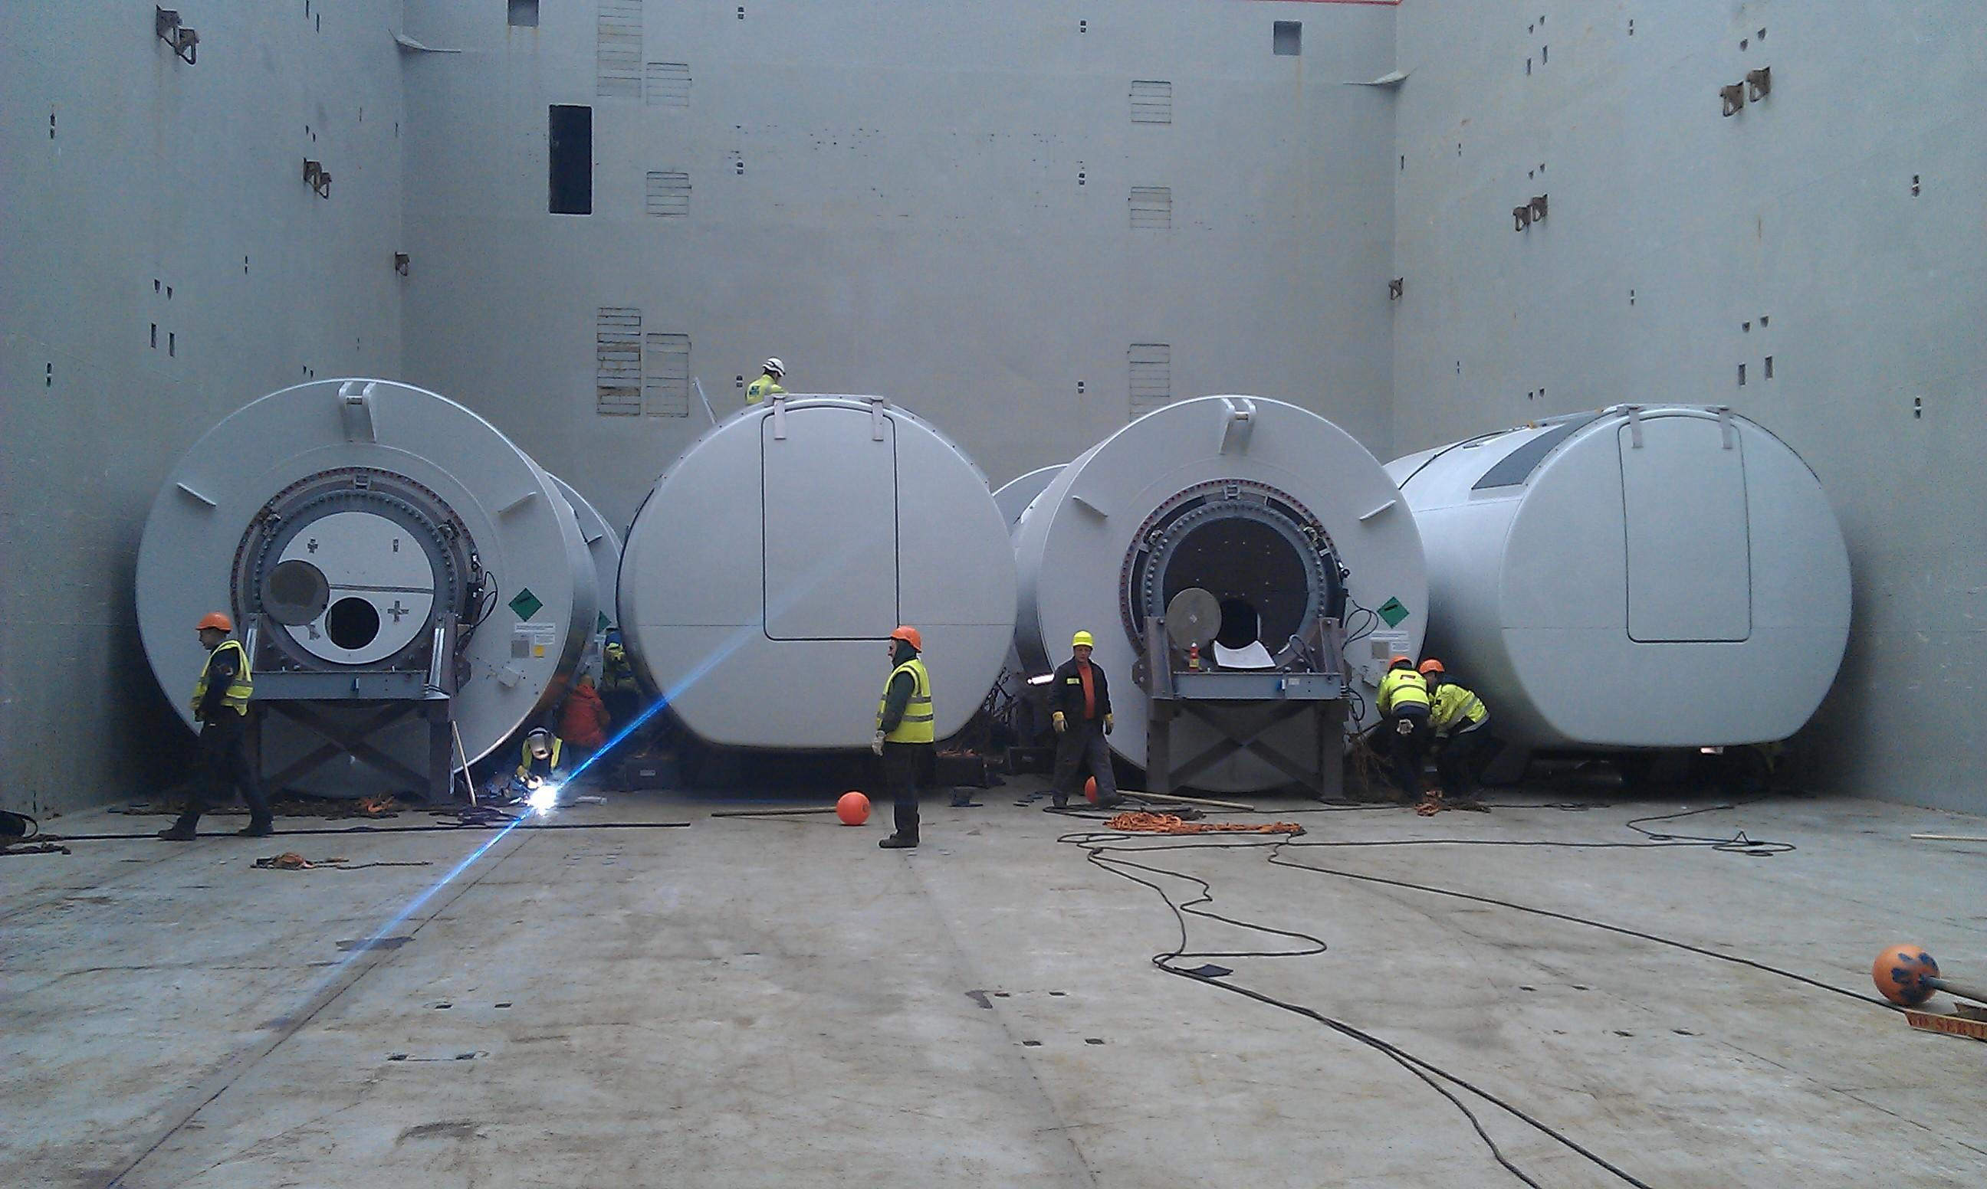
View of cargo hold with removal of tact welding

Slide 10
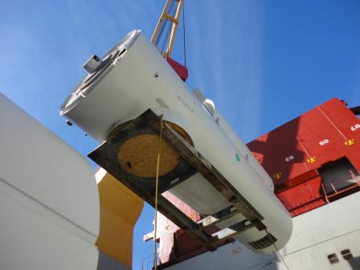
View of nacelle crane lift from cargo hold on vessel
showing transport fixture
n
n

Slide 11
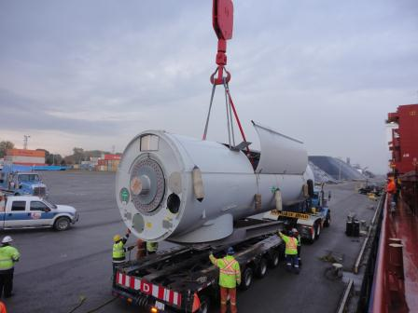
Nacelle off-load to mafi trailer (not used outside of port)
n
n

Slide 12
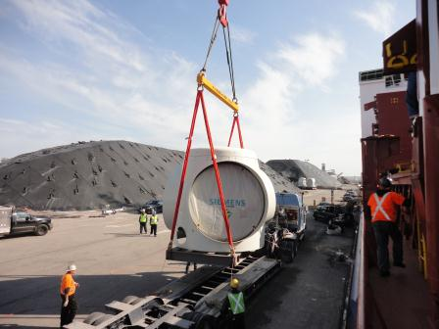
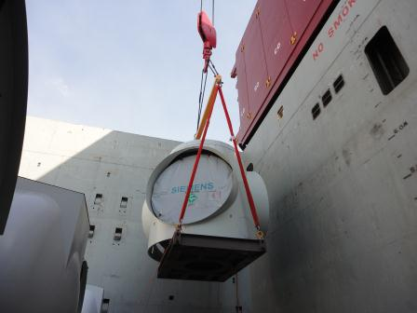
Hub off-load from vessel to truck using special lifting gear

Slide 13
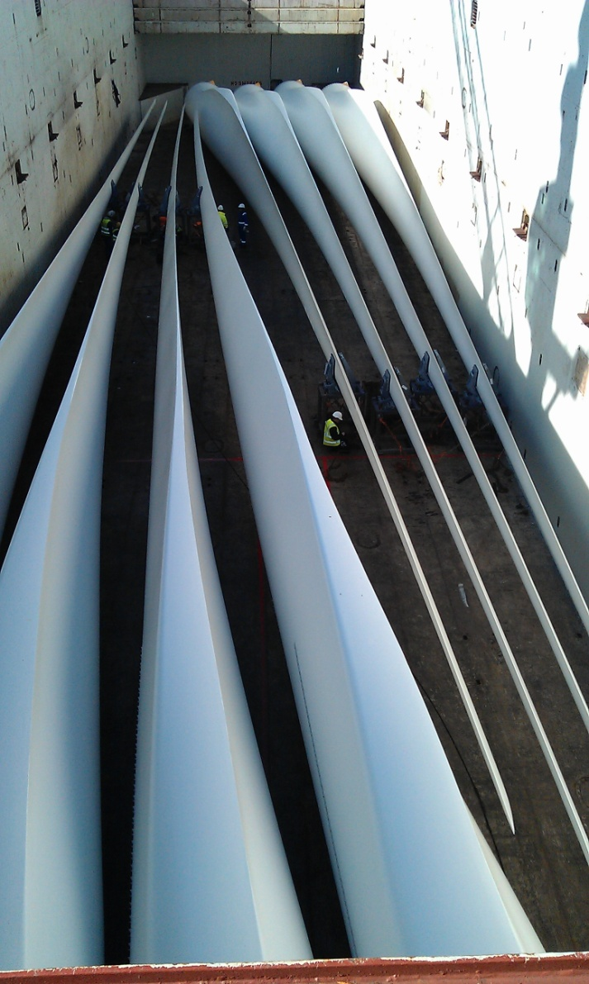
View of blades nested in hold

Slide 14
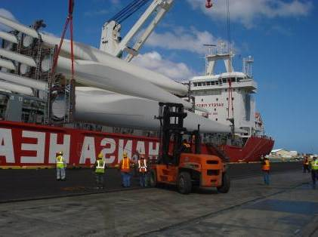
Blade off-loaded from stacking system on deck of break-bulk vessel

Slide 15
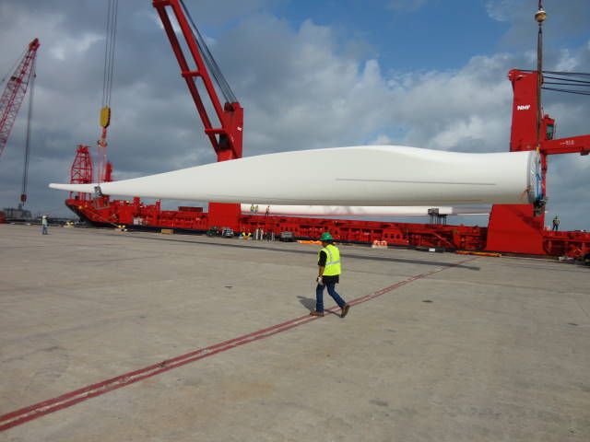
53-meter blades off-load via self-geared vessel

Slide 16
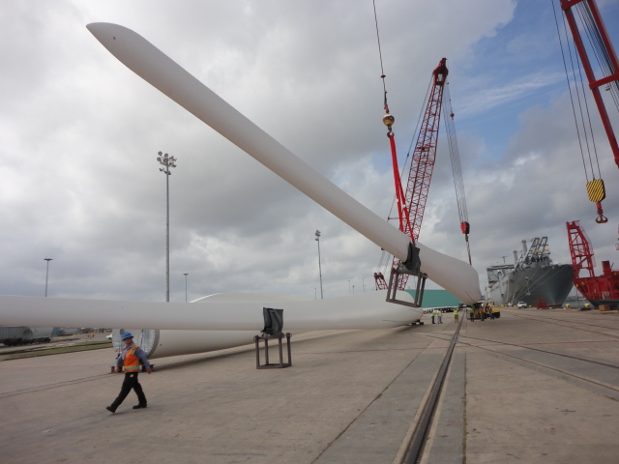
53-meter blade off-load

Slide 17
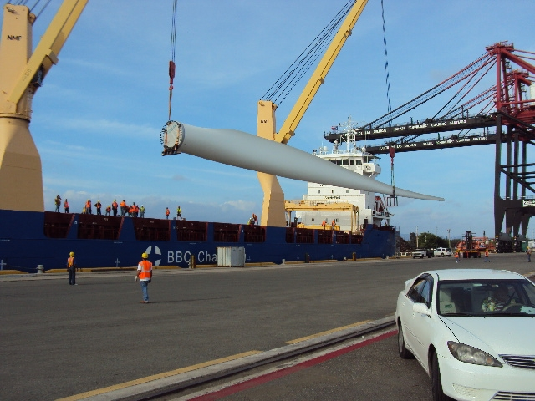
Blade off-load with ship’s gear, container cranes in background

Slide 18
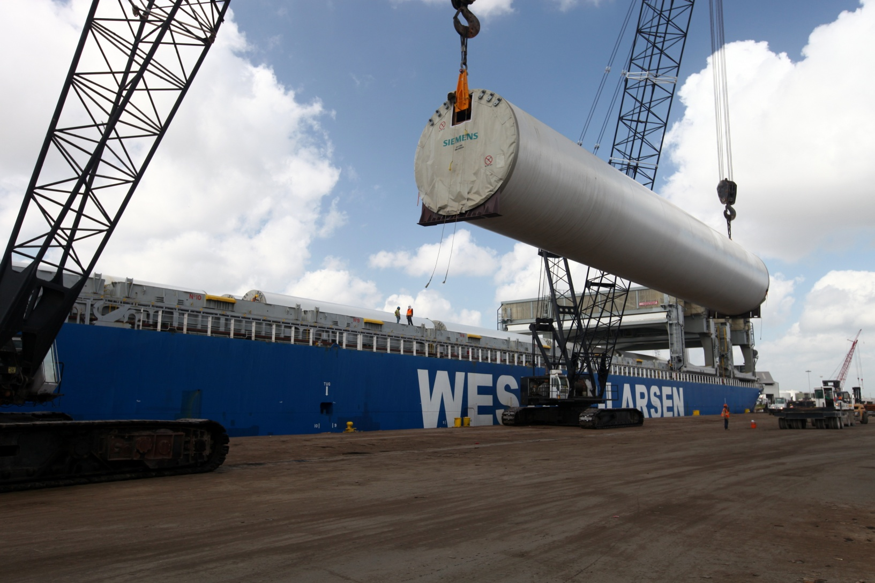
J-hooks are utilized to load and off-load towers

Slide 19
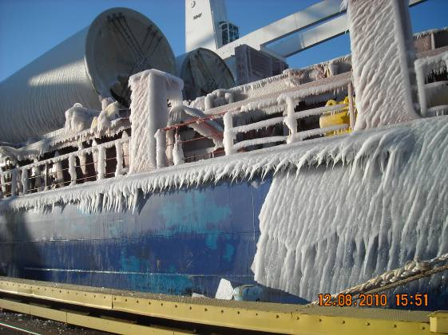
Tower vessel in Duluth via St. Lawrence seaway

Slide 20
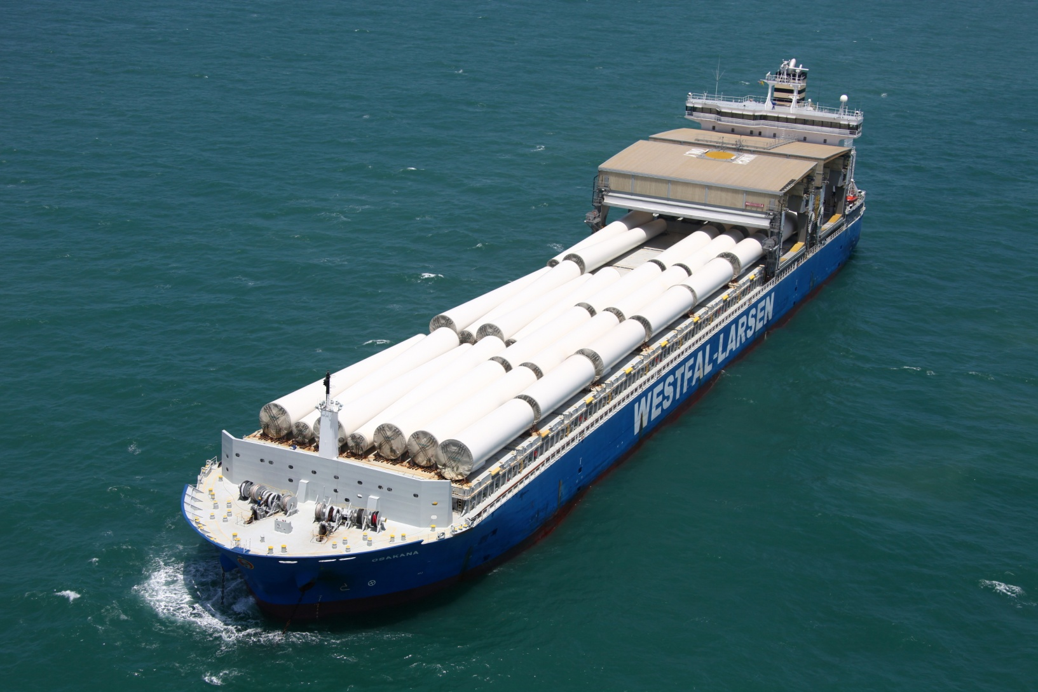
Single stack on deck tower shipment Shore cranes required for off-load

Slide 21
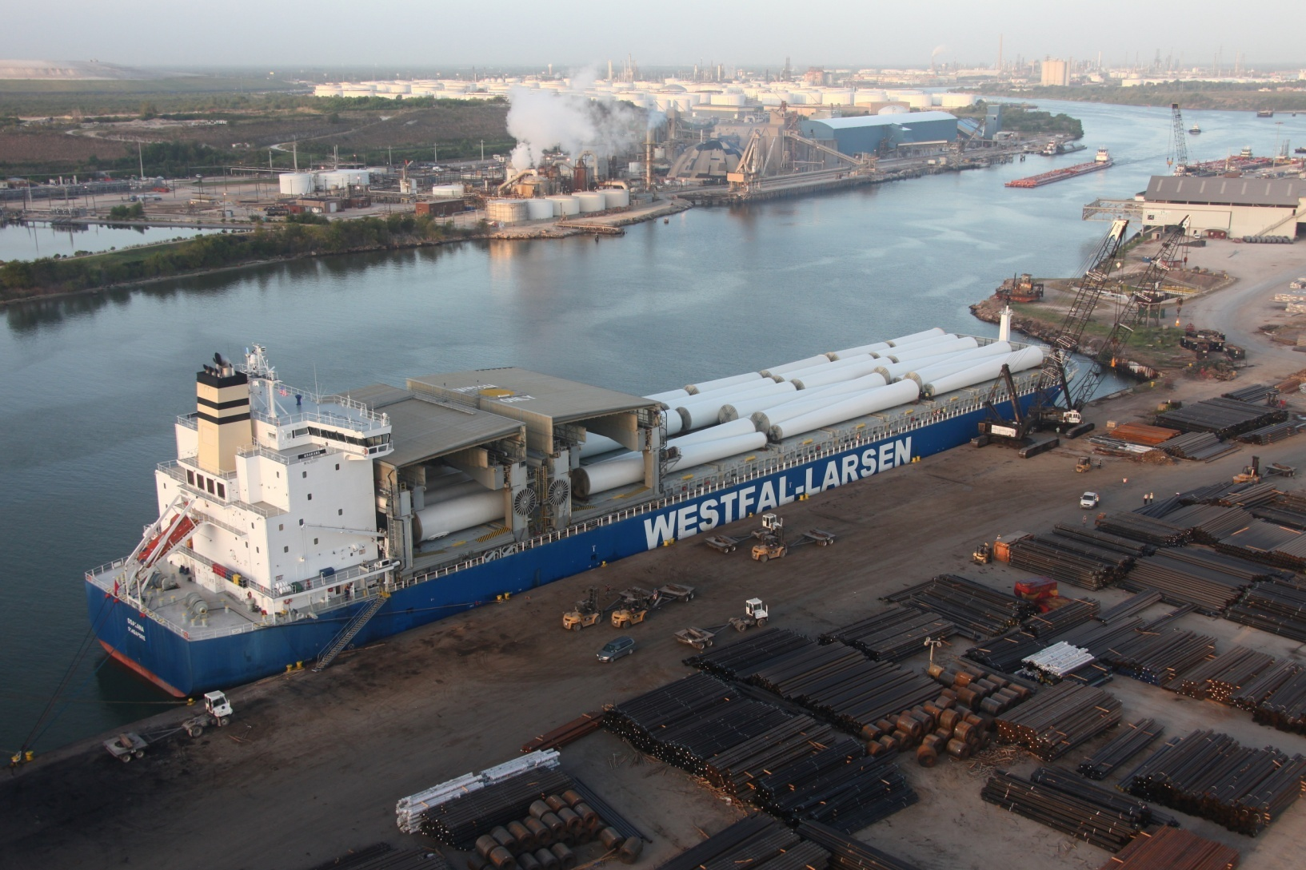
Another view of towers on deck

Slide 22
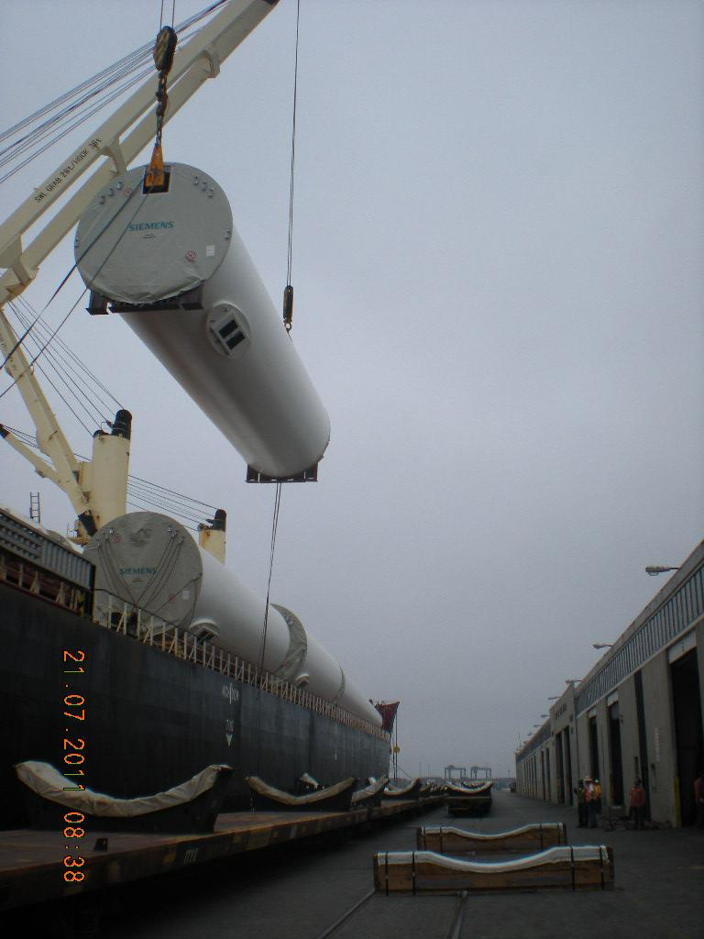
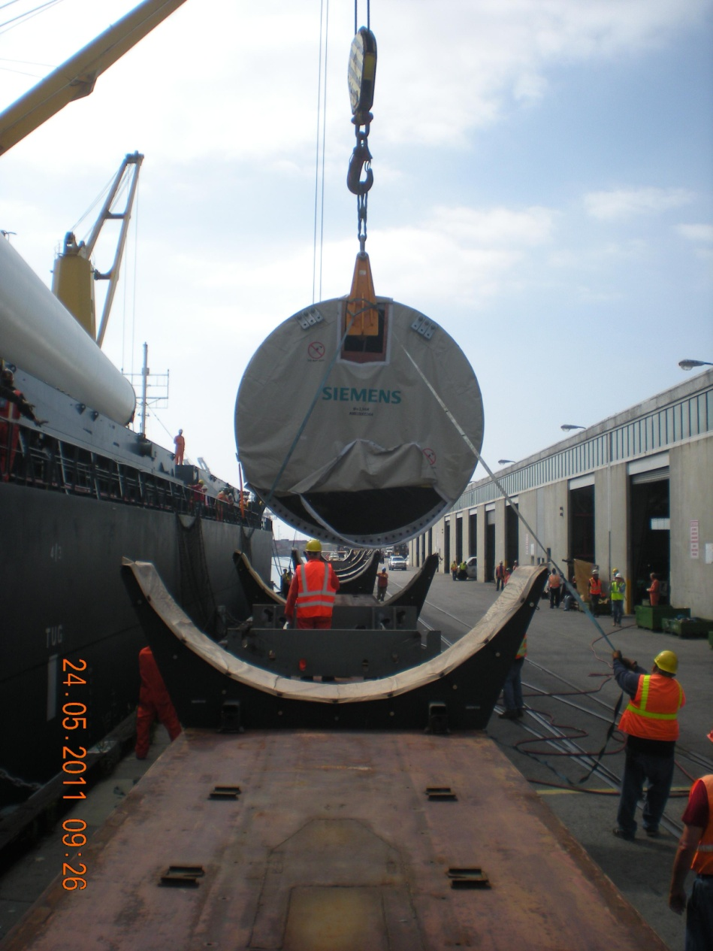
Direct off-load of towers to railcars with ship’s gear in Long Beach, California

Slide 23
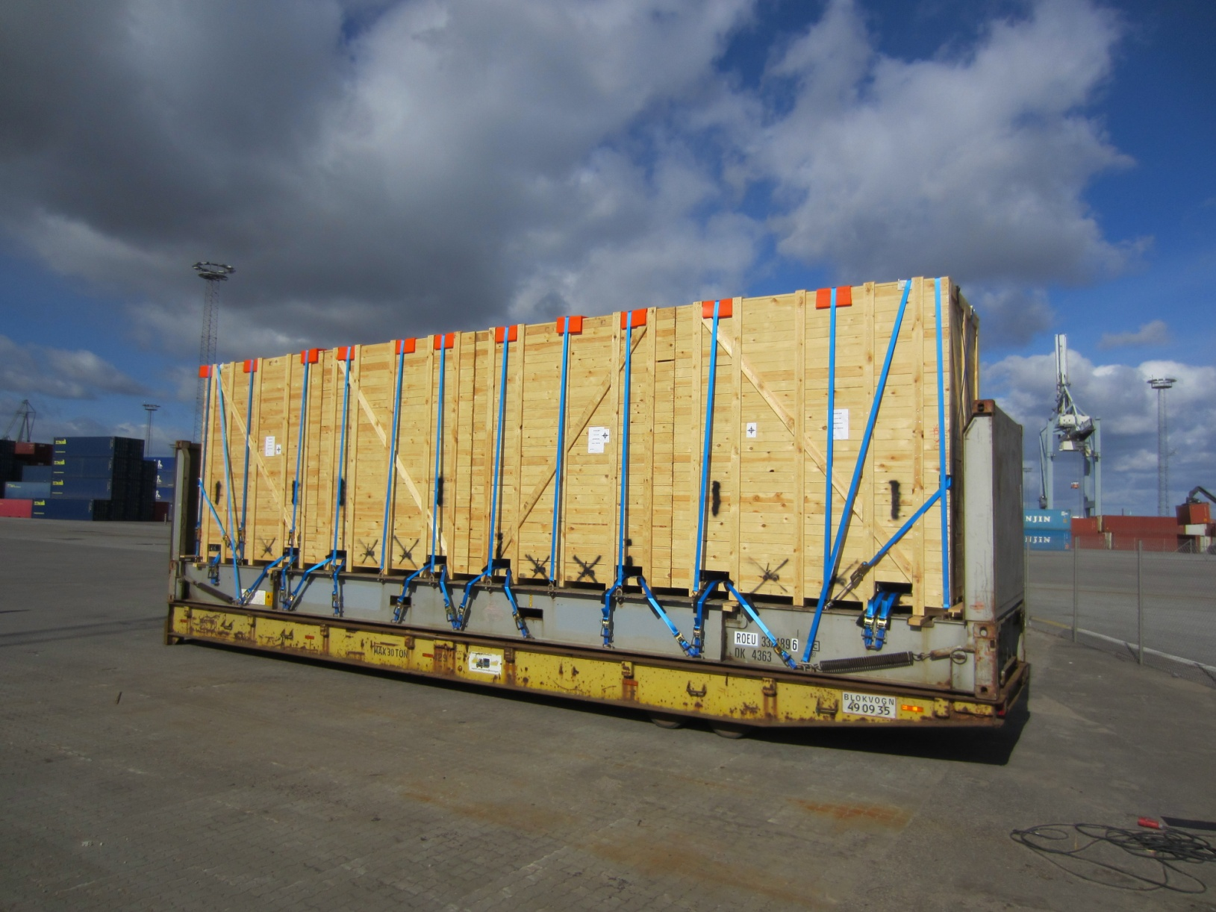
Four crated power units on flat rack

Slide 24
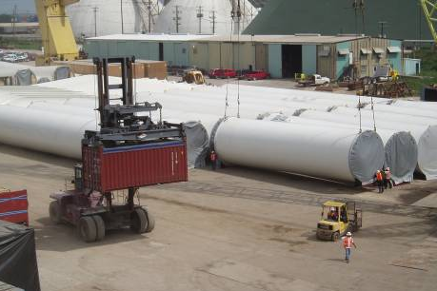
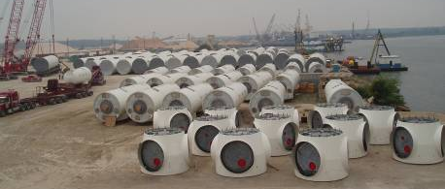
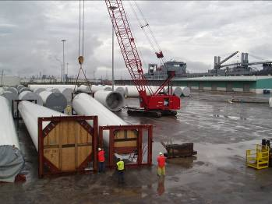
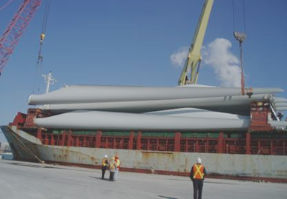
Components at port of import laydown area

Slide 27
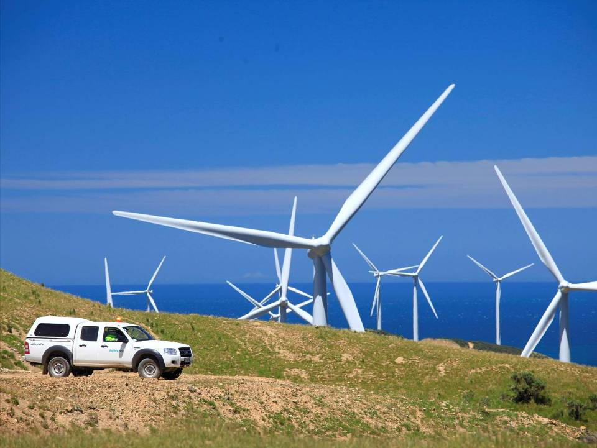
Questions?
Thank you!

