Slide 1
The General Data Protection Regulation in the European Union How It Applies to Freelance Translators Worldwide
Monique Longton
monique@longtontranslation.com
www.longtontranslation.com
Audrey Pouligny
audrey@quidlingualegal.com
www.quidlingualegal.com
© Copyright 2018 | Monique Longton, Longton Linguistic Services | All Rights Reserved

Slide 2
Disclaimer
I am not an attorney.
I do not provide legal advice.
I am here in capacity as a business owner.

Slide 3
Session Outline
GDPR Scope, Principles and Obligations
Step 1: Let’s take a look at what we do
Step 2: Let’s get organized (register)
Step 3: Let’s prepare our tools to meet our obligations (our websites, our mailing marketing campaigns, our translation workflow, our invoicing processes)
Step 4: Let’s secure our data
Step 5: Let’s translate
Step 6: Let’s invoice our clients and pay our suppliers
Other Topics

Slide 4
What is the General Data Protection Regulation (“GDPR”)?
Regulation (EU) 2016/679 to protect data subjects with regard to their personal data (GDPR, Art. 1)
Data subjects = natural persons living in the EU/EEA (Iceland, Lichtenstein and Norway)
‘Personal data’ = any information relating to an identified or identifiable natural person (‘data subject’); an identifiable natural person is one who can be identified, directly or indirectly, in particular by reference to an identifier such as a name, an identification number, location data, an online identifier or to one or more factors specific to the physical, physiological, genetic, mental, economic, cultural or social identity of that natural person (GDPR, Art. 4)

Slide 5
What is the main purpose of the General Data Protection Regulation (“GDPR”)?
Gives certain rights to data subjects
Access to your privacy policy (GDPR, Art. 12, 13 and 14)
Confirmation whether you are/are not processing their personal data (GDPR, Art. 14)
Access to their personal data (GDPR, Art. 12, 13 and 14)
Rectification of inaccurate personal data (GDPR, Art. 16)
Erasure of personal data (= “right to be forgotten) (GDPR, Art. 17)
Restriction of processing (GDPR, Art. 18)
Object to processing (GDPR, Art. 21)
Withdraw their consent to have their data processed (GDPR, Art. 13.2.c & 14.2.d)
Data portability (GDPR, Art. 20)
Not be subject to a decision based solely on automated processing, including profiling (GDPR, Art. 22.1)
Raise complaints with a Data Protection Authority

Slide 6
Does GDPR apply to you?
Do you deal with clients in the EU?
Website: EUR prices? Languages? References to EU clients?
Do you translate files which contain EU data subjects’ personal data (e.g. birth certificate, passport, resume…)
B2B +B2C: professional email address = personal data!
It does not matter where YOU live (GDPR, Art. 3)
GDPR was implemented in EU member states’ national legislation

Slide 7
Principles of privacy by design applicable to translators
Lawfulness, fairness and transparency (your privacy policy)
Purpose limitation
Data minimization
Accuracy (obligation to maintain a register of files)
Storage limitation
Integrity and confidentiality (security)
Accountability (data protection impact assessment)
(GDPR, Art. 5)

Slide 8
In plain English… When you process EU data subjects’ personal data
Say what you do and do what you say
Be concise and go straight to the point
To become “GDPR-compliant”, trying is not enough -- you need proof that you’ve tried really hard!

Slide 9
Who are we under the GDPR?
 | When we do administration/ marketing and billing activities | When we translate
Under the GDPR, who are we? | A Controller | A Processor or a Sub-Processor
Why? | We determine the purposes and means of the processing of personal data | We process the personal data on behalf of the controller
Our main duties? | Protect the data subject’s personal data (GDPR, Art. 24) Allow the data subjects to exercise their rights (GDPR, Art. 12) Report any personal data breach to the Data Protection Authorities and the data subjects (GDPR, Art. 33) Comply with your transparency requirements (GDPR, Art. 12, 24) | Process the data based on the data controller’s instructions (GDPR, Art. 28) Protect the data subject’s personal data (GDPR, Art. 28) Help the data controller meet their obligations (GDPR, Art. 28)

Slide 10
Session Outline
GDPR Scope, Principles and Obligations
Step 1: Let’s take a look at what we do
Step 2: Let’s get organized (register)
Step 3: Let’s prepare our tools to meet our obligations
Step 4: Let’s secure our data
Step 5: Let’s translate
Step 6: Let’s invoice our clients and pay our suppliers
Other Topics

Slide 11
Step 1 - Let’s take a look at what we do
It’s time to audit our businesses!
The translation business life cycle - as simple as writing down what we need and what we do.
The goal: having a picture in mind to create your register (one of the key tools for GDPR compliance) and set up your legal documentation.

Slide 12
Step 1 - Let’s take a look at what we do (cont.)
We have a website
Contact form?
Web analytics tool?
We send emails to our clients to keep them informed
We exchange files
We send warm emails to qualified leads
We translate and add segments to our TMs
We save our projects and need them for our repeat clients
We send invoices to our clients and pay our suppliers

Slide 13
Step 1 - Let’s take a look at what we do (cont.) – Our legal documents
We use service providers:
Email services
Software to exchange files
SaaS in the cloud (e.g. backup system?)
Hosting environment
Billing system
…
Every time you use a service provider to process personal data, you need appropriate safeguards to make sure the service provider will only process the data for the purposes you need, nothing else:
Check if your service provider’s general terms of use contain a data processing agreement
In case of doubt, check your data processing agreement with your lawyer

Slide 14
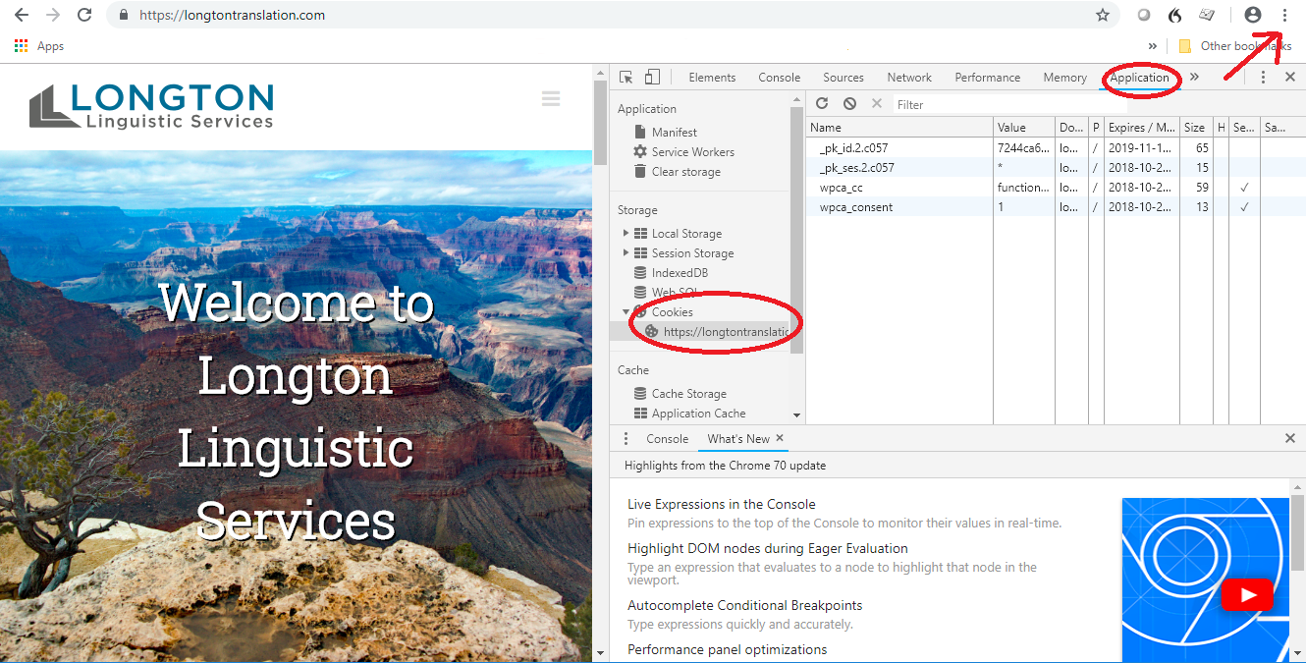
Step 1 – Let’s take a look at what we do (cont.) – Our website
Does your website collect personal data?
Contact form – copies on your hosting environment?
Cookies?
Expiration time?
Name?
Functional/Analytics
cookie?
IP addresses in
Analytics tool?

Slide 15
Session Outline
GDPR Scope, Principles and Obligations
Step 1: Let’s take a look at what we do
Step 2: Let’s get organized (register)
Step 3: Let’s prepare our tools to meet our obligations
Step 4: Let’s secure our data
Step 5: Let’s translate
Step 6: Let’s invoice our clients and pay our suppliers
Other Topics

Slide 16
Step 2 – Let’s list our files and organize our data - Create a register
1. Where is our data?
Local electronic storage (computer, local discs, USB device/key…)
Online storage
Website: Copies of email requests submitted though your website contact form
Cloud
Online backup systems
Email boxes
Cookies: IP addresses collected by your website
Paper documents (business cards anyone?)
2. Let’s delete/destroy all data we no longer need!
Mandatory retention period?
3. Create a register with the data you need to keep (GDPR, Art. 30)

Slide 17
Step 2 – Let’s list our files and organize our data - Create a register (cont.)
Template for Controllers (GDPR, art. 30):
Template for Processors:

Slide 18
Session Outline
GDPR Scope, Principles and Obligations
Step 1: Let’s take a look at what we do
Step 2: Let’s get organized (register)
Step 3: Let’s prepare our tools to meet our obligations
Step 4: Let’s secure our data
Step 5: Let’s translate
Step 6: Let’s invoice our clients and pay our suppliers
Other Topics

Slide 19
Step 3 – Your tools Your website - your “master tool” for GDPR compliance
A privacy policy
Your contact form
A cookie policy
A cookie banner
Your internal documents for GDPR compliance
Data processing agreements (SaaS, email providers, hosting company, other linguists…)

Slide 20
Step 3 – Your tools Your website - your “master tool” for GDPR compliance (cont.)
A privacy policy and a cookie policy available on your website:
How to go about it?
Cookie Policy: EU templates available
Privacy Policy: unfortunately, there is no official template available.
Talk to your local attorney! If outside the EU, ideally an attorney who works in partnership with an EU attorney of your targeted country.

Slide 21
Step 3 – Your tools Your website - your “master tool” for GDPR compliance (Cont.)
Privacy Policy = your most important document to meet your transparency requirement!!!
Transparency requirement: SAY WHAT YOU DO
Use clear language (no legalese)
Content: GDPR, Art. 13 or Transparency Guidelines, Annex
Only include your activities as a controller
If processing changes, update the Privacy Policy + notify users

Slide 22
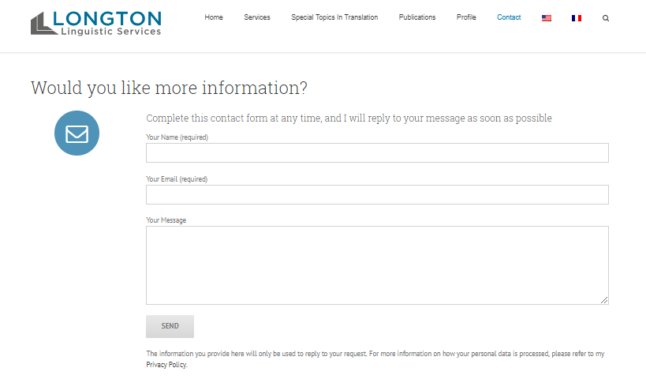
Step 3 – Your tools Your website - your “master tool” for GDPR compliance (Cont.)
Your contact form
TRANSPARENCY REQUIREMENT:
Purpose of processing?
Link to Privacy Policy

Slide 23
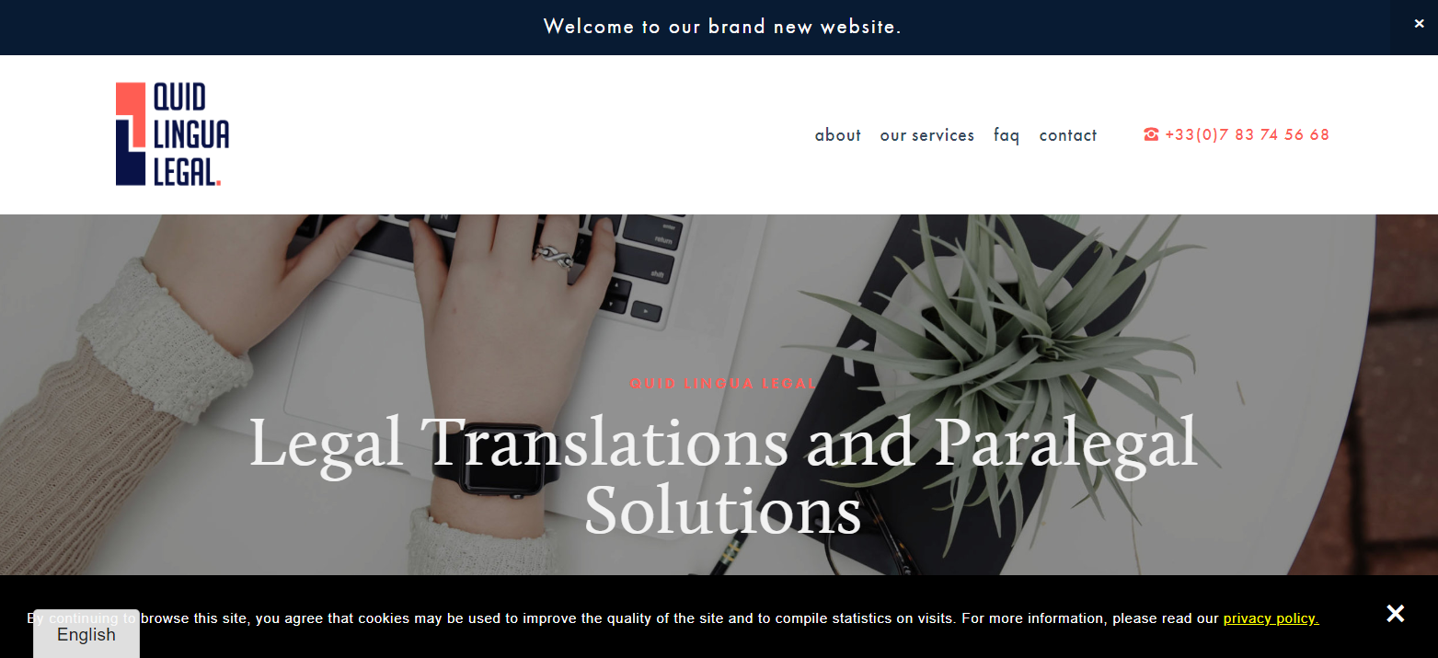
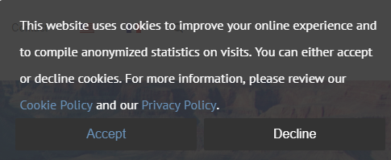
Step 3 – Your tools Your website – your “master tool” for GDPR compliance (cont.)
A cookie-banner referencing your privacy policy:

Slide 24
Step 3 – Your tools Your website – your “master tool” for GDPR compliance (cont.)
Different cookies, different purposes and objectives:
Functional Cookies
Analytics/performance cookies
Where the « OK » button of your cookie banner comes in: under current EU cookie law, you must have your website user’s consent
Otherwise, your site should not run analytics and performance cookies
In any event, your analytics tool should not display complete IP addresses (anonymized addresses only at most)!!!
Notes:
CNIL anonymizes more than Google Analytics and WordPress IP address anonymization functions
Google Analytics alternative solution for the French market: Matomo (formerly Piwik)

Slide 25
Step 3 – Your tools Your mailing marketing tool - how to inform clients and potential clients
Legal basis = prior consent
Legitimate interest – Be careful!!!
Clear and easy way to unsubscribe
Email marketing tools now offer GDPR options, but watch out!
Ex: Squarespace new marketing campaigns
MailChimp GDPR option

Slide 26
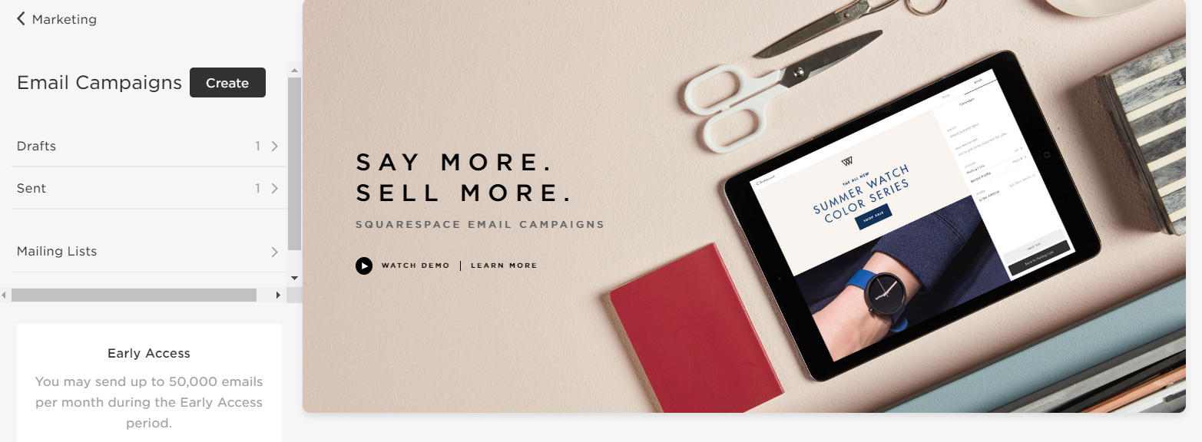
Step 3 – Your tools Your mailing marketing tool - how to inform clients and potential clients (cont.)
Examples: Email marketing campaigns with Squarespace and Mailchimp

Slide 27
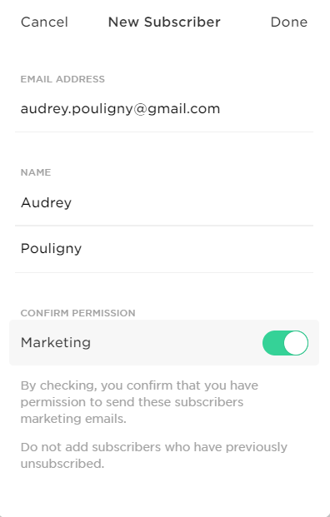
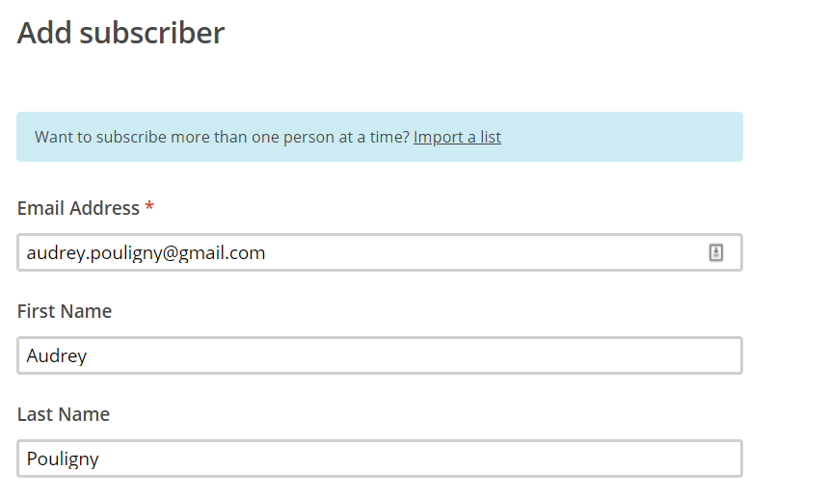
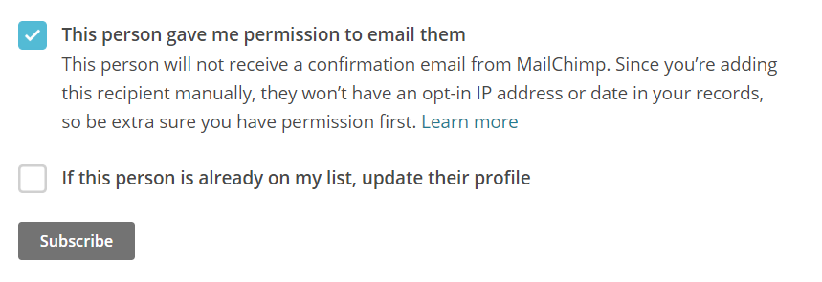
Step 3 – Your tools Your mailing marketing tool - how to inform clients and potential clients (cont.)
Example: Email marketing campaign/creating mailing lists

Slide 28
Step 3 – Your tools Your mailing marketing tool - how to inform clients and potential clients (cont.)
Scenario #1: You send an email to your regular/active clients
You should inform your clients about why they receive the message, inform them of the option to unsubscribe at any time, and provide a link to your privacy policy.
Example (_____ with hyperlinks to corresponding page):
"You are receiving this e-mail because we have had the opportunity to correspond in the context of translation projects. You can unsubscribe from our communications at any time by clicking on the link below: click here.
For more information, you can consult our privacy policy »

Slide 29
Step 3 – Your tools Your mailing marketing tool - how to inform clients and potential clients (cont.)
Scenario #2: You send an email to prospective clients
You can send emails to prospective clients if they have expressed a specific need for translation services and if you make a commercial offer.
Example (_____ with hyperlinks to corresponding page):
" You are receiving this e-mail because your firm has posted an announcement on _____ (website name or magazine column name) expressing a need for translation services. You can unsubscribe from our communications at any time by clicking on the link below: click here.
For more information, you can consult our privacy policy »

Slide 30
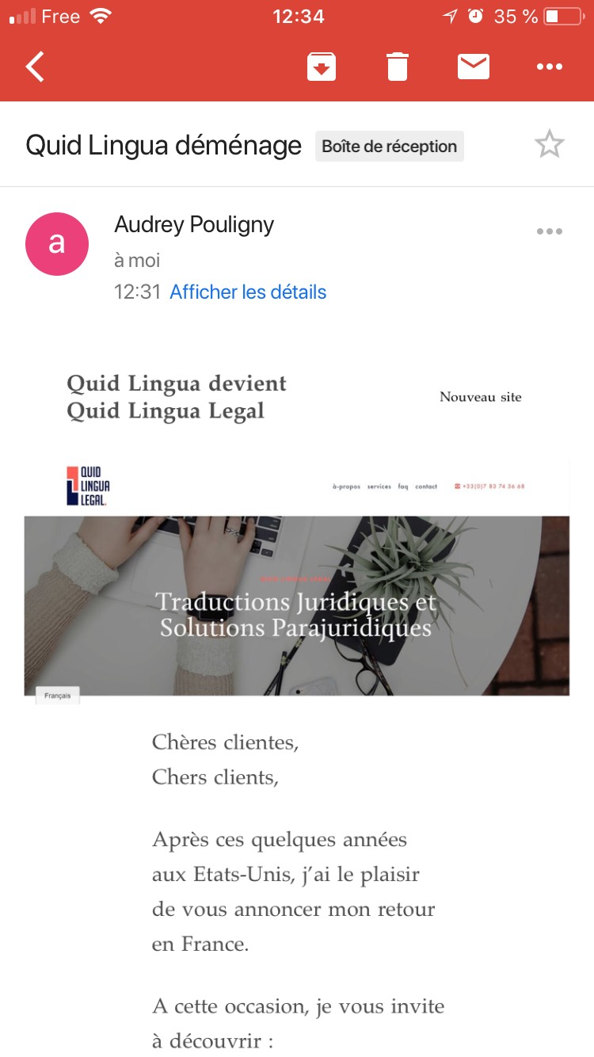
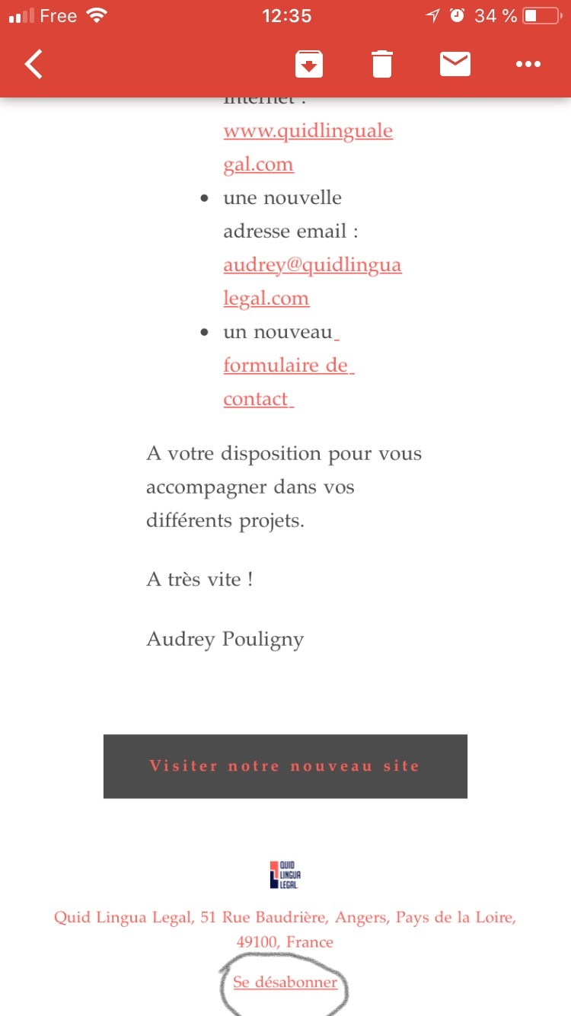
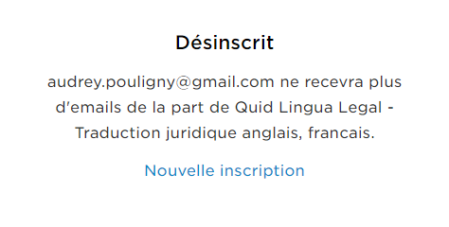
Step 3 – Your tools Your mailing marketing tool - how to inform clients and potential clients (cont.)
Example: Email marketing campaign/quick and easy way to unsubscribe!

Slide 31
Session Outline
GDPR Scope, Principles and Obligations
Step 1: Let’s take a look at what we do
Step 2: Let’s get organized (register)
Step 3: Let’s prepare our tools to meet our obligations
Step 4: Let’s secure our data
Step 5: Let’s translate
Step 6: Let’s invoice our clients and pay our suppliers
Other Topics

Slide 32
Step 4 – Let’s secure our data
GDPR requirements:
Process personal data in a manner that ensures appropriate security of the personal data (GDPR, Art. 5)
Data Protection by design and by default (GDPR, Art. 25)
How to do it?
Define a Security Framework (GDPR, Art. 32.1.d)
Follow (your) national/international standards (ISO IEC 27001:13)

Slide 33
Step 4 – Let’s secure our data (cont.)
Short Term Plan (as soon as you leave this room/the conference): stick to the golden rules:
Never ever click a hyperlink or open an attached file you do not trust within an email
Make sure all your devices are protected against unauthorized access (phone, laptop, desktop, modem…)
Use strong passwords
Encrypt any sensitive or personal data… anything that is important to you!
Don’t keep your passwords on your device (check www.lastpass.com)
Set your devices to apply security patches automatically
Use an antivirus software at all times on all devices
Only keep the data you absolutely need on your working computer
Never ever ever… send sensitive information over email, text message or any unsecure platform (check https://signal.org/)
Don’t use the WiFi in public places
Back up your data:
Cloud (check www.carbonite.com)
Local: use at least two separate devices
Keep up with the security news

Slide 34
Step 4 – Let’s secure our data (cont.)
LONG TERM PLAN: set up your Cybersecurity Plan
Nr. | Step | Description
Step 1 | IDENTIFY | Identify your organization's members as well as the hardware, the software and the data that need protection
Step 2 | PROTECT | List every means you have to protect all items identified in step 1
Step 3 | DETECT | Be able to recognize if something is going wrong
Step 4 | RESPOND | Create an incident response plan and know who to call for help
Step 5 | RECOVER | Be able to get your business back to normal after a breach or other incident

Slide 35
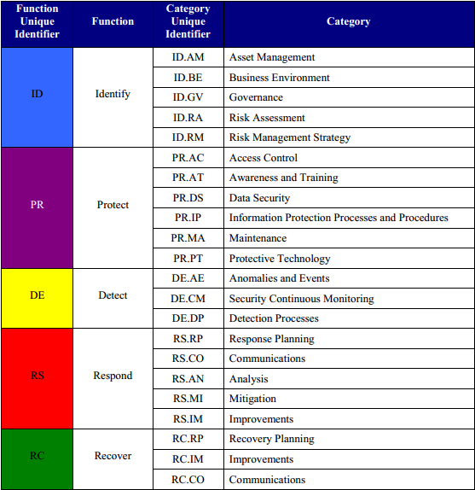
Step 4 – Let’s secure our data (cont.)
Complete the NIST framework spreadsheet first (see toolbox at end of presentation)

Slide 36
Step 4 – Let’s secure our data (cont.)
NIST framework – Step 2 – Secure your data at rest
If you don’t have an antivirus software, find one that fits your needs:
https://www.pcmag.com/article2/0,2817,2372364,00.asp
Tools to protect your files in your system
7-zip
VeraCrypt
Methods to protect personal data:
Anonymization (e.g. IP addresses)
Pseudonymization

Slide 37
Step 4 – Let’s secure our data (cont.)
NIST framework – Step 2 – Secure your data in transit
French Data Protection Authority’s recommendation:
7-zip (use the AES-256 encryption method) Free easy-to-use software!
And send encryption key/password through separate means (e.g. text message)
An exchange platform using a secure protocol like an https:// server (maybe some of your clients require you to use one)
Anonymize or pseudonymize your personal data
Other solutions:
Office 365 (at least E3 product with Azure protection layer)
WeTransfer (company headquarters in Amsterdam, free version till 2 GB/file sent)
Compare prices, offers… and talk to your client !!

Slide 38
Step 4 – Let’s secure our data (cont.)
Draft your Security Policy
Based on your NIST framework spreadsheet
Use plain, clear language, no legalese
Structure of your Security Policy (see template links at the end of the presentation)
Introduction
Security Identification Policy
Security Protection Policy
Security Detection Policy
Security Response Policy
Security Recovery Policy

Slide 39
Session Outline
GDPR Scope, Principles and Obligations
Step 1: Let’s take a look at what we do
Step 2: Let’s get organized (register)
Step 3: Let’s prepare our tools to meet our obligations
Step 4: Let’s secure our data
Step 5: Let’s translate
Step 6: Let’s invoice our clients and pay our suppliers
Other Topics

Slide 40
Step 5 – Let’s translate
Does the file you need to translate contain EU data subjects’ personal data?
Secure all files, during transfer and storage (encryption/anonymization/pseudonymization methods)
Update your GDPR register
Make sure your legal documentation is in place, i.e. data processing agreement. If you work with partners/are based outside the EEA, you will need to make sure you have appropriate safeguards in place (GDPR, Art. 46)
Keep your files only for the required time
When you are acting as a data processor, strictly follow the data controller’s instructions (GDPR, Art. 28)
Notes:
Data Processing Agreements: check regularly if template available on your relevant Data Protection Authority’s website

Slide 41
Step 5 – Let’s translate (cont.) – transferring data out of the EU
When personal data is transferred out of the EU, certain requirements must be met (GDPR, Art. 44 to 50):
Did the European Commission decide the third country ensures an adequate level of protection:
Check: https://ec.europa.eu/info/law/law-topic/data-protection/data-transfers-outside-eu/adequacy-protection-personal-data-non-eu-countries_en#dataprotectionincountriesoutsidetheeu
United States: Privacy Shield??
Auto certification mechanism
In practice, cost may be high for freelance translator (could be $1,000/year)
Standard Contractual Clauses (but may not be used for sub-processors)
May have to obtain clear mandate from EEA-based controller to EEA-based processors to use standard contractual clauses
Other solution: EEA-based translator must anonymize/pseudonymize data BEFORE sending file to translate to their non-EU sub-processors
Notes:
Privacy shield = mechanism designed by the U.S. Department of Commerce and the European Commission to comply with data protection requirements
Strictly speaking, only applicable to data controllers, but many cases where big companies use it as data processor (+ data processing agreements)
July 2018 – News:
Personal data protection provided by EU-US deal is inadequate – Facebook-Cambridge Analytica data breach revealed lack of protection
MEPs say deal must be suspended if US fails to comply in full by 1 September 2018
MEPs call on the EU Commission to suspend the EU-US Privacy Shield as it fails to provide enough data protection for EU citizens. To be followed… + new trend in US privacy law

Slide 42
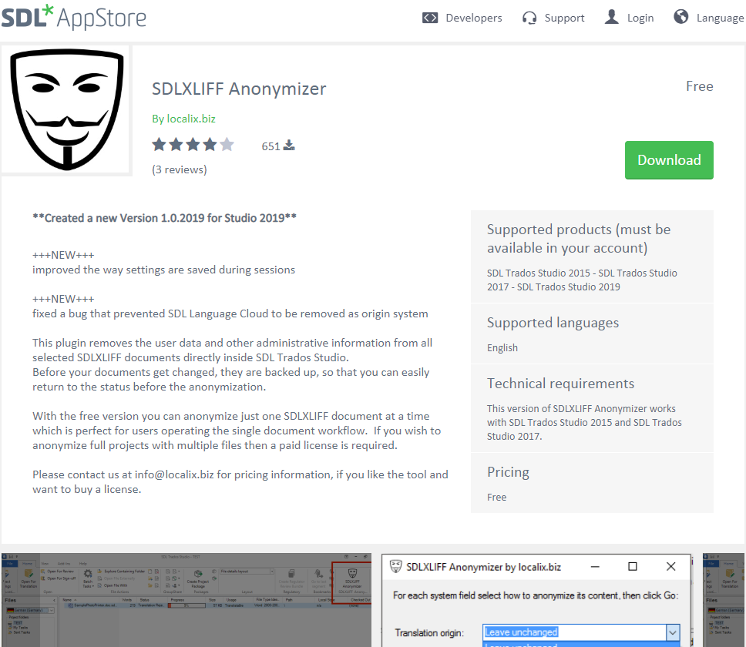
Step 5 – Let’s translate (cont.)
Some CAT tool companies have developed some anonymization/GDPR tools.

Slide 43
Step 6 – Let’s invoice our clients/pay our suppliers
Again… secure your clients and suppliers’ financial information
Don’t store credit card information
Observe your data retention period

Slide 44
Other Topics – Making sure EU data subjects can exercise their rights
1. State all rights the data subject can exercise in your Privacy Policy
2. Your Privacy Policy must indicate how to contact you
3. Subject Access Requests (SAR): timeline = one month (GDPR, Art. 12.3, 12.4)
4. Give reasons if you don’t intend to comply with the request (GDPR, Art. 12.4)
5. Free of charge (unless repetitive/unfounded/excessive requests) (GDPR, Art. 12.5)

Slide 45
Other Topics – Protection authorities and ISO standards
No existing ISO standard can be used as a GDPR certificate.
As of today, GDPR certifications are not delivered by protection authorities.
May exist in the future, however costs may be too high for freelance translators.
Consulting an attorney for GDPR compliance (ideally an EU lawyer or a US lawyer in partnership with an EU Lawyer) can serve as a “certificate” evidencing the measures put in place and efforts made toward GDPR compliance.
Remember: as of today, being 100% compliant is not possible!!!

Slide 46
Other Topics – Data violation: what to do?
Data controllers must report a personal data breach to their supervisory authority within 72 hours, and in some cases to the concerned data subjects.
The steps to follow will differ depending on the type of breach and the competent Data Protection Authority.
Example on the ICO’s website:
https://ico.org.uk/for-organisations/report-a-breach/
Data processors must report the data breach to the data controller (see your data processing agreements) (in general less than 72 hours…)
GDPR, Art. 33 and 34

Slide 47
List of general resources
General Information
Official regulation | https://eur-lex.europa.eu/legal-content/EN/TXT/PDF/?uri=CELEX:32016R0679&from=FR
Structured overview of the regulation | https://cnpd.public.lu/en/legislation/droit-europ/union-europeenne/rgpd.html
ITI Brochure | http://www.atanet.org/resources/ITI_Guide_to_GDPR.pdf
WP29 Guidelines | http://ec.europa.eu/newsroom/article29/news.cfm?item_type=1360
Data Subjects’ Rights | GDPR, chapter III (= articles 12 to 23)

Slide 48
List of general resources (cont.)
Data Registers
Write your records of processing activities | Template for data controllers: https://ico.org.uk/media/for-organisations/documents/2172937/gdpr-documentation-controller-template.xlsx Template for data processors: https://ico.org.uk/media/for-organisations/documents/2172936/gdpr-documentation-processor-template.xlsx

Slide 49
List of general resources (cont.)
Prepare your Website
Privacy Policy | Guidelines on Transparency under Regulation 2016/679 (wp260rev.01) (http://ec.europa.eu/newsroom/article29/item-detail.cfm?item_id=622227)
Cookie Banner/Tag Manager | WeePie Coookie Allow Plugin (WordPress platform): https://www.weepie-plugins.com/cookie-allow/ Tarteaucitron: https://opt-out.ferank.eu/en/ Tip: check what your/the EU Data Protection Authority/ies recommend(s)/use(s)
Cookie Policy Template | http://ec.europa.eu/ipg/basics/legal/cookies/index_en.htm
Your legal information on your contact form | Guidelines on Transparency under Regulation 2016/679 (wp260rev.01) (http://ec.europa.eu/newsroom/article29/item-detail.cfm?item_id=622227)

Slide 50
List of general resources (cont.)
Protect your Personal data
SBDC Small Business Cybersecurity Workbook | http://wsbdc.org/wp-content/uploads/2017/03/Sm-Bus-Cybersecurity-Workbook-opt.pdf
NIST Security spreadsheet | https://www.nist.gov/document-3764
Antivirus software reviews | https://www.pcmag.com/article2/0,2817,2372364,00.asp
Encryption software | Examples of tools to exchange files in a secure way: 7-Zip (https://www.7-zip.org/download.html) WeTransfer (https://wetransfer.com/plus?trk=Splashpage_v40_yellow) Office 365 (Enterprise E3 or E5) (https://products.office.com/en/business/compare-more-office-365-for-business-plans)
 | Disk encryption Windows 10 (BitLocker) (https://support.microsoft.com/en-us/help/4028713/windows-10-turn-on-device-encryption) Encrypt each file separately: Office 365 (Enterprise E3 or E5) 7-Zip (https://www.7-zip.org/download.html)
Write your NIST plan | Templates for the NIST Security Policy: please send email to monique@longtontranslation.com

Slide 51
List of general resources (cont.)
Translate
Data processing agreements | Check regularly for any available template on your competent Data Protection Authority’s website: to see if any template (https://edpb.europa.eu/about-edpb/board/members_en) CNIL (French DPA) (in English) (p. https://www.cnil.fr/sites/default/files/atoms/files/rgpd-guide_sous-traitant-cnil_en.pdf) DLA Piper’s example: https://www.dlapiper.com/~/media/files/insights/publications/2017/08/example_data_protection_addendum.doc

Slide 52
List of general resources (cont.)
Translate
SDL Studio | https://www.regular-expressions.info/ https://multifarious.filkin.com/tag/regex-tutorial/ https://multifarious.filkin.com/2018/05/27/data-protection/

Slide 53
List of general resources (cont.)
Working with partners outside the EEA
European Commission’s Adequacy decisions | https://ec.europa.eu/info/law/law-topic/data-protection/data-transfers-outside-eu/adequacy-protection-personal-data-non-eu-countries_en
EU-US Privacy Shield | https://www.privacyshield.gov/welcome
Standard Contractual clauses | https://ec.europa.eu/info/law/law-topic/data-protection/data-transfers-outside-eu/model-contracts-transfer-personal-data-third-countries_en FAQ concerning standard contractual clauses (covers cases for transfers from an EEA processor to a non-EEA sub-processor) https://www.cnil.fr/sites/default/files/typo/document/FAQ_Clauses_de_responsable_a_sous-traitant_EN.pdf
TM Management | Examples SDL Studio: https://appstore.sdl.com/language/app/sdlxliff-anonymizer/580/

Slide 54
List of general resources (cont.)
Violation notifications
List of EU Data Protection Authorities | https://edpb.europa.eu/about-edpb/board/members_en

Slide 55
Questions?

