Slide 1
ATA Conference – November 2015
Brazilian Tax Law: Understanding and Translating This Alphabet Soup

Slide 2

WHO AM I?
English and Portuguese translator and interpreter.
Law degree and diploma in corporate law, worked for major Brazilian companies as a corporate lawyer until 2007.
ATA member and representative of Associação Brasileira de Tradutores e Intérpretes (ABRATES) in Belo Horizonte, Brazil.

Slide 3
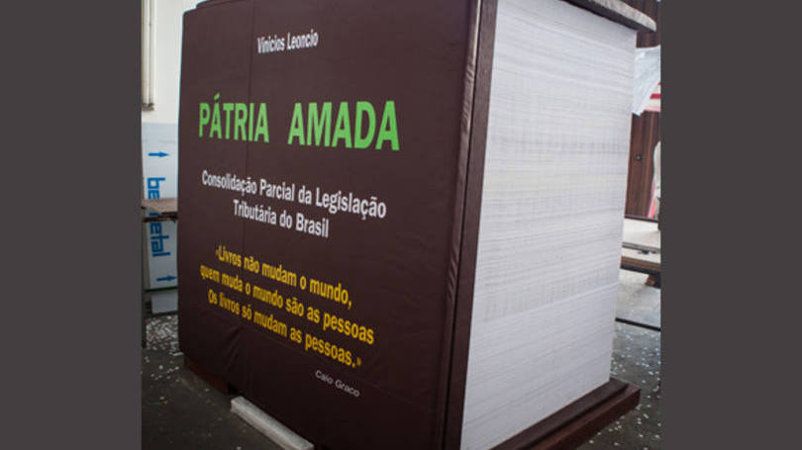
Notes:
Forbes has ranked Brazil as the most time consuming tax regime in the world
Brazilian companies spend over 2600 hours per year just to fufill their tax obligations.
Since 1988, over 320,000 tax laws and regulations have been enacted in Brazil – that’s abount 46 new laws passed each business day.
So any foreign company doing business in Brazil is bound to run into tax issues – and their headquarters abroad want to understand what goes on. The tax system is so complex that SAP and other software companies spend a lot of time and money customizing their tax management software. Plenty of opportunities for translators

Slide 4
KEY CONCEPTS
Tributos: taxes in general, which can be:
  Impostos: Tax per se - charged according to taxable event but their revenues are not tied to specific purpose
  Taxas: Fees paid for licenses, permits, and other public services
  Contribuições sociais ou de melhorias: levied as taxes, but their revenues are tied to a specific purpose.
Fato Gerador: Taxable Event / Triggering Event
Contribuinte: Taxpayer
Alíquota: Tax Rate
Base de Cálculo: Calculation Basis / Taxable Basis
Certidão Negativa de Débito: tax clearance certificate
Notes:
TAXES ARE NOT TAXAS, ALTHOUGH TAXAS ARE A FORM OF TAXES

Slide 5
CSLL
COFINS
ICMS
IRPJ
INSS
FGTS
IPTU
IPI
PIS
ISS

Slide 6
MUNICIPAL TAXES
IPTU – IMPOSTO PREDIAL E TERRITORIAL URBANO:
PROPERTY TAX ON REAL ESTATE LOCATED IN URBAN AREAS
Triggering event: Property ownership
Taxable basis (Fato Gerador): Value of the property, as appraised by the city
ISSQN – IMPOSTO SOBRE SERVIÇOS DE QUALQUER NATUREZA
SERVICE TAXS
Triggering event: Services listed by the federal government in Complementary Law 116/2003.
Taxable basis: the price of the service rendered.
Notes:
ITR for Rural Properties
ISS is generally levied by the municipality in which the company that provides the service is established, although in exceptional cases, ISS may be levied by the municipality where the services are performed. ISS rates vary between 2% and 5%, depending on the municipality and the type of service. The importation of services is also subject to ISS, whilst exportations may be exempt if the result of the supply is exclusively verified abroad

Slide 7
STATE TAX
ICMS – IMPOSTO SOBRE CIRCULAÇÃO DE MERCADORIAS E PRESTAÇÃO DE SERVIÇOS:
VALUE ADDED SALES AND SERVICES TAX
Triggering event: circulation of merchandise/ rendering of interstate and intercity transportation services and communication services
Taxable basis (Fato Gerador): Value of goods or services
Calculation process: Noncumulative tax - Debits and Credits are listed and checked every payment period to see if there is tax to be paid.
“CRÉDITOS TRIBUTÁRIOS” – Taxpayer’s Tax Credits
Specific regulations for each state.
Notes:
It is not a cumulative tax, that is, such tax is only assessed on the increase in the price of the product in each part of the circulation process. The calculation process involves a system that, in each payment period, the taxpayer must check the amount of ICMS debits (generated on the circulation of merchandise/ rendering of services) and ICMS credits (generated on the acquisition of goods) and if the taxpayer has more debits than credits, it will have to pay the tax on the difference.
Since the collection of this tax is under state responsibility, each of the Brazilian states has specific regulations concerning ICMS calculation, rates, payments and accessory obligations. Therefore, companies that operate in different states are subject to several different compliance requirements.

Slide 8
FEDERAL TAXES
Social Contributions on Gross Revenues (Receita Bruta):
PIS- Contribuição para Programa de Integração Social - Social Integration Program Contribution
COFINS - Contribuição para Financiamento da Seguridade Social– Social Security Contribution
Income Taxes
IRPJ - Imposto de Renda Pessoa Jurídica: Corporate Income Tax
CSLL - Contribuição Social sobre Lucro Líquido: Social Contribution on Profits
Notes:
- PIS/COFINS: The calculation method is generally non-cumulative, under which PIS and COFINS are levied on gross revenue at 1.65% and 7.6%, respectively, with deductions of input tax credits for expenses strictly connected to the company's business and prescribed by the regulating laws
- IRPJ / CSLL Taxpayers may choose one of the three taxation methods provided by the tax legislation for purposes of calculating IRPJ and CSLL. These methods are: Taxable Income (Lucro Real), Estimated Profit (Lucro Presumido) and Arbitrated Profit (Lucro Arbitrado);
Taxpayers that choose the Taxable Income method are eligible to calculate IRPJ on an annual (Lucro Real Anual) or quarterly basis (Lucro Real Trimestral). In case of adoption of the annual calculation period, tax anticipations must be calculated and collected (if applicable) on a monthly basis, based on monthly revenues (Receita Bruta e Acréscimos) or year-to-date accounted for net income (Balancete de Suspensão e Redução);

Slide 9
FEDERAL TAXES
IPI: Imposto Sobre Produtos Industrializados - Federal Tax on Industrialized Goods or Federal Excise Tax
Value added tax levied on nearly all sales (gross revenue) and transfers of products manufactured in or imported into Brazil.
Tax rate varies according to the degree of necessity.
II - Imposto de Importação – Import Duty
Variable by product (HTS code)
Custom value of the imported good (CIF value)
IOF: Imposto sobre Operações Financeiras - Tax on Financial Transactions
Payroll Taxes:
INSS - Employee Social Security
FGTS - Fundo de Garantia por Tempo de Serviço - Severance Indemnity Fund

Slide 10
TAX PLANNING
ELISÃO FISCAL: TAX AVOIDANCE
Although still technically legal, the government is increasing regulations that make it harder.
EVASÃO FISCAL: TAX EVASION
Illegal and leads to criminal charges (representação penal)

Slide 11
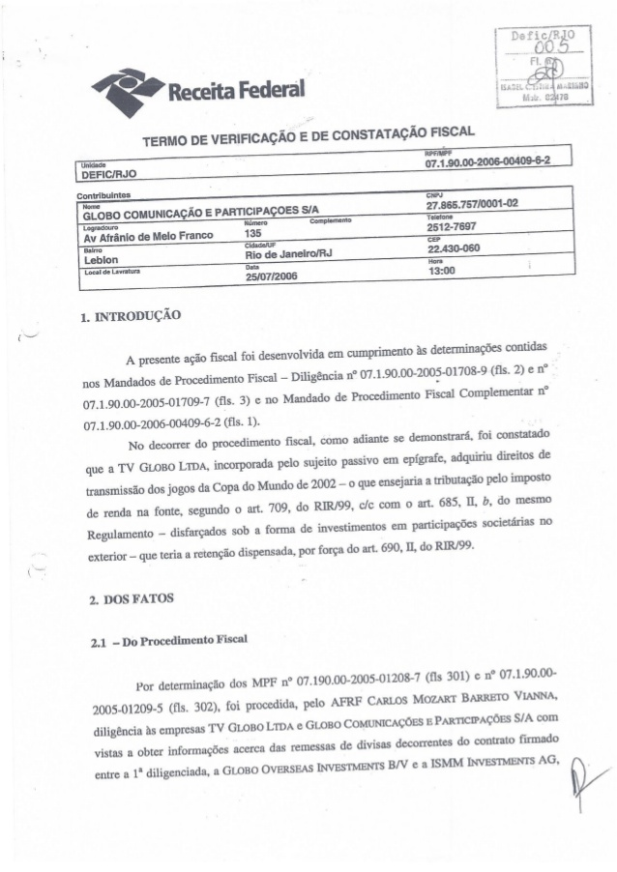
TAX DELINQUENCY

Slide 12
TAX DELINQUENCY
Fiscalização: Tax Audit
Auto de Infração: Tax Delinquency Notice / Notice of Tax Assessment
Lançamento tributário: Tax Assessment
Sujeito passivo/Contribuinte: Taxpayer
Sujeito ativo: Tax Authority that files the tax assessment
Impugnação: Challenge - file an administrative defense (no collateral required)
Delegacia Regional da Receita Federal: Regional Office of the Brazilian Revenue Service
Dívida ativa: Delinquent Account / Tax Debt Warrant
Notes:
So, with all those taxes and the filing obligations that come along with them, taxpayers are bound to run into trouble.
Often this happens through a Tax Audit – once a problem is discovered – whether underpayment of taxes or failure to comply with a regulation or filing obligations,
The tax auditors issue a Tax Delinquency Notice – Auto de Infração
If there is tax to be collected, then this is a Tax Assessment – Lançamento Tributário
Tax Assessment NOT Tax Levy = The legal seizure of property to satisfy a debt. NOT Tax Lien levy differs from a lien because a levy takes the property to satisfy the tax debt, whereas a lien is a claim used as security for the tax debt
All the allegations and documents to sustain the position of the taxpayer must be presented together with the initial defense. However, different from the procedure at the Judiciary branch, the procedural rules in the administrative court tend to be much more informal and flexible. Thus, in practice the presentation additional documents, specially technical experts reports, its not uncommon after the filing of the defense. In order to avoid any opposition to the presentation of new documents, the defense shall include a special request for such action and provide the due necessary clarifications for the reasons the evidences were not exhibited since the beginning of the dispute.
Once the defense is filed the case is remitted for review by a panel formed by three judges, formed exclusively by members of the RFB. This panel is a body of the RFB and is called "Delegacia Regional de Julgamento – DRJ" and serves as a Federal Lower Administrative Tax Court.After the receipt of the defense, the panel can request additional clarifications from the tax auditor responsible for the draft of the tax assessment. In this case, after given clarifications, the taxpayer is notified to present additional defense regarding the issues added or clarified by the tax auditor.

Slide 13
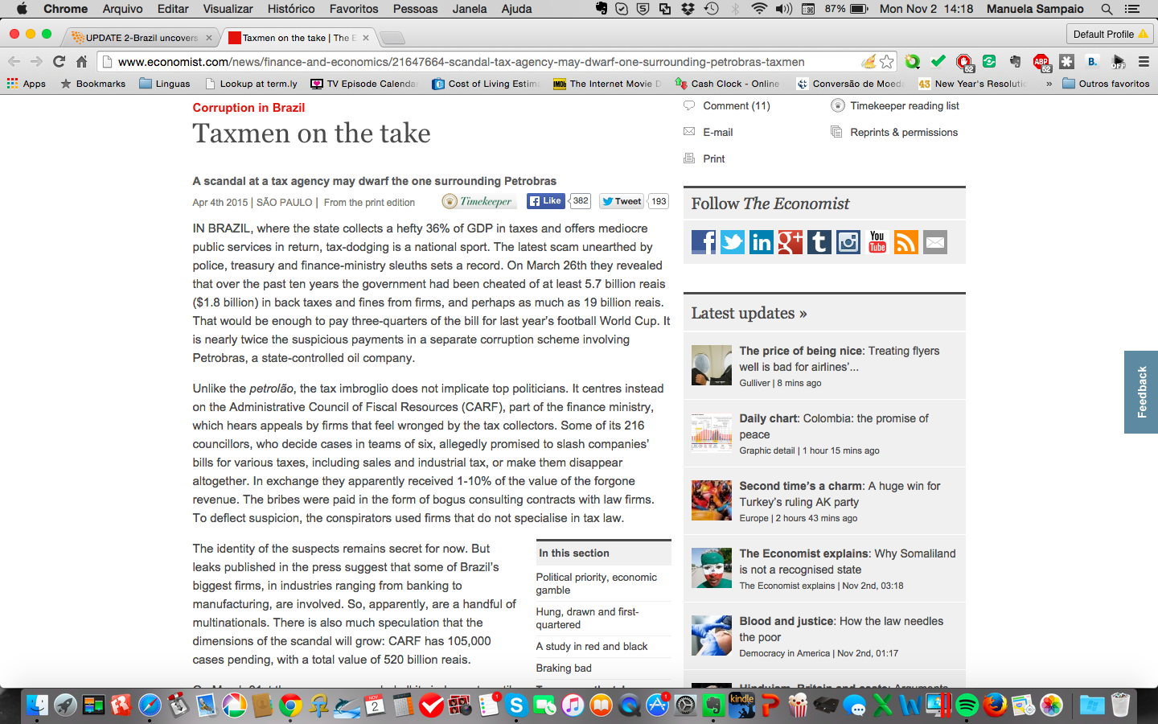
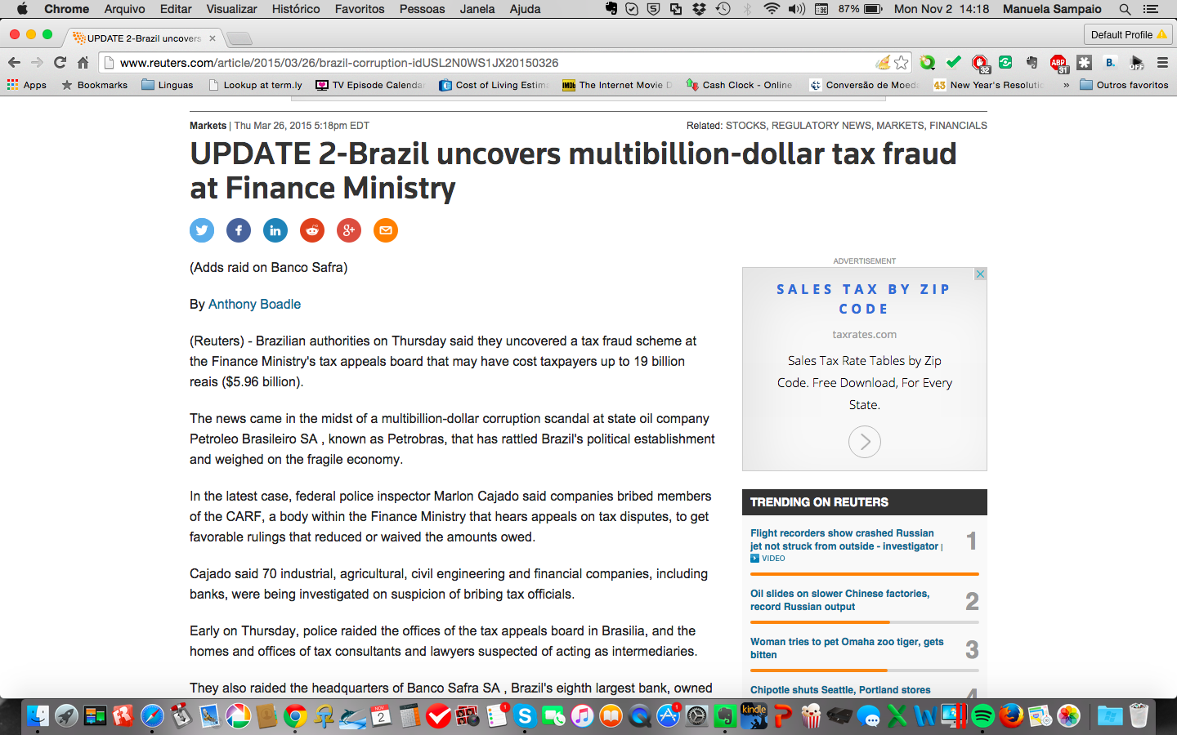
TAX DELINQUENCY
CARF: Conselho Administrativo de Recursos Fiscais
Federal Tax Appeals Council
Execução Fiscal: Tax Collection Claim in Cour
Notes:
Once notification about the decision is formalized, the taxpayer has 30 days to file a voluntary appeal to be reviewed by the Taxpayers Council ("CARF") or to pay the debt with 30% over the penalty maintained by the DRJ's decision. There is no need to post any collateral to file an appeal to the CARF or to pay any court fees.
Six counselors form each panel, three appointed by the RFB and three appointed by the taxpayers.
Once the taxpayer is notified about the a final decision from the CARF, the taxpayer has 30-days to proceed with the payment of the debt charged or take a judicial measure in anticipation to the filing of a tax collection claim (execução fiscal) by the tax authority.
Vara da Fazenda: Tax Court

Slide 14
TRANSFER PRICING
Brazilian Methods | OCDE Methods
Parameter Prices for Import Activities
PIC: Preços Independentes Comparados | CUP: Comparable Uncontrolled Price
PRL (Revenda): Preço de Revenda Menos Lucro | RPM: Resale Price Method
PRL (Produção): Preço de Revenda Menos Lucro | RPM: Resale Price Method
CPL: Custo de Produção Mais Lucro | CPM: Cost Plus Method
Parameter Prices for Export Activities
E: Preço de Venda nas Exportações | CUP: Comparable Uncontrolled Price
PVA: Preço de Venda Por Atacado no País de Destino Diminuído do Lucro | RPM: Resale Price Method
PVV: Preço de Venda a Varejo no País de Destino Diminuído do Lucro | RPM: Resale Price Method
CAP: Custo de Aquisição ou de Produção Mais Tributos e Lucro | CPM: Cost Plus Method
Notes:
All private persons or legal entity residents or residents of Brazil that practice operations with private persons or legal entity residents or residents abroad, are subjected to the Brazilian legislation of transfer pricing control. Others that are also subjected to this regime are private persons or legal entity residents or residents of Brazil that practice operations with any private persons or legal entities, resident or residents of a country with low tax jurisdiction:
that does not tax income that has an income tax rate of less than 20%
Organisation for Economic Co-operation and Development (OECD), on February 12, 2013, issued its initial report regarding Base Erosion and Profit-Shifting (BEPS)
Os paraísos fiscais e o BEPS
O grande volume de recursos financeiros que as empresas enviam, por meio de brechas legais, a suas sedes localizadas em países onde os impostos sobre operações dessa origem são menores (paraísos fiscais) cria sérios problemas tributários nos países de origem dessas empresas. Com resultados financeiros menores a contabilizar no fisco, a base de cálculo dos impostos devidos diminui e, consequentemente, a sua arrecadação.
BEPS (sigla em inglês para Erosão da Base Tributária e Transferência de Lucros)”

Slide 15
REFERENCES
Instituto Brasileiro de Planejamento Tributário
Revista Exame
Código Tributário Nacional
PKF Worldwide Tax Guide 2013
Overview of the Brazilian taxation system - Deloitte Touche Tohmatsu Limited
Doing Business in Brazil - Deloitte Touche Tohmatsu Limited
Wikipedia
Reuters
The Economist
Overview on Federal Administrative Tax Disputes in Brazil - Thales Stucky

Slide 16
THANK YOU!
OBRIGADA!
manuela@luminatrad.com.br

