Slide 1
They Have No Idea: Part I
Translation Insiders and Outsiders
Carol Apollonio
ATA 64th Annual Conference
Miami, FLA, October 2023

Slide 2
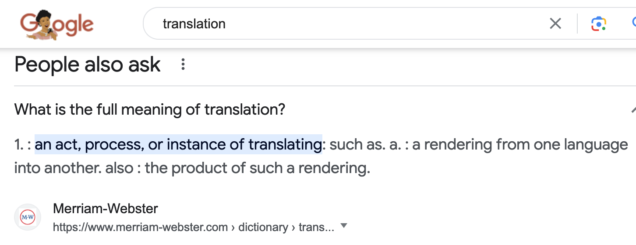
INTRODUCTION
A short lesson in Translation Theory

Slide 3
A short lesson in translation theory (2)
Translation activity is restrained by limited resources, which results in limited translatability, hence the need to enter into multiple spaces to canvas and enhance possibilities and experimentation by relating to the points of sense in the original and identifying the corresponding points in the target language. These points in both source and target texts are seen as reciprocal and interconnected in a dialogic relationship on which to build further upon the network of possibilities. It should be noted that translation can be imprisoned within a given space, and if this happens, it must move to another related space. The distancing effects of space for reflection and meaning making are exemplified in showing its usefulness only as an interpretive act but more importantly, as a translation act where it becomes possible to gain a different perspective on the nature of the challenge. Our perception of space(s) allows us to make better use of the referential power of language.
The operation of signifying substitution in translation is a complex issue. Deconstruction aims at showing how meaning is deferred. But translation entails the practice of rewriting. André Lefevere has reconceptualized translation as a practice of rewriting, necessitated by the consideration of the referential dimension, including its interpretation and reproduction. Yet significantly, translation is not all about interpretation or paraphrasing based on interpretation. Domesticating translation is typically marked by overt appropriation including alteration and adaptation. But this could lead to superficial over-determination to which translation is notoriously prone, and which is not the most effective way to tackle untranslatability.
….and so on, forever….

Slide 4


Slide 5

Metaphor #1
Translation is putting new clothes on old content

Slide 6

Douglas Robinson

Slide 7
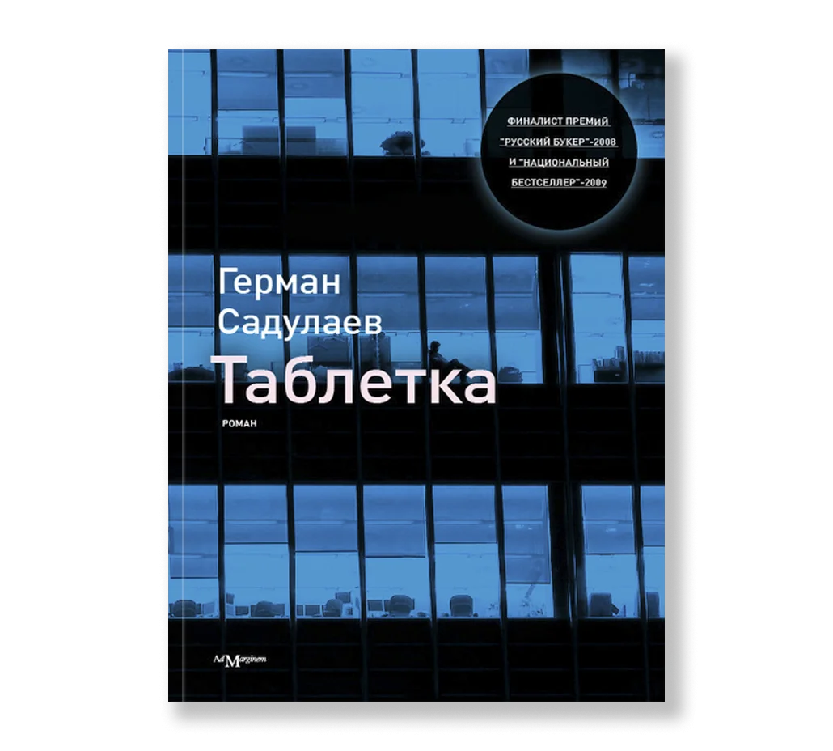
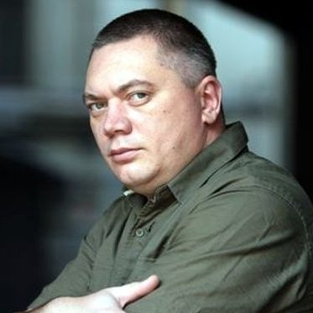
Герман Садулаев

Slide 8
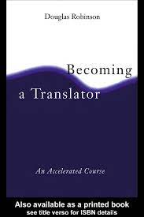
INSIDERS
INTERNAL (INSIDERS)
A translator thinks and talks about translation from inside the process, knowing how it’s done, possessing a real-world sense of the problems involved, some solutions to those problems, and the limitations on those solutions.
EXTERNAL (OUTSIDERS)
A non-translator thinks and talks about translation from outside the process not knowing how it’s done.
p. 6

Slide 9

END OF INTRODUCTION

Slide 10
INTERLUDE: What Insiders Know
(the human being in the middle)
A social event with students
2. Interpreting equipment
3. In the Japanese pharmacy

Slide 11
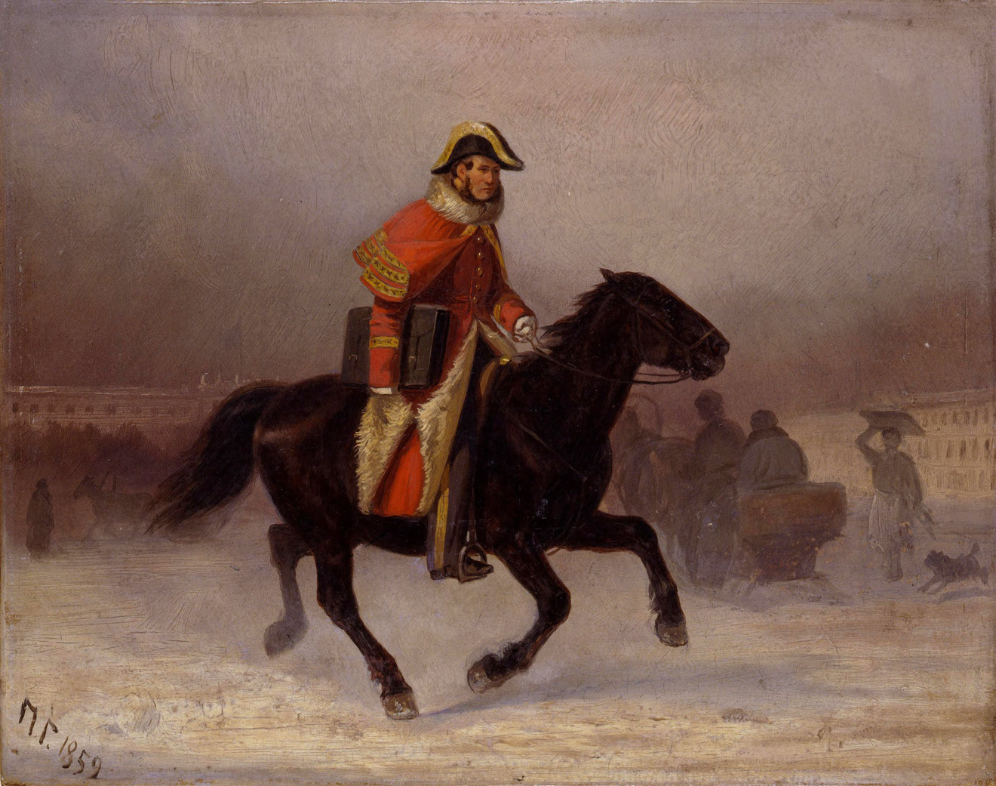
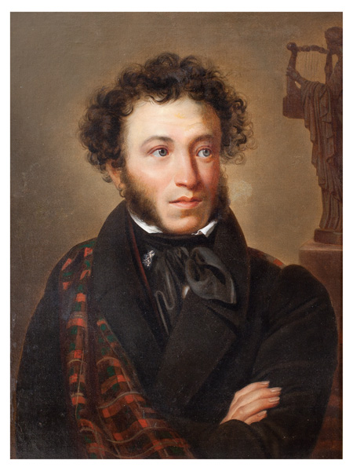
Metaphor #2:
Переводчики—«Почтовые лошади прогресса»
Александр Сергеевич
Пушкин

Slide 12
More stories
4. The banker at the banquet
5. A novice interpreter and two words:
“This is not a proposal, it’s just a suggestion.”

Slide 13
I. GENDER
Теперь, когда он рассказывал все это Наташе, он испытывал то редкое наслаждение, которое дают женщины, слушая мужчину, […] —то наслажденье, которое дают настоящие женщины, одаренные способностью выбирания и всасыванья в себя всего лучшего, что только есть в проявлениях мужчины. Наташа, сама не зная этого, была вся внимание: она не упускала ни слова, ни колебания голоса, ни взгляда, ни вздрагиванья мускула лица, ни жеста Пьера. Она на лету ловила еще не высказанное слово и прямо вносила в свое раскрытое сердце, угадывая тайный смысл всей душевной работы Пьера. (»Война и мир» IV, iv, 17)

Slide 14
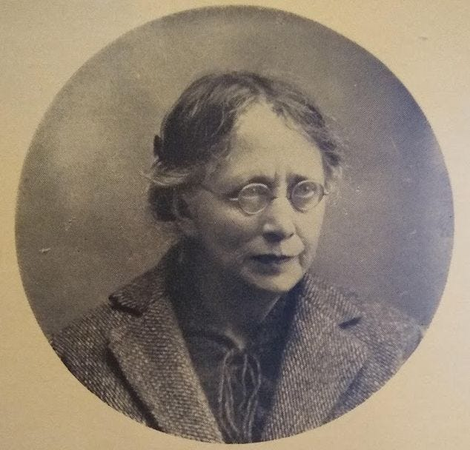
Metaphor #3
A translator is a woman.

Slide 15
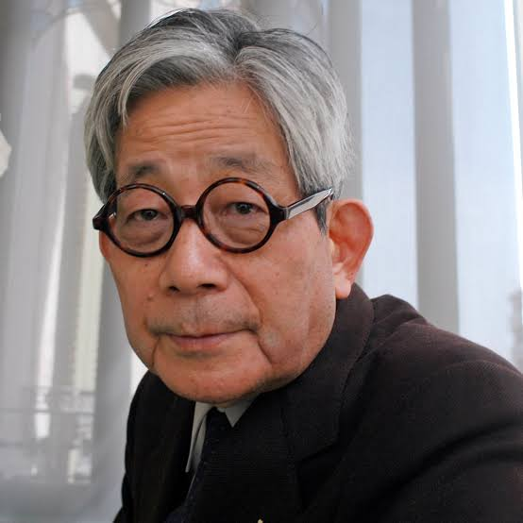
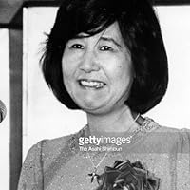
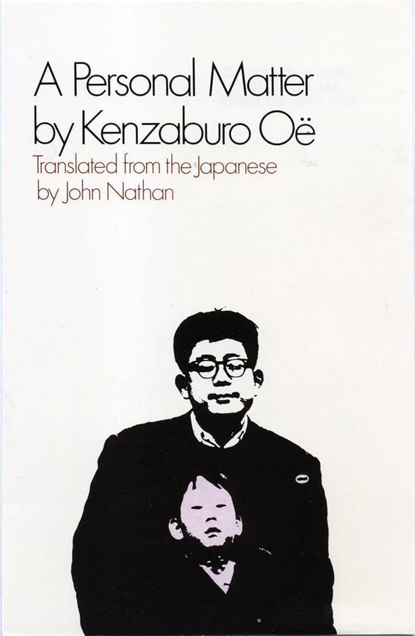

Being the author?
(story #6)

Slide 16
Герман Садулаев

Slide 17



Slide 18
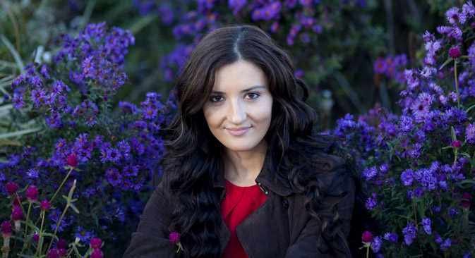
Alisa Ganieva

Slide 19



Alisa Ganieva’s books from Deep Vellum

Slide 20
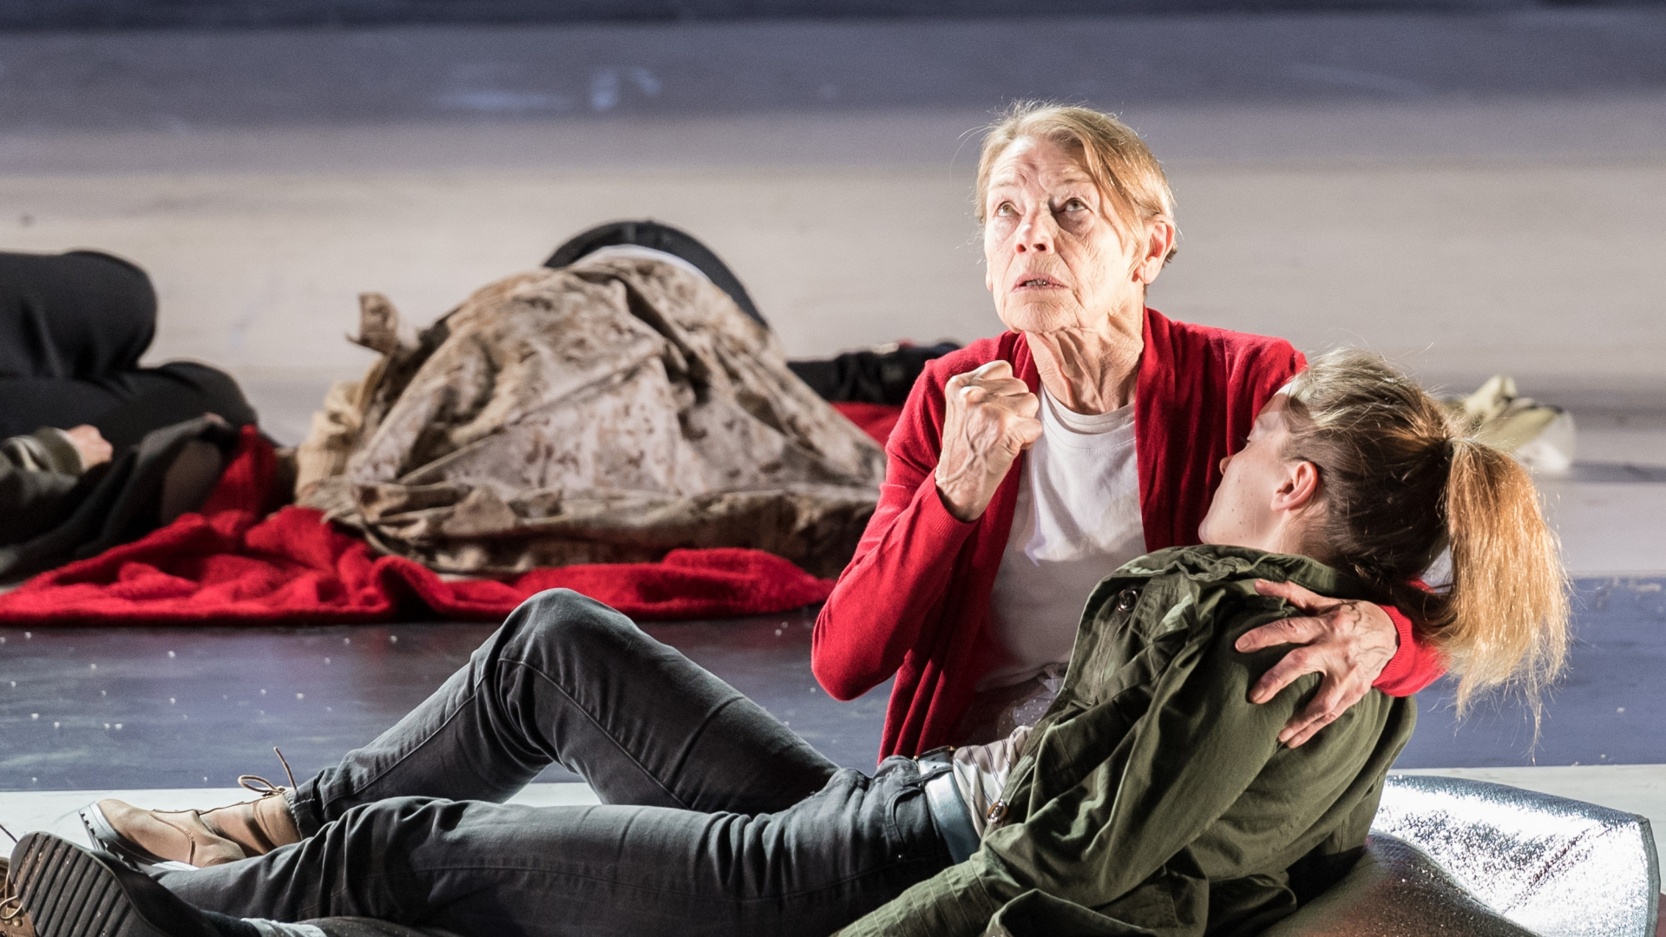
Glenda Jackson as Lear (2016)

Slide 21

Metaphor #4: Translation as a Performing Art

Slide 22

II. INTERPRETING

Slide 23
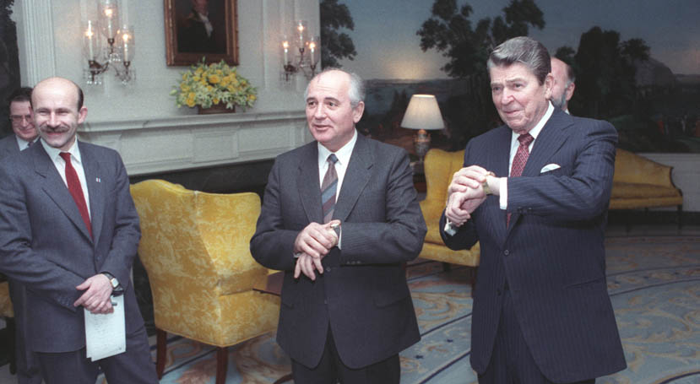
II. INTERPRETING
Spot the interpreters 1

Slide 24
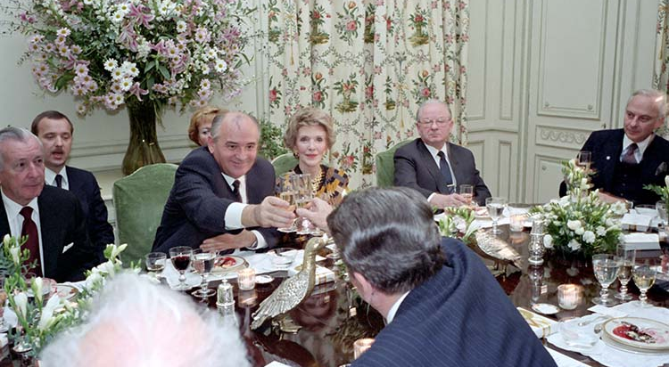
Spot the interpreters 2

Slide 25
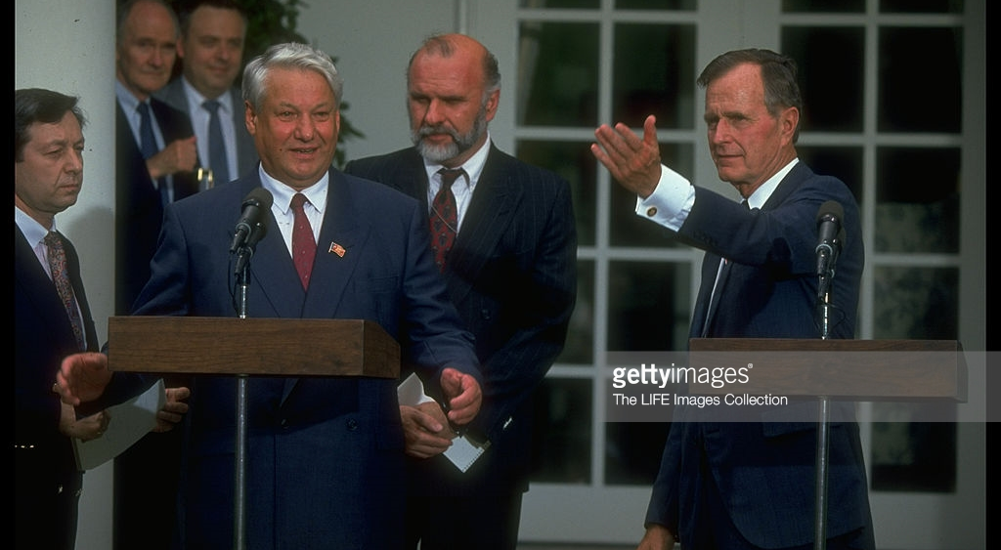
Spot the interpreters 3

Slide 26
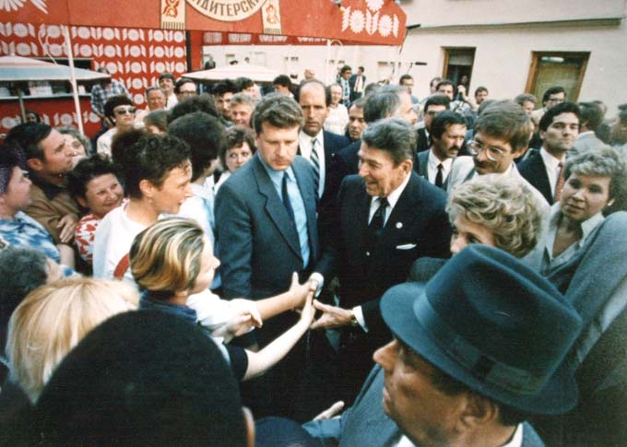
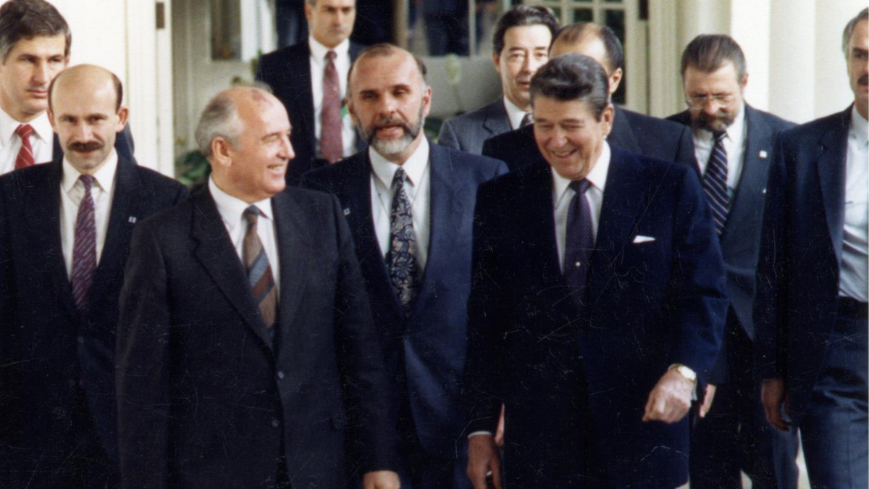
Spot the interpreters 4

Slide 27
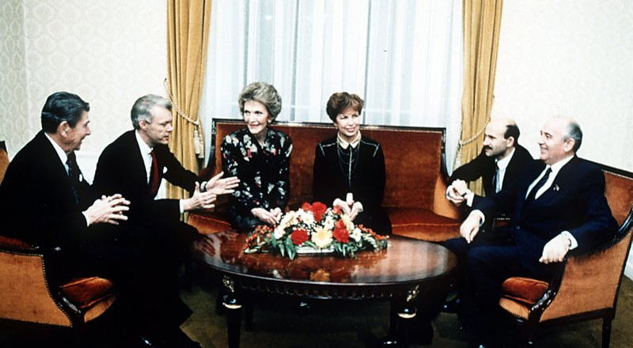
Spot the interpreters 5

Slide 28
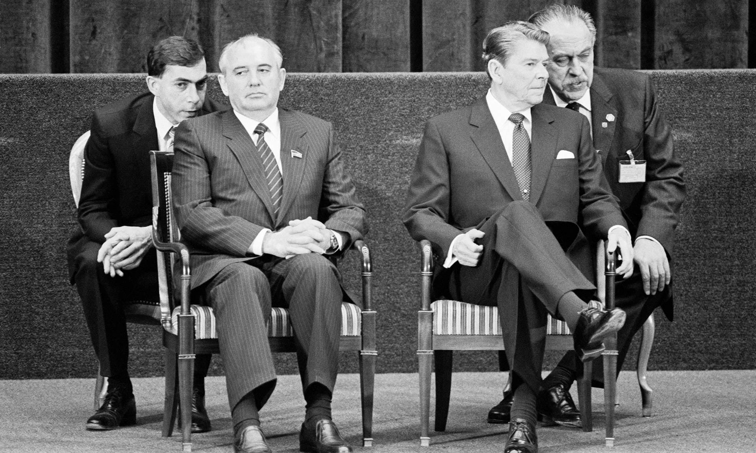
William Krimer interpreted for presidents from Nixon through Clinton.

Slide 29
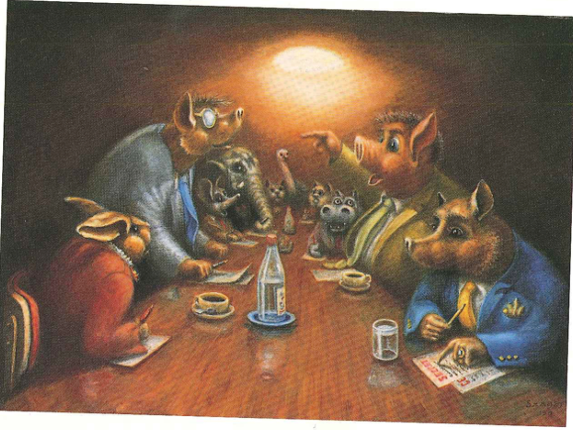
Spot the interpreters 7
(interpreter Sergei Shachowskoi is the artist)

Slide 30
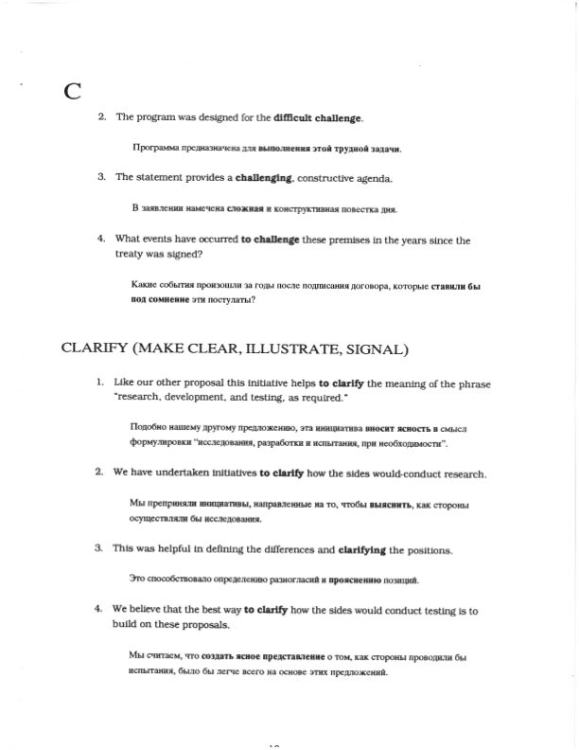
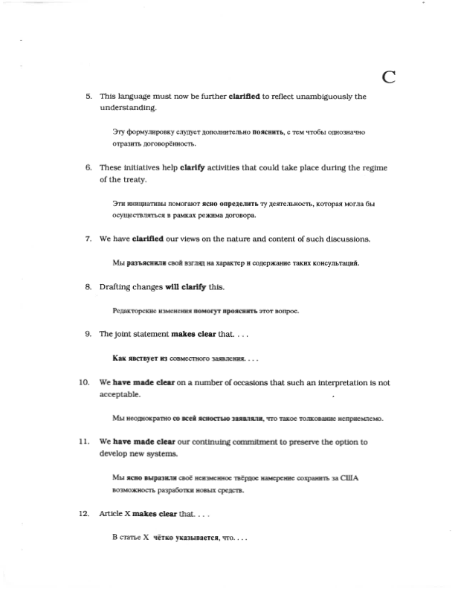
Vocabulary (Alan French’s Glossary)

Slide 31
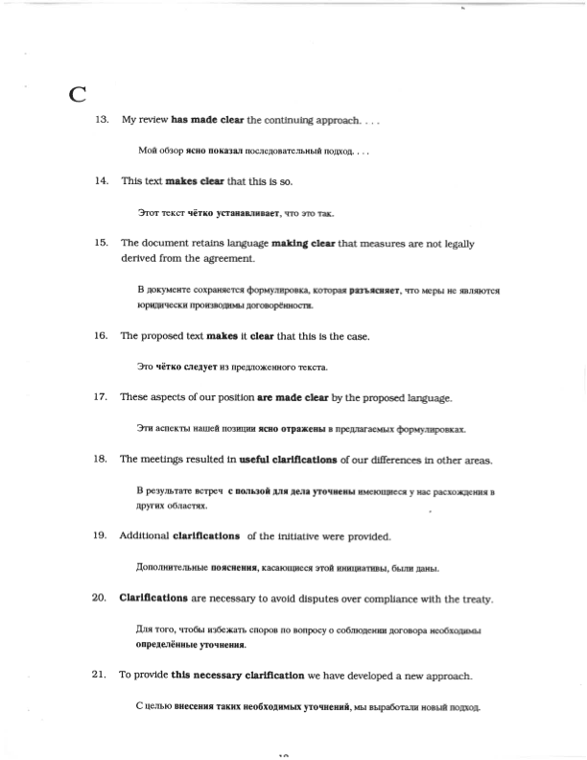

Slide 32
A task for you:
Please take notes;
You may start now.

Slide 33
You may now stop taking notes.
Please tell your neighbor what I just said, reading from your notes (you may translate into Russian or some other language if you’d like).
(2 minutes)

Slide 34

How did that feel?

Slide 35
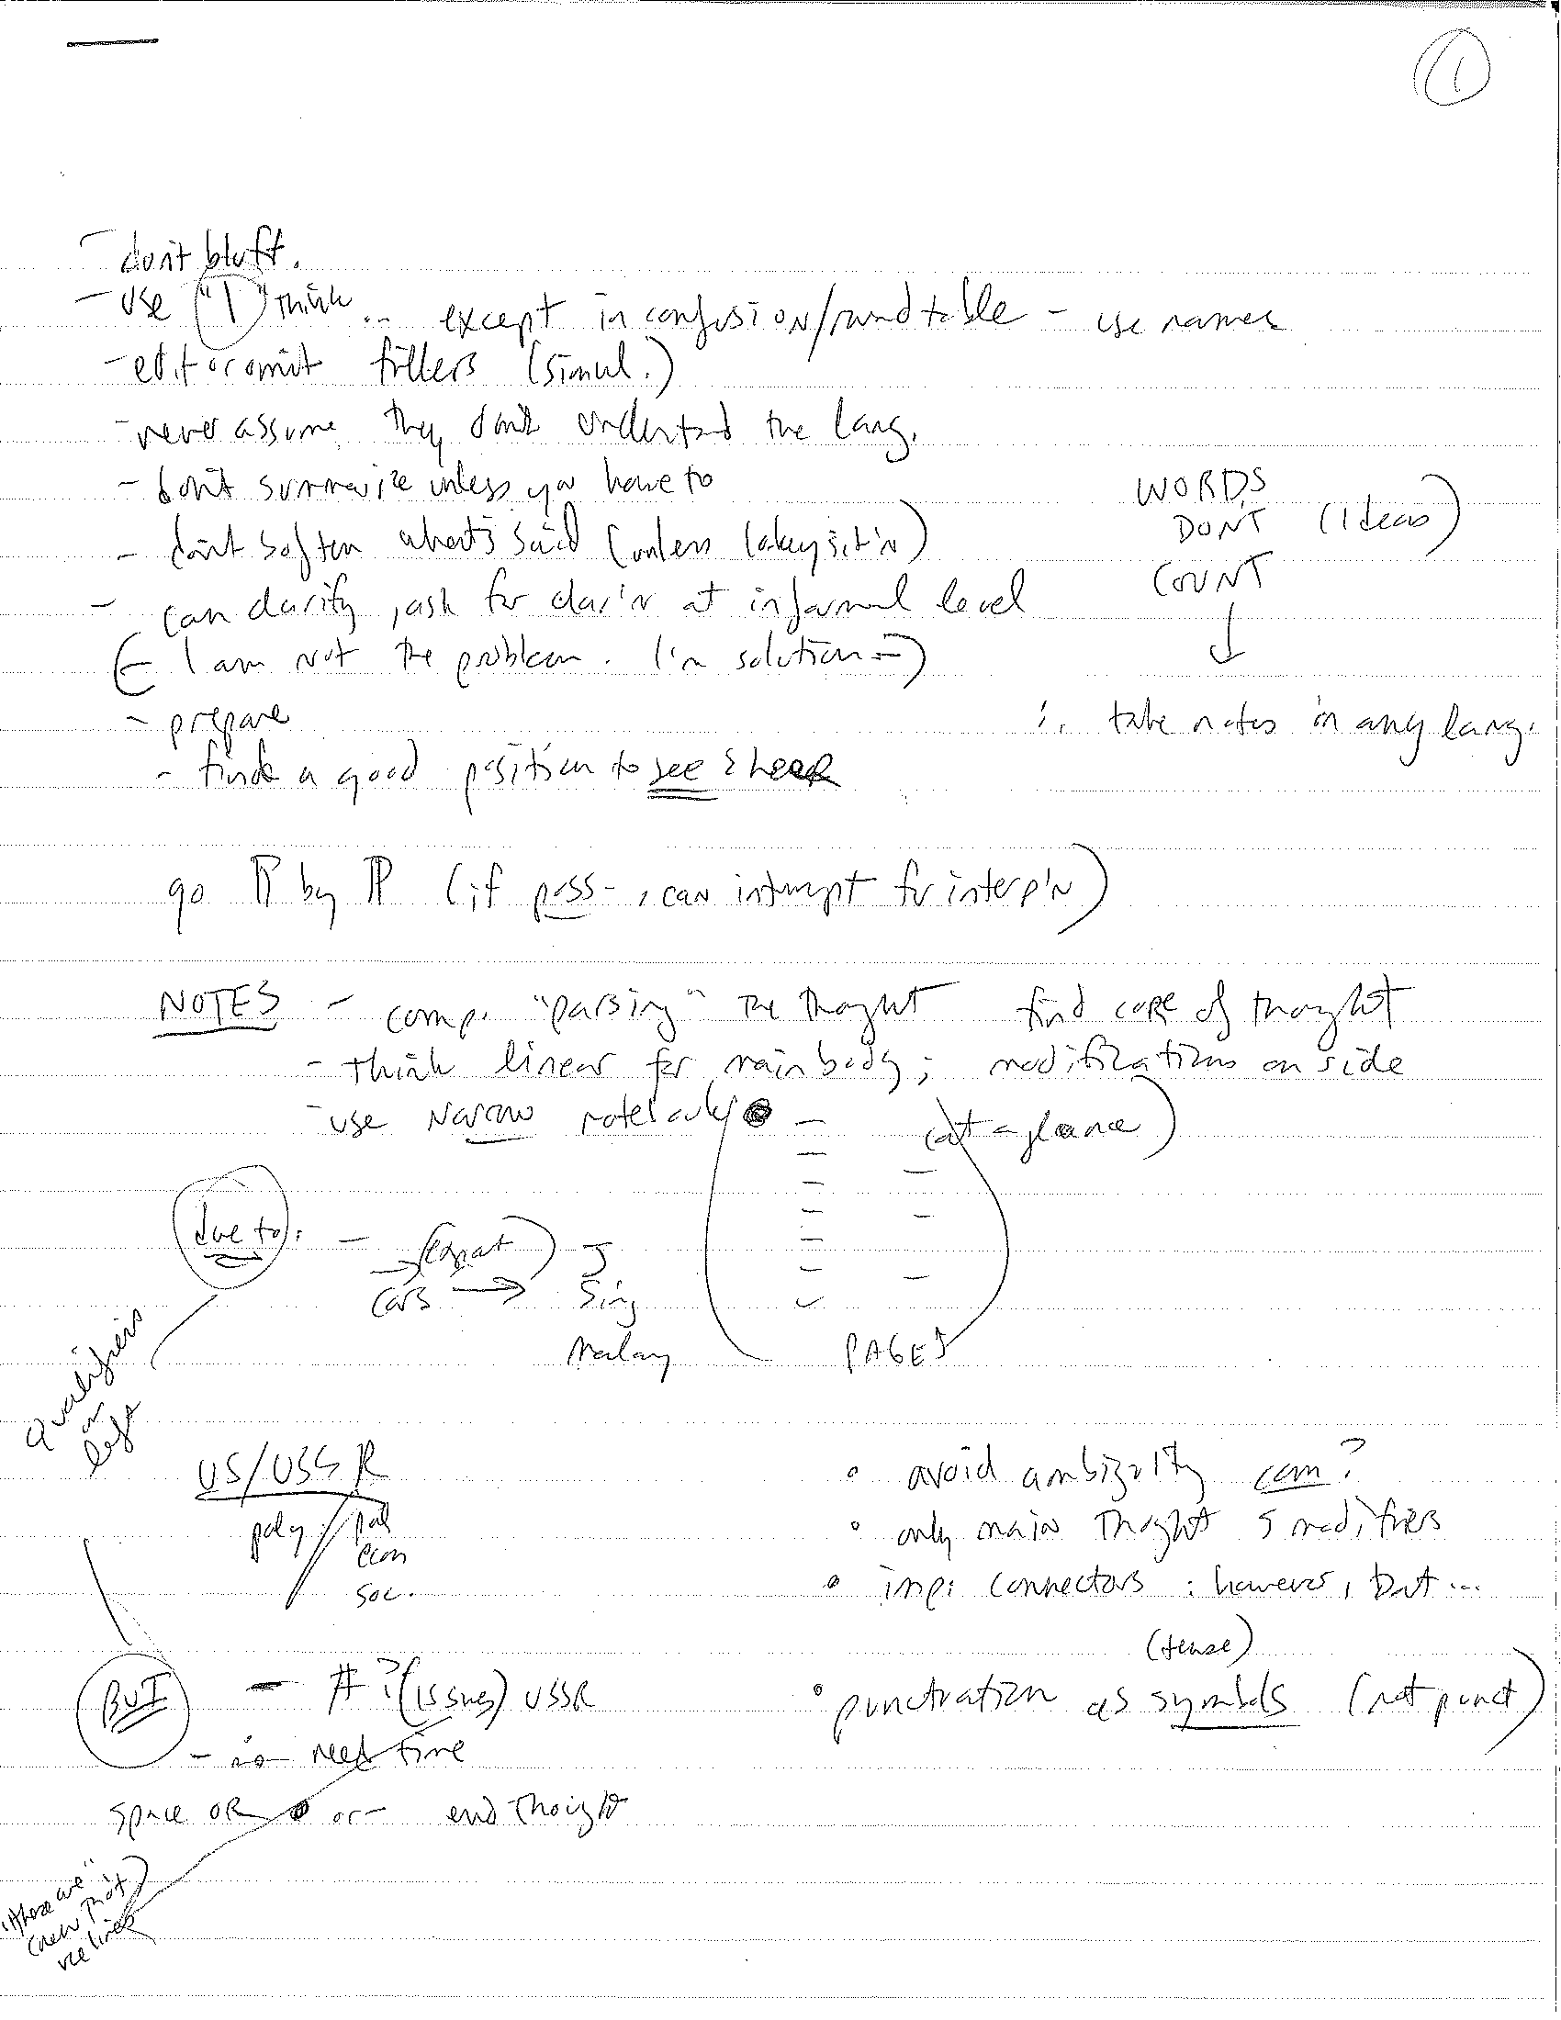
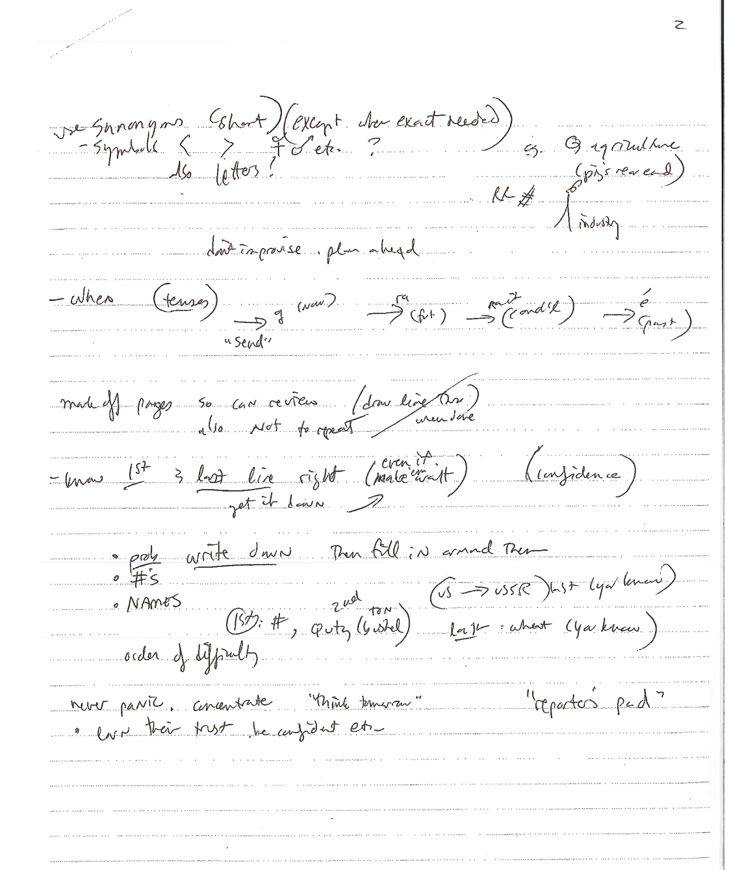
Notes from the State Department week-long interpreting course

Slide 36
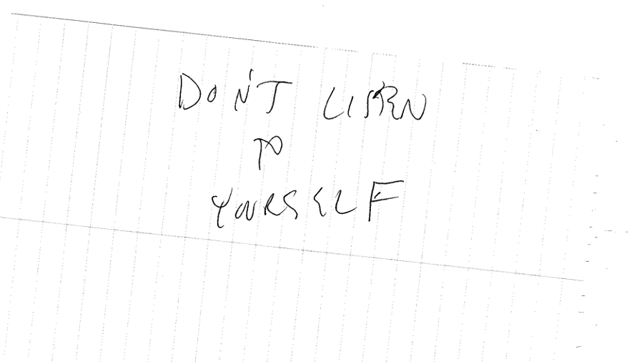
Extremely useful advice (for simultaneous interpreting)

Slide 37
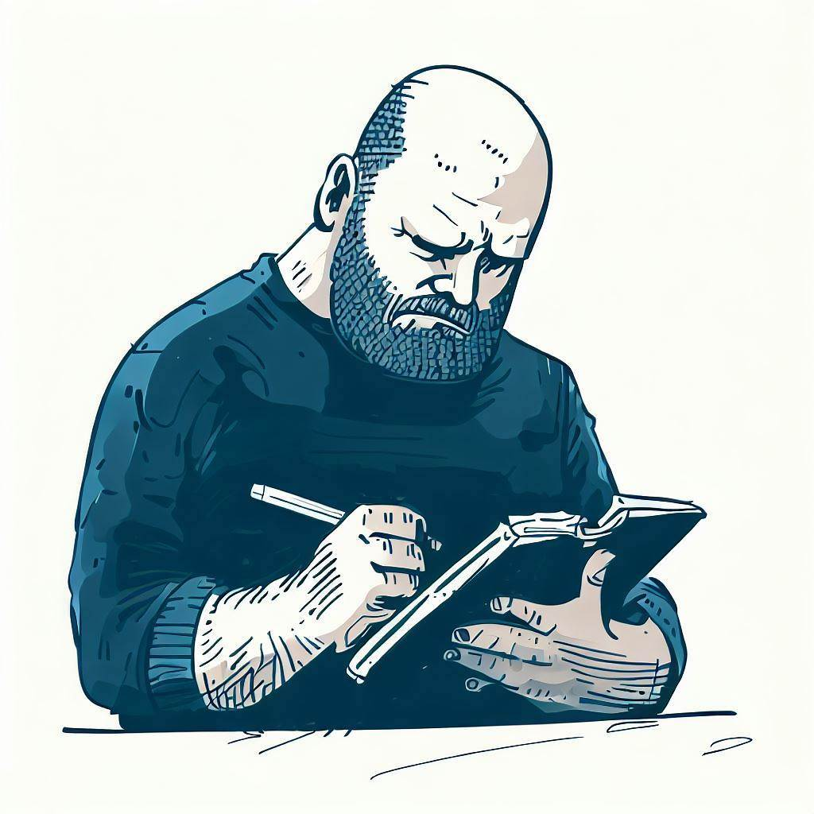
CONSECUTIVE INTERPRETING
NOTE TAKING

Slide 38
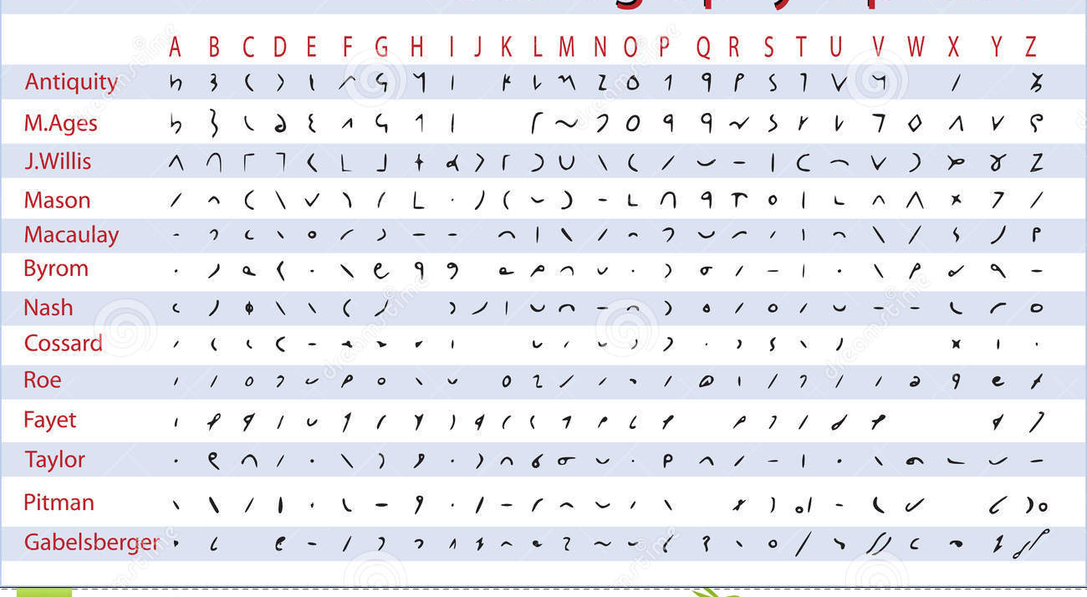
Shorthand methods

Slide 39
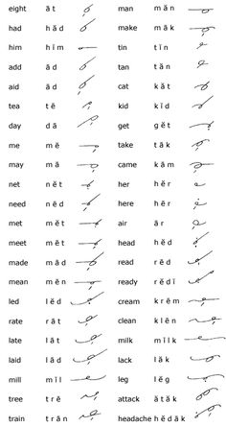
More shorthand

Slide 40
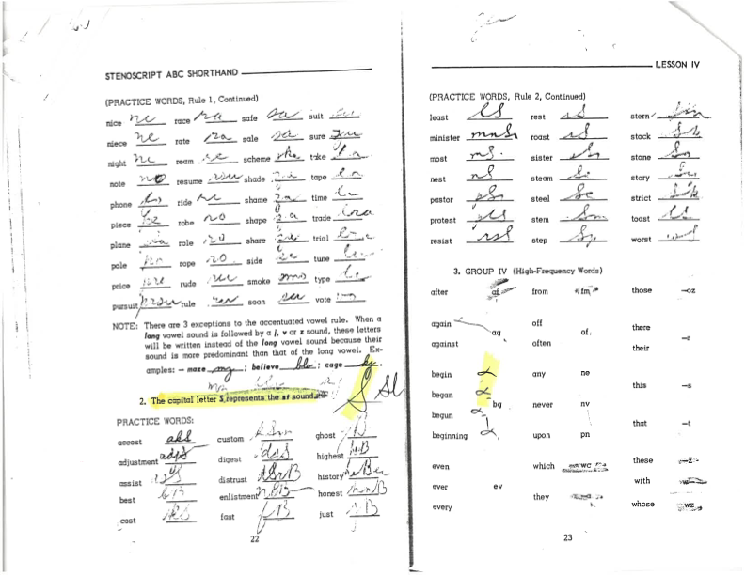

Slide 41
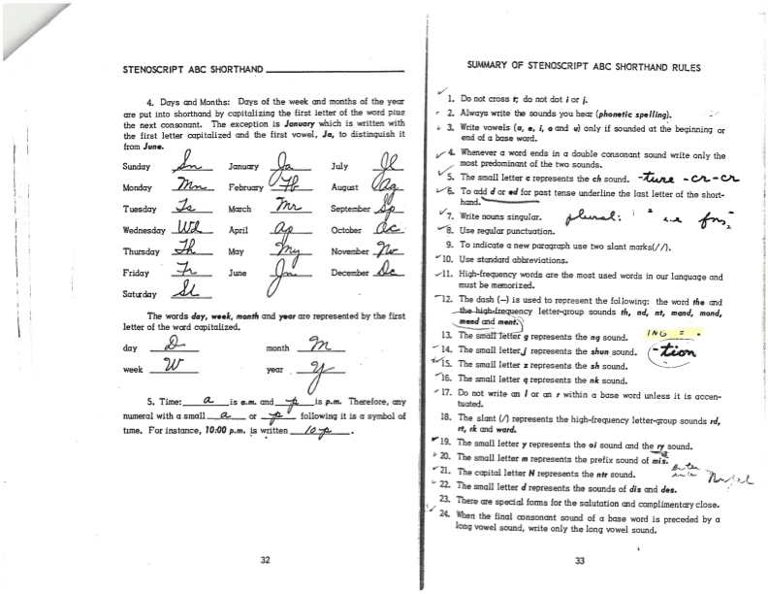

Slide 42
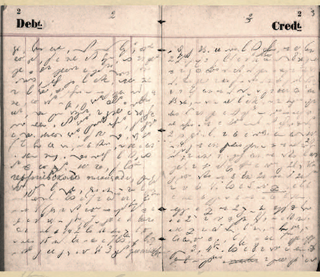
Анна Григорьевна Достоевская stenography system

Slide 43
How might shorthand be a problem for consecutive interpreters?

Slide 44
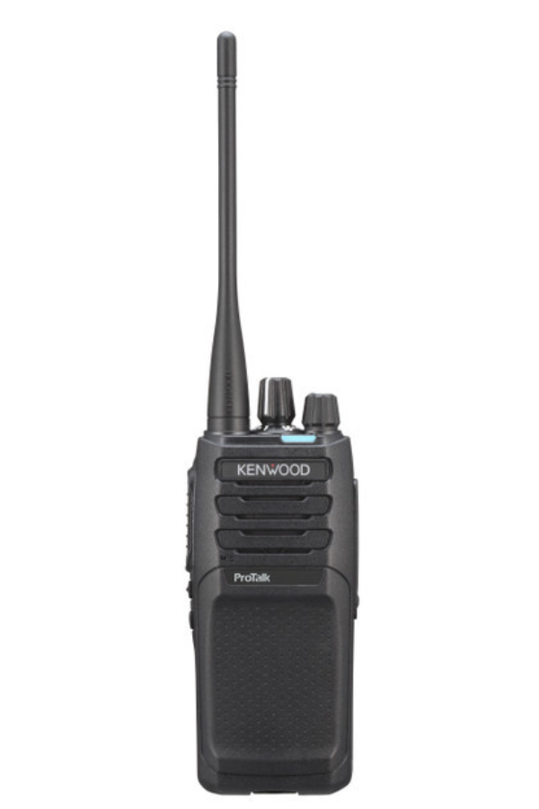
A walkie talkie42

Slide 45
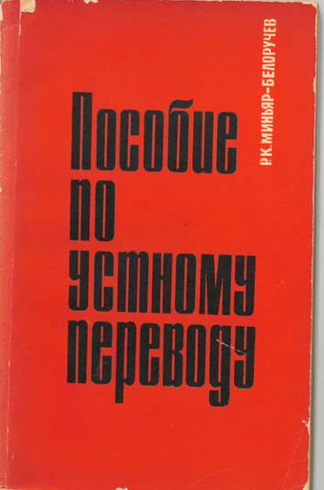
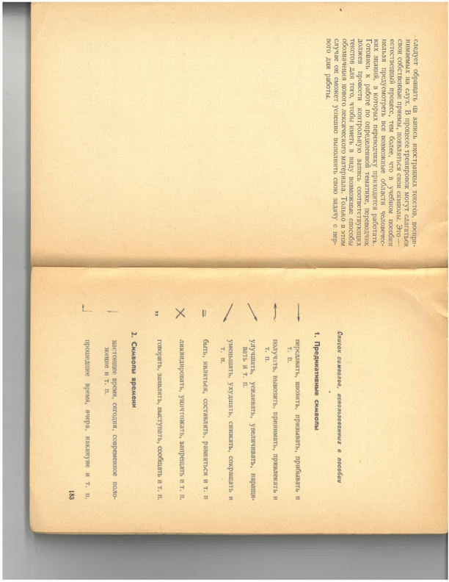
Note-taking: Minyar-Beloruchev

Slide 46
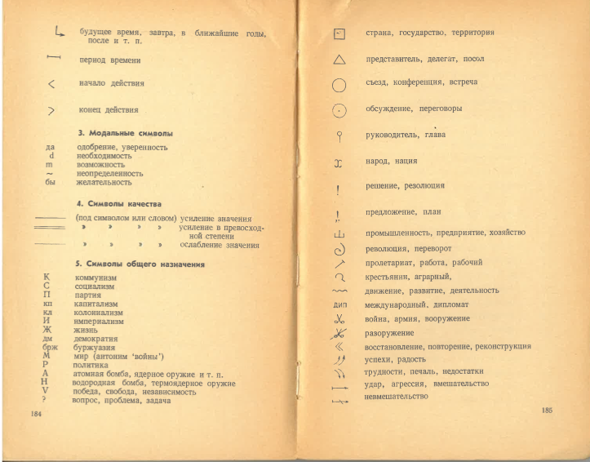

Slide 47
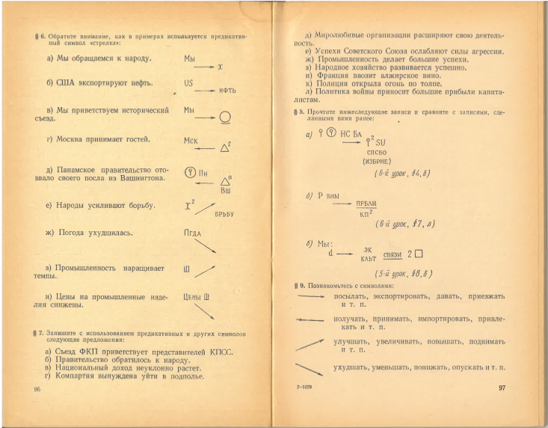

Slide 48
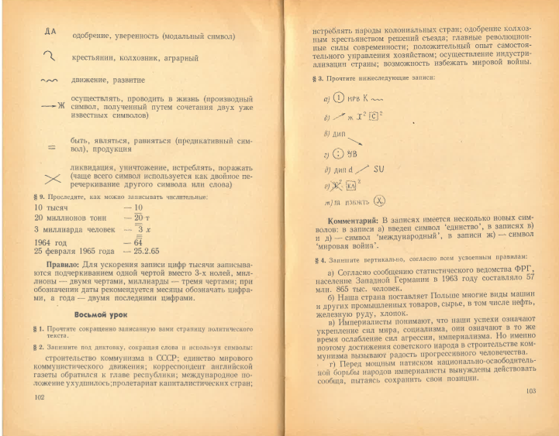

Slide 49
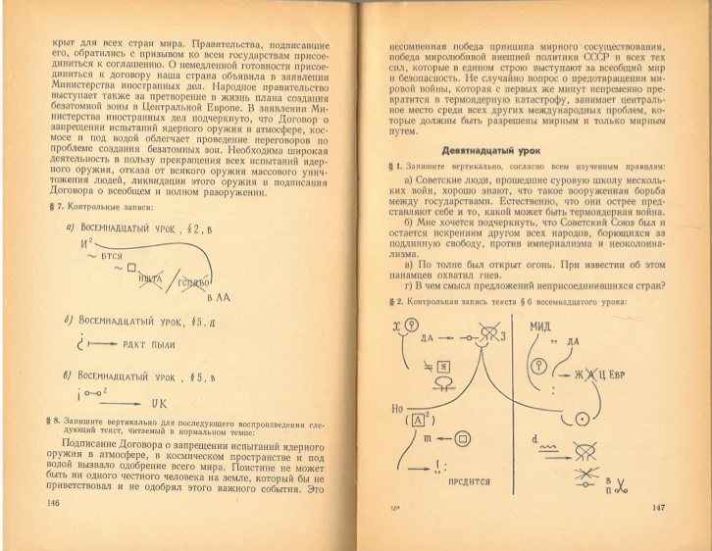

Slide 50
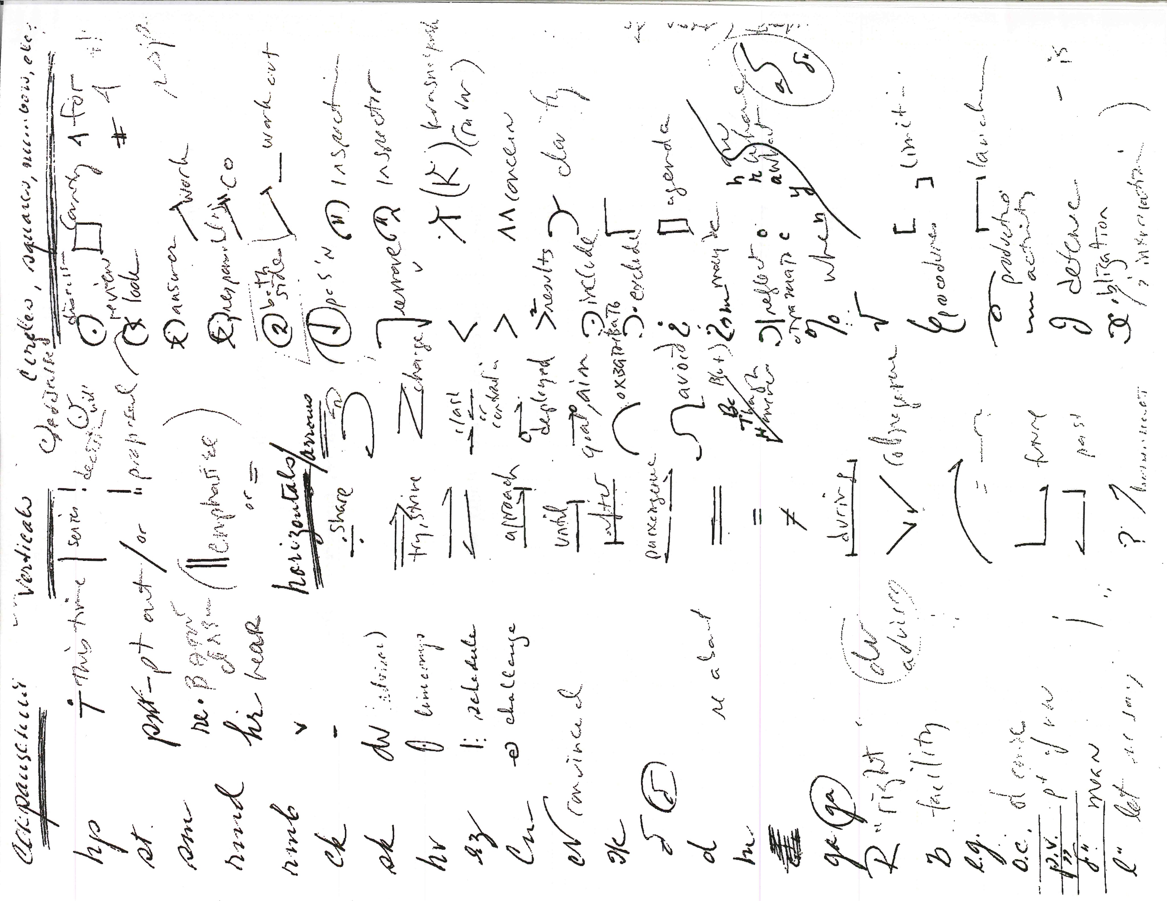
Fun abbreviations
Notes:
Fun abbreviations

Slide 51
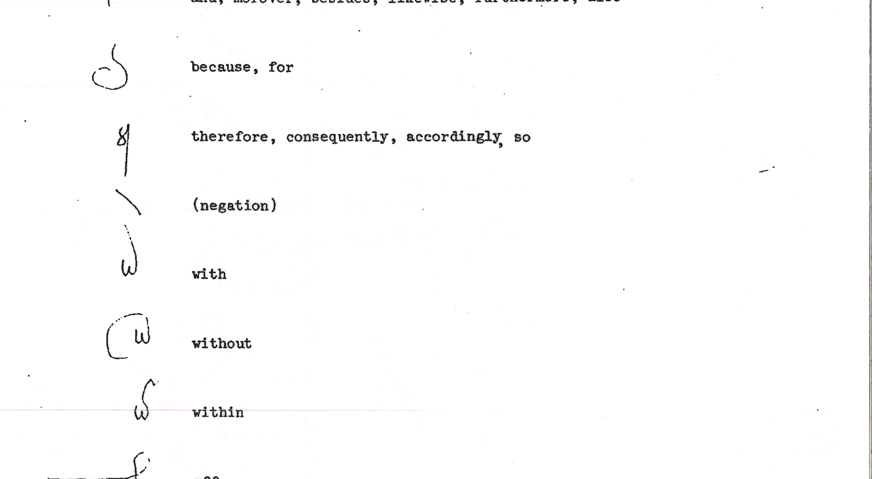
Galina’s abbreviations

Slide 52
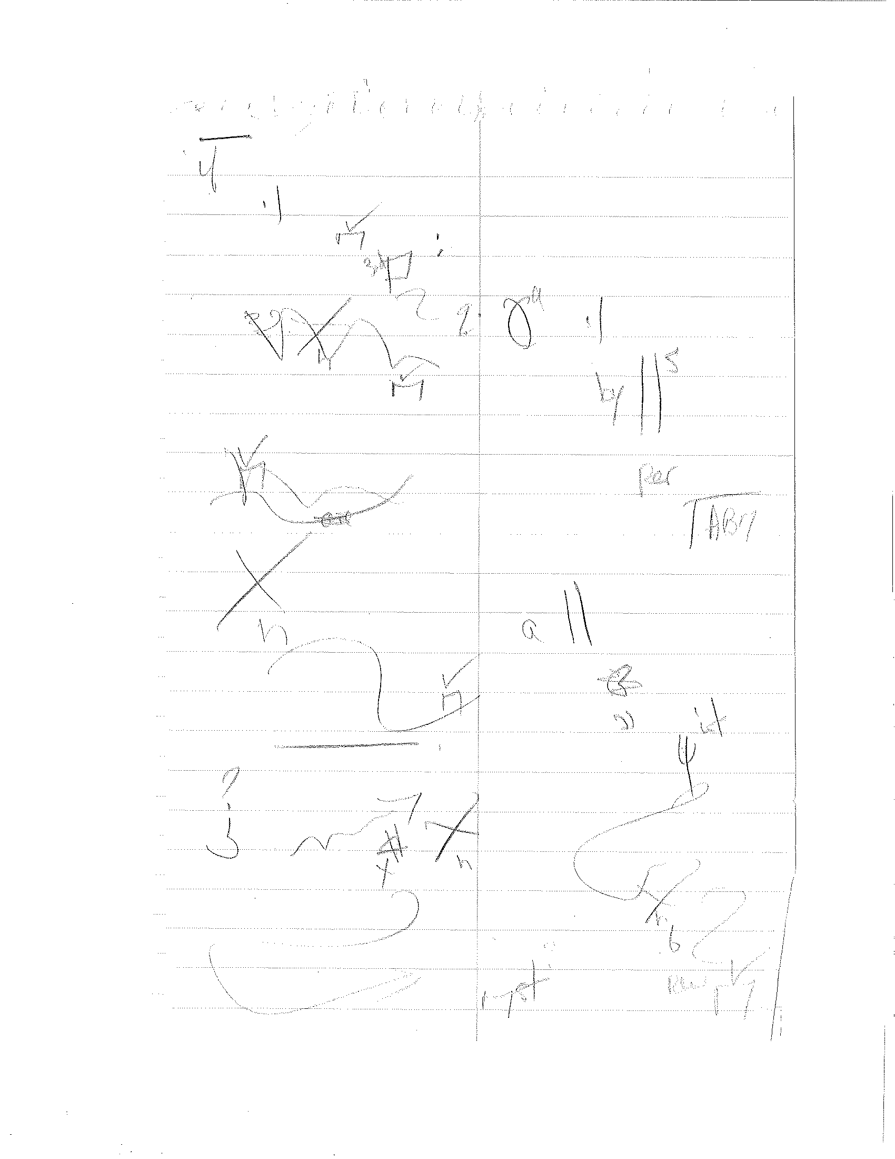
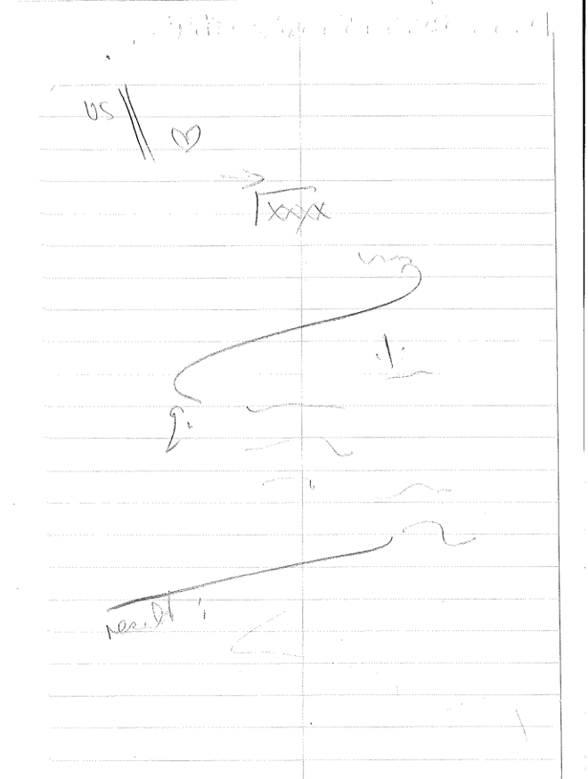
DG’S notes 1

Slide 53
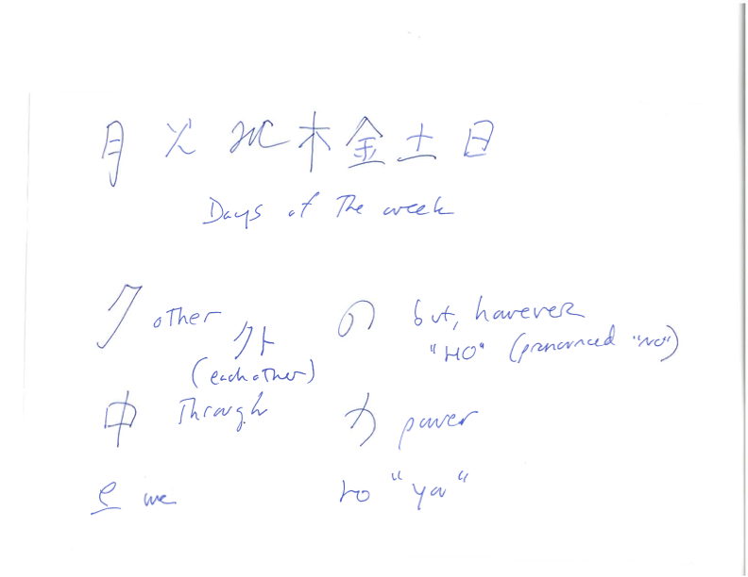
Some of mine (from Japanese)

Slide 54
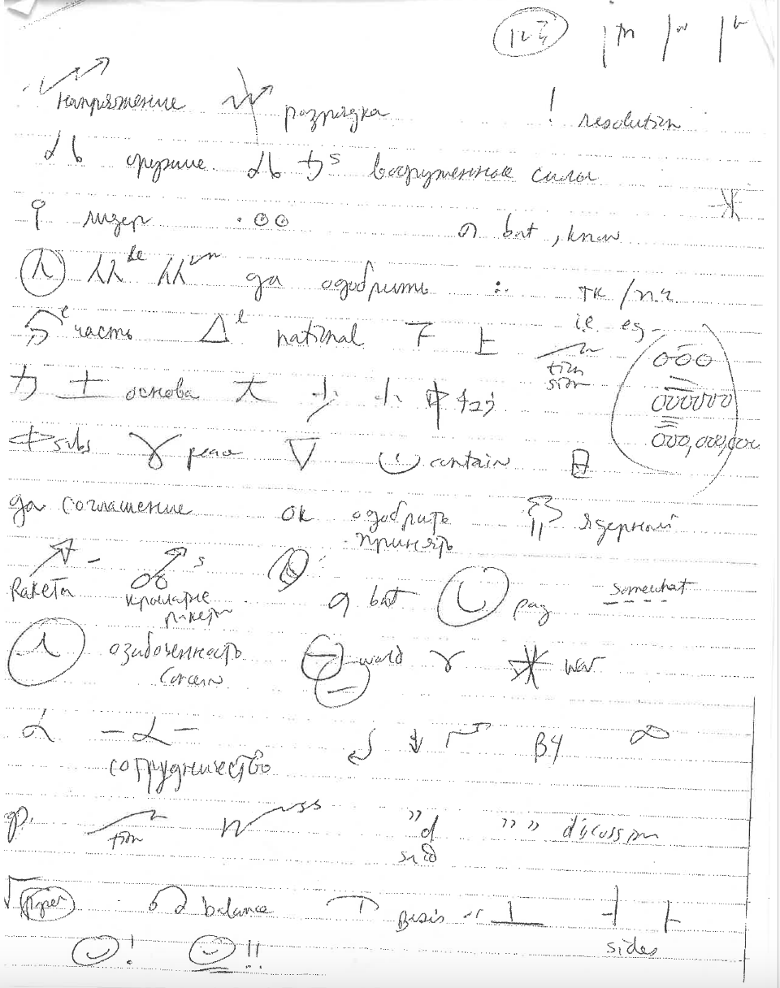
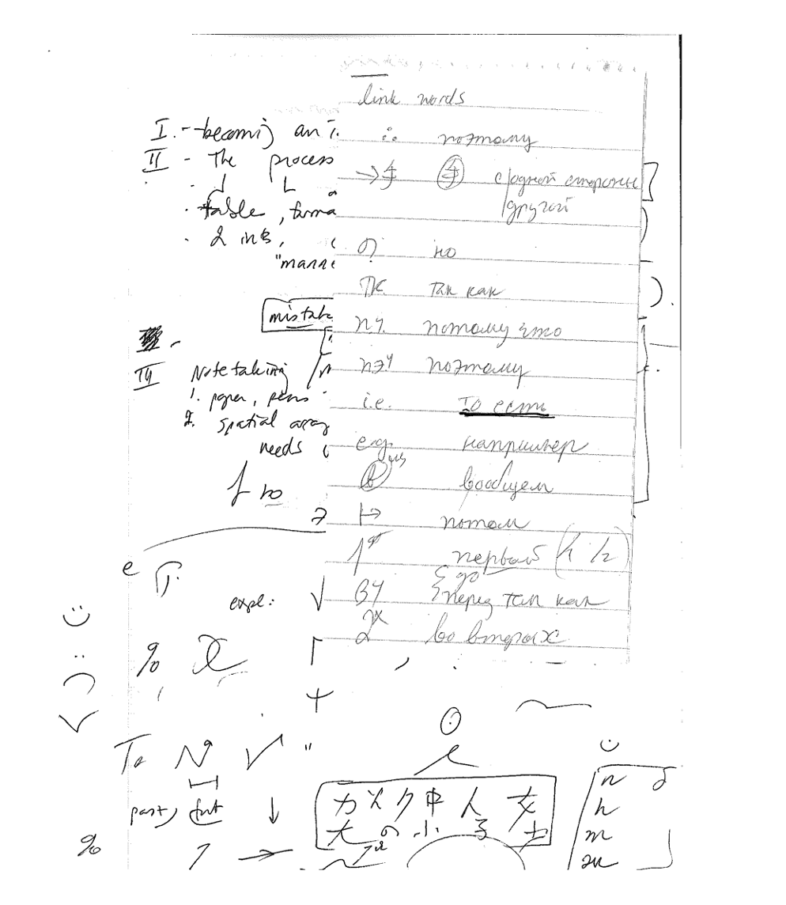
More of mine

Slide 55
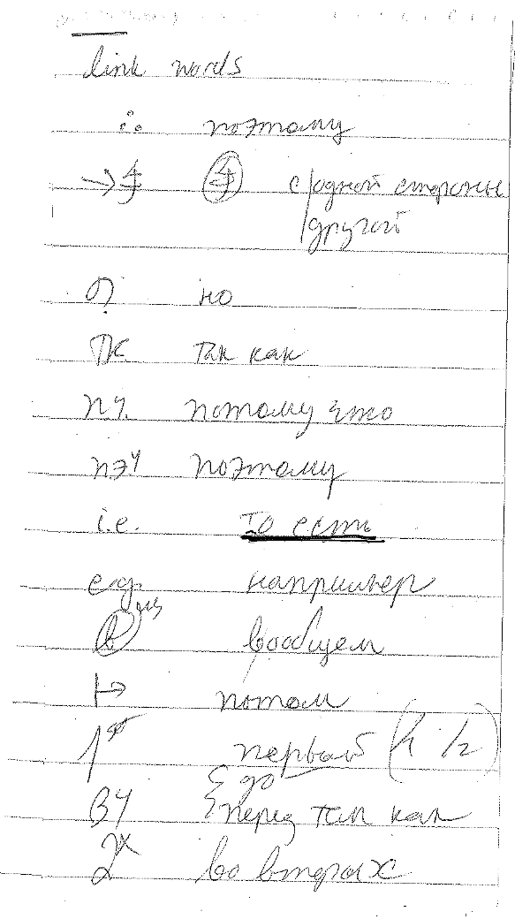
Some of my notes for link words

Slide 56
NOTE TAKING IN ACTION

Slide 57
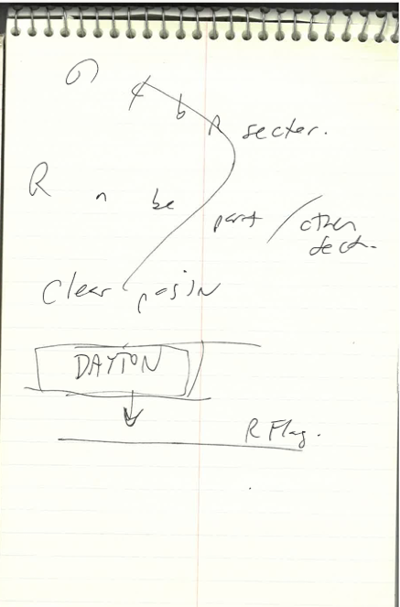
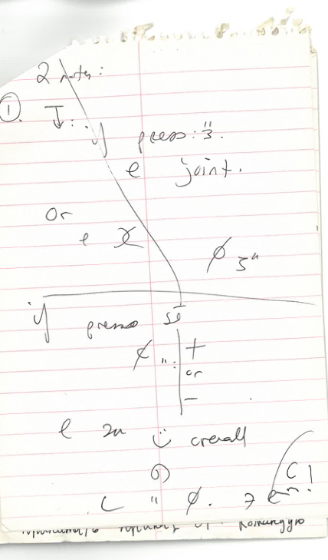
Some of my meeting notes

Slide 58
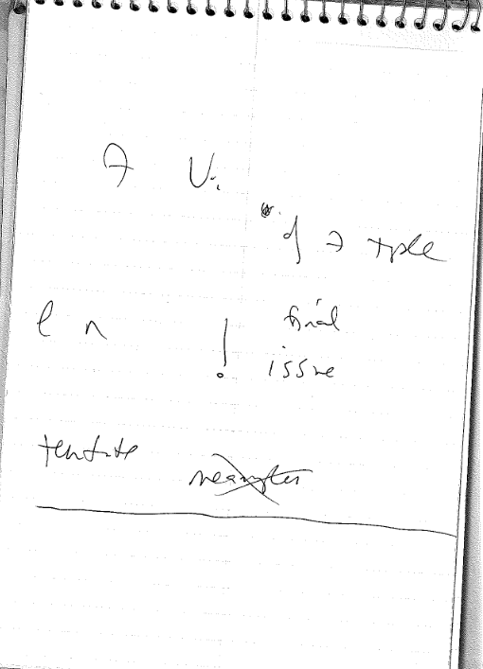


Slide 59

Dmitry’s example

Slide 60

Interpreters love “talking points”

Slide 61


Slide 62
Story #6 ACRONYMS
”Roy” the MA in Political Science

Slide 63
III. TRANSLATING LITERATURE
Пьер был неуклюж. Толстый, выше обыкновенного роста, широкий, с огромными красными руками, он, как говорится, не умел войти в салон и еще менее умел из него выйти, то есть перед выходом сказать что-нибудь особенно приятное. Кроме того, он был рассеян. Вставая, он вместо своей шляпы захватил треугольную шляпу с генеральским плюмажем и держал ее, дергая султан, до тех пор, пока генерал не попросил возвратить ее.
Л.Н. Толстой, «Война и мир» (I: I: 2)
(English versions, Handout #1)

Slide 64

Спасибо за внимание!

