Slide 1
They Have No Idea: Part II
Carol Apollonio
ATA 64th Annual Conference
Miami, FLA, October 2023

Slide 2
Translation it is that openeth the window, to let in the light; that breaketh the shell, that we may eat the kernel; that putteth aside the curtain, that we may look into the most holy place; that removeth the cover of the well, that we may come by the water.
--the translators of the King James Bible

Slide 3
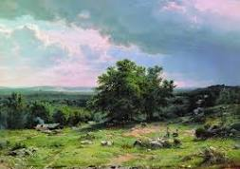
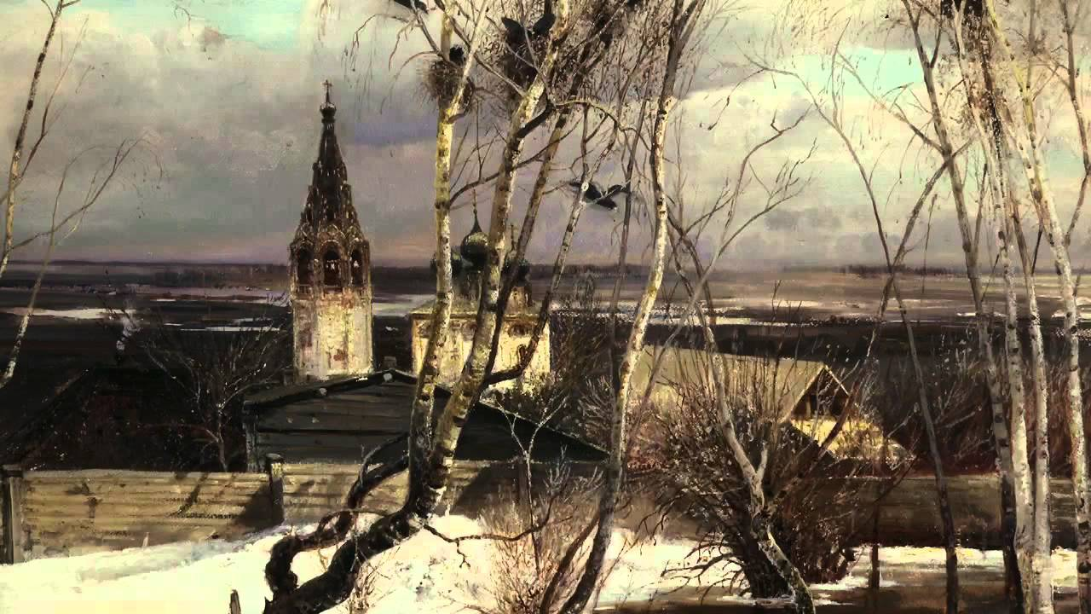
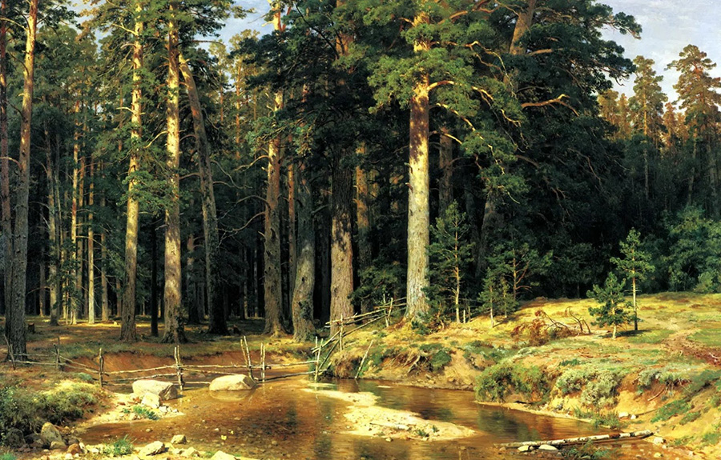
Russians love to talk (and write) about nature

Slide 4
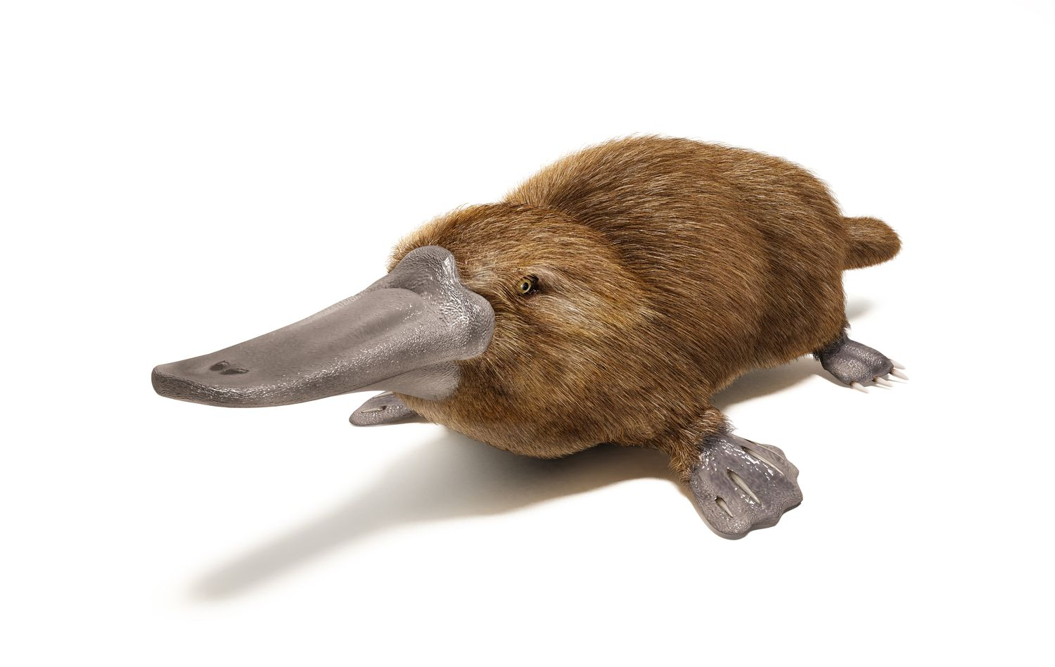

Slide 5
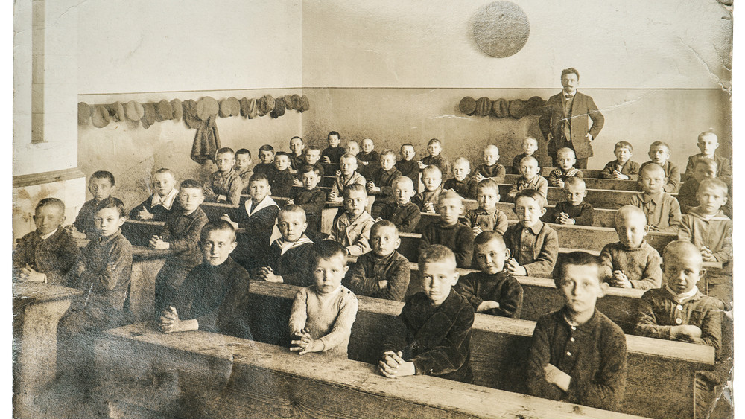
END OF INTRODUCTION

Slide 6

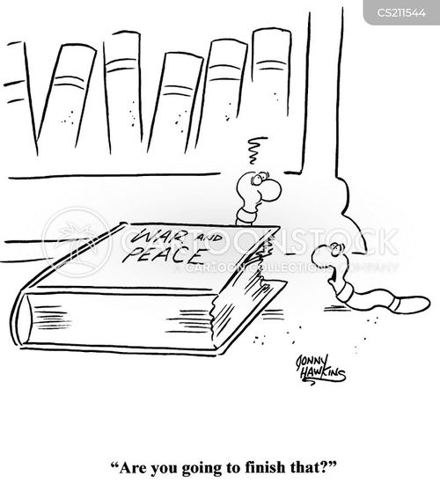

Slide 7
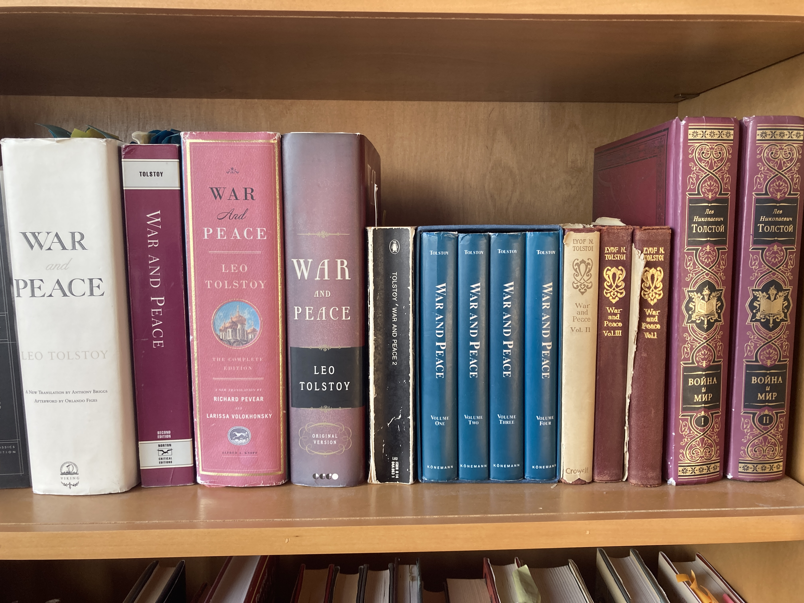

Slide 8
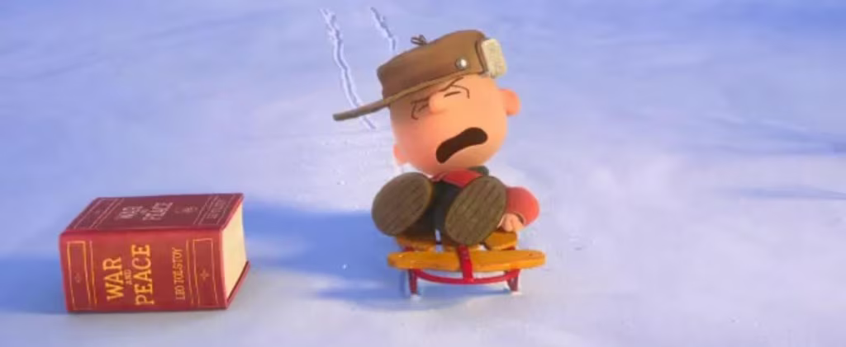

Slide 9
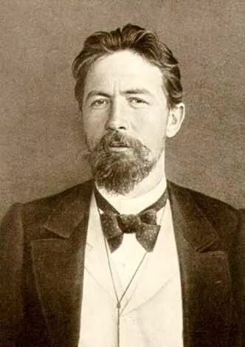
CHEKHOV (beneath the words)

Slide 10
“The Lady with the Dog”
Impersonal expressions, example #1
How would you translate the story’s first sentence?
Говорили, что на набережной появилось новое лицо: дама с собачкой.
Write your sentence, then compare with your neighbors (4 people).

Slide 11
Your solutions?

Slide 12
Which is your favorite? Why?
It was said that a new person had appeared on the sea-front: a lady with a little dog (CG 3).
It was reported that a new face had been seen on the quay; a lady with a little dog (KC 206).
People were telling one another that a newcomer had been seen on the promenade—a lady with a dog. (IL 221)
A new person, it was said, had appeared on the esplanade: a lady with a pet dog (AY 412).
There was a rumour that somebody new had appeared on the Esplanade: a lady with a little dog (JC 270).
They were saying a new face had been seen on the esplanade: a lady with a pet dog (RP 284).
The appearance on the front of a new arrival—a lady with a lapdog—became the topic of general conversation (DM 264).
They said that a new person had appeared on the sea-front—a lady with a little dog (EF 223).
There was said to be a new arrival on the Esplanade: a lady with a dog. (RH 7)
The talk was that a new face had appeared on the embankment: a lady with a little dog (PV 361).
People said that there was a new arrival on the Promenade: a lady with a little dog (RW 223).
People were saying that someone new had appeared on the seafront: a lady with a little dog (RB 167).

Slide 13
“Lady with the Dog”
Impersonal expressions, example #2
(the 3d-person plural verb) What does the translator need to add? Will our text in English have a different interpretation from the Russian original? What is lost? Is anything gained?
Here’s another one:
Его женили рано
How would you translate this? (discuss with your group). Then compare (from the handout)

Slide 14
He had been married young (CG 3).
He had married young (KC 206).
He had been talked into marrying (IL 221).
They had found a wife for him (AY 412).
A marriage had been arranged for him (JC 271).
He had married young (RP 284).
He had been married off (DM 264).
He was married off (EF 223).
His marriage had been arranged early (RH 7).
He had married young (PV 361).
He had been married off while still quite young (RW 223).
He had been married off early (RB 167).

Slide 15
“Lady with the Dog”
Impersonal expressions, example #3
Был праздничный день. […] Весь день хотелось пить […]. Некуда было деваться.

Slide 16
It was a holiday. […] It was a thirsty day […]. One did not know what to do with oneself (CG ).
It was a blazing day. […] All day long he was plagued with thirst […]. It was impossibly hot (KC 210).
It was a holiday. […] It was a parching day […]. The heat was overpowering (IL).
It was a holiday. […] One was thirsty all day […]. One did not know what to do with oneself (AY).
It was a holiday. […] It was a thirsty day […]. There was no escaping from the heat (JC).
It was a holiday. […] All day long Gurov was plagued with thirst […]. There was no refuge from the heat (RP).
It was a holiday. […] All day long one felt thirsty […]. There was nowhere to go (DM).
It was a holiday. […] One felt thirsty all day […]. They could not think of a place to go (EF).
It was Sunday or some other holiday. […] It was a thirsty day […]. There was no escaping the heat (RH).
It was Sunday. […] They felt thirsty all day […]. There was no escape (PV 364).
It was a holiday. […] All day one felt thirsty […]. But there was no escaping the heat (RW).
It was the weekend. […] They were thirsty all day […]. They did not know what to do with themselves (RB).

Slide 17
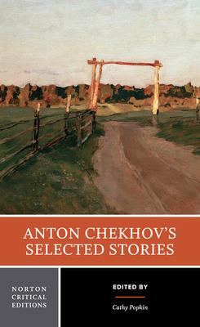
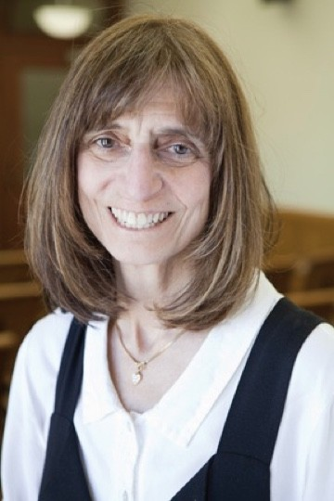
The first Norton Critical edition to feature translation as a major theme of the collection
Cathy Popkin

Slide 18
Chekhov«Невеста» Impersonals
2nd paragraph (“handout #2)
В саду было тихо, прохладно, и темные покойные тени лежали на земле. Слышно было, как где-то далеко, очень далеко, должно быть, за городом, кричали лягушки. Чувствовался май, милый май! Дышалось глубоко и хотелось думать, что не здесь, а где-то под небом, над деревьями, далеко за городом, в полях и лесах, развернулась теперь своя весенняя жизнь, таинственная, прекрасная, богатая и святая, недоступная пониманию слабого, грешного человека. И хотелось почему-то плакать.

Slide 19
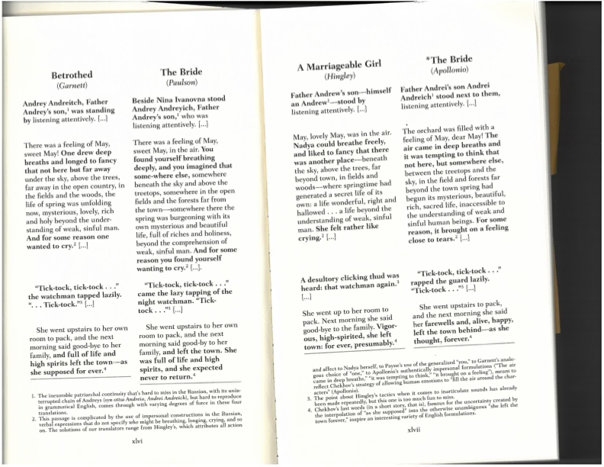
From Popkin’s collection:
“The Bride” («Невеста»)
Paragraph 2 in different translations (аlso available in the handout collection)

Slide 20
GENDER and SOUND
Chekhov’s “The Grasshopper” (”Попрыгунья»)
The artist has had an affair with Olga, the doctor’s wife. They have been spending the summer on the Volga River, where the artist has been painting landscapes. The summer love is ending, and they are grouchy. They sit on the boat and he looks at the shores, which are losing their summer color:
И казалось, что роскошные зеленые ковры на берегах, алмазные отражения лучей, прозрачную синюю даль и всё щегольское и парадное природа сняла теперь с Волги и уложила в сундуки до будущей весны, и вороны летали около Волги и дразнили ее: «Голая! голая!»
Translate and compare notes; check the handout

Slide 21
SOUND and IMPERSONALS
Chekhov’s «Спать хочется» (1888)
Баю-баюшки-баю,
А я песенку спою…[…]
Боль так сильна, что он не может выговорить ни одного слова и только втягивает в себя воздух и отбивает зубами барабанную дробь:
--Бу-бу-бу-бу

Slide 22
“I Want to Sleep”
“Bayu-bayushki-bayu,
A little song I sing….” […]
The pain is so strong that he is not able to speak even one word and only draws air into himself and beats with his teeth like a drum: “Boo-boo-boo-boo…” (ANON)
“Sleepy-Eye”
"Bayu, bayushki, bayu!
Nurse will sing a song to you." […]
The pain is so intense that he cannot utter a single word, and only inhales air and emits through his lips a drumming sound. "Bu, bu, bu, bu, bu -- "
( R.E.C. LONG)
“Sleepy”
“Hush-a-bye, my baby wee,
While I sing a song for thee." […]
[…] the pain is so violent that he cannot utter a single word, and can only draw in his breath and clack his teeth like the rattling of a drum:
"Boo--boo--boo--boo. . . .” (GARNETT)
“sleepyhead”
Hush-a-bye, hush-a-bye,
I’ll sing you a song…[…]
The pain was so fierce that he was unable to speak a single word. He just sucked in the air and expelled it from his mouth with a sound like the rolling of drums.
“Bu, bu, bu, bu…” (PAYNE)
“Let Me Sleep”
Bayu-bayushki-bayu,
I’ll sing a song for you… […]
The pain is so great that he cannot utter a single word, only draw in sharp breaths and beat a tattoo with his teeth:
“Bm-bm-bm-bm-bm…” (MILES-PITCHER)
“Sleepy”
Hush-a-bye, baby,
I’ll sing you a song… […]
The pain is so intense that he cannot utter a single word and only sucks in air, his teeth chattering like a drum roll:
“Rat-a-tat-tat-tat.” (PV)

Slide 23
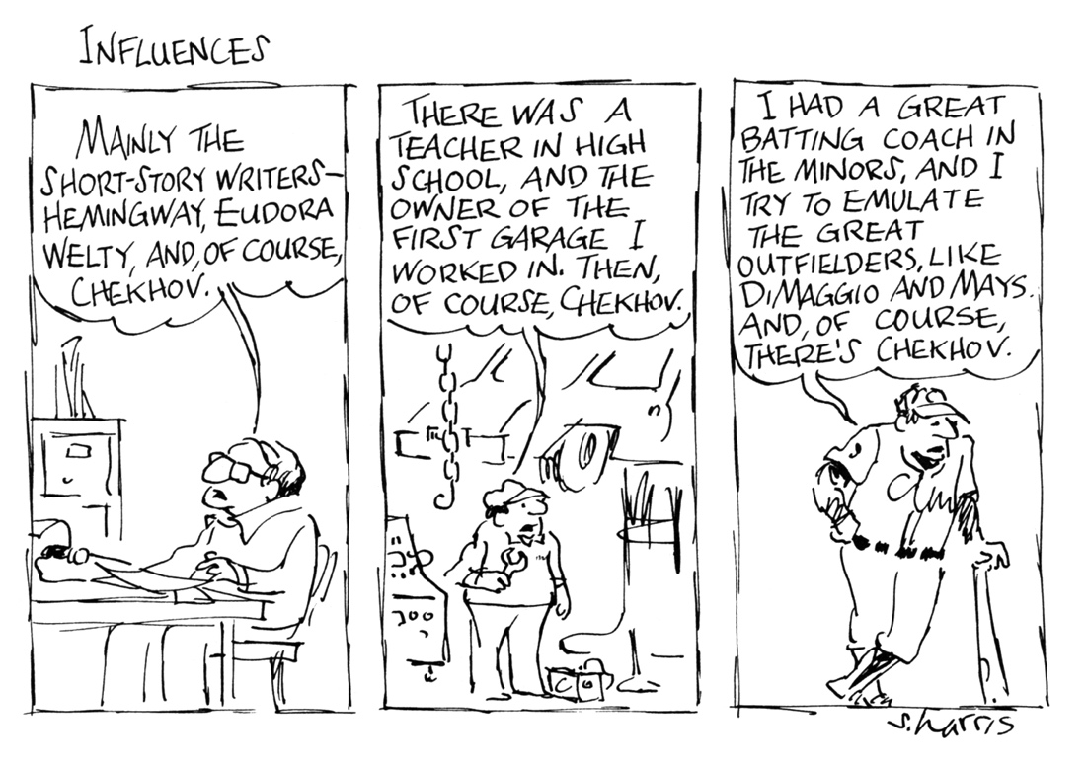
Too much Chekhov? I can’t help it.

Slide 24
TENSE: back to “The Lady with the Dog”
Листва не шевелилась на деревьях, кричали цикады, и однообразный, глухой шум моря, доносившийся снизу, говорил о покое, о вечном сне, какой ожидает нас. Так шумело внизу, когда еще тут не было ни Ялты, ни Ореанды, теперь шумит и будет шуметь так же равнодушно и глухо, когда нас не будет (133).

Slide 25
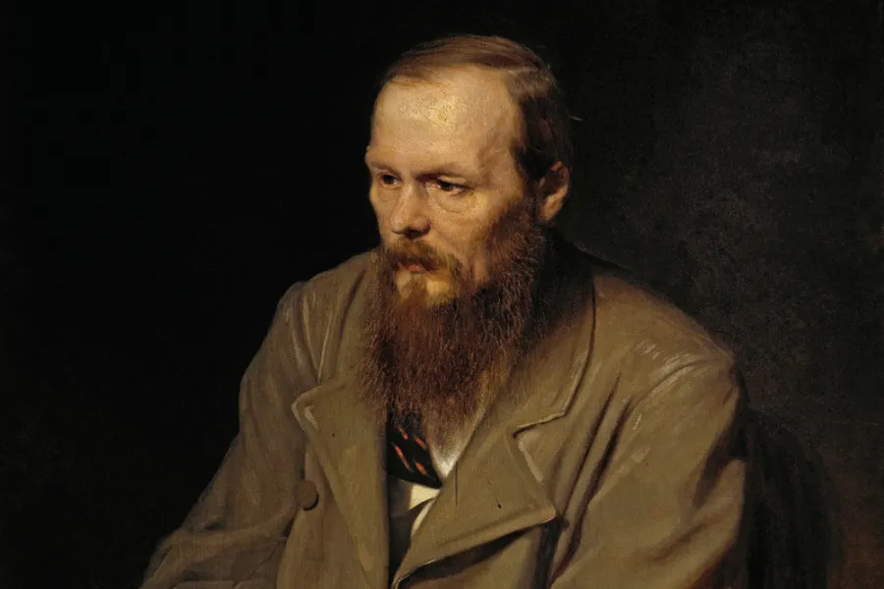
DOSTOEVSKY

Slide 26
DOSTOEVSKY, The Brothers Karamazov
Constance Garnett’s vocabulary
Blunders, dumbfounded, puling chicken, peevish child, blind moles and scoffers, vile, ignominy, medley of human passions, awestricken alarm, profound despondency, timorous, mortification, inexplicable humiliating terror, rankling, devilish and criminal cunning, lacerations, escapade, perplexity, preemptorily, bethink himself, discreditable, subtleties and distinctions, overwrought, infamous, repugnance, baffling, sheepish sentimentality, twitching, diverting, impulsively, guffawed, hauty superciliousness, discordant, fretted, beamed, destitute wanderer, dreadfully, pompous, amorous intrigues, idle swaggerer, gibing and growling, aberration, sallow, wretch, drawled, subterfuge, jauntily, mournful and dispirited, mental faculties, pot-house debauchery, turbulent energies, utmost hilarity, miscreant, clambering, wisp of tow, crew of quacks, rules of canine etiquette, saucy pranks, sniveling fellow, positive ferocity, noxious, pounced...

Slide 27
Alyosha’s “fall to the earth”
Какая-то как бы идея воцарялась в уме его—и уже на всю жизнь и на веки веков. Пал он на землю слабым юношей, а встал твердым на всю жизнь бойцом и сознал и почувствовал это вдруг, в ту же минуту своего восторга. И никогда, никогда не мог забыть Алеша во всю жизнь свою потом этой минуты. «Кто-то посетил мою душу в тот час», говори он потом с твердою верой в слова свои...(14: 328)

Slide 28
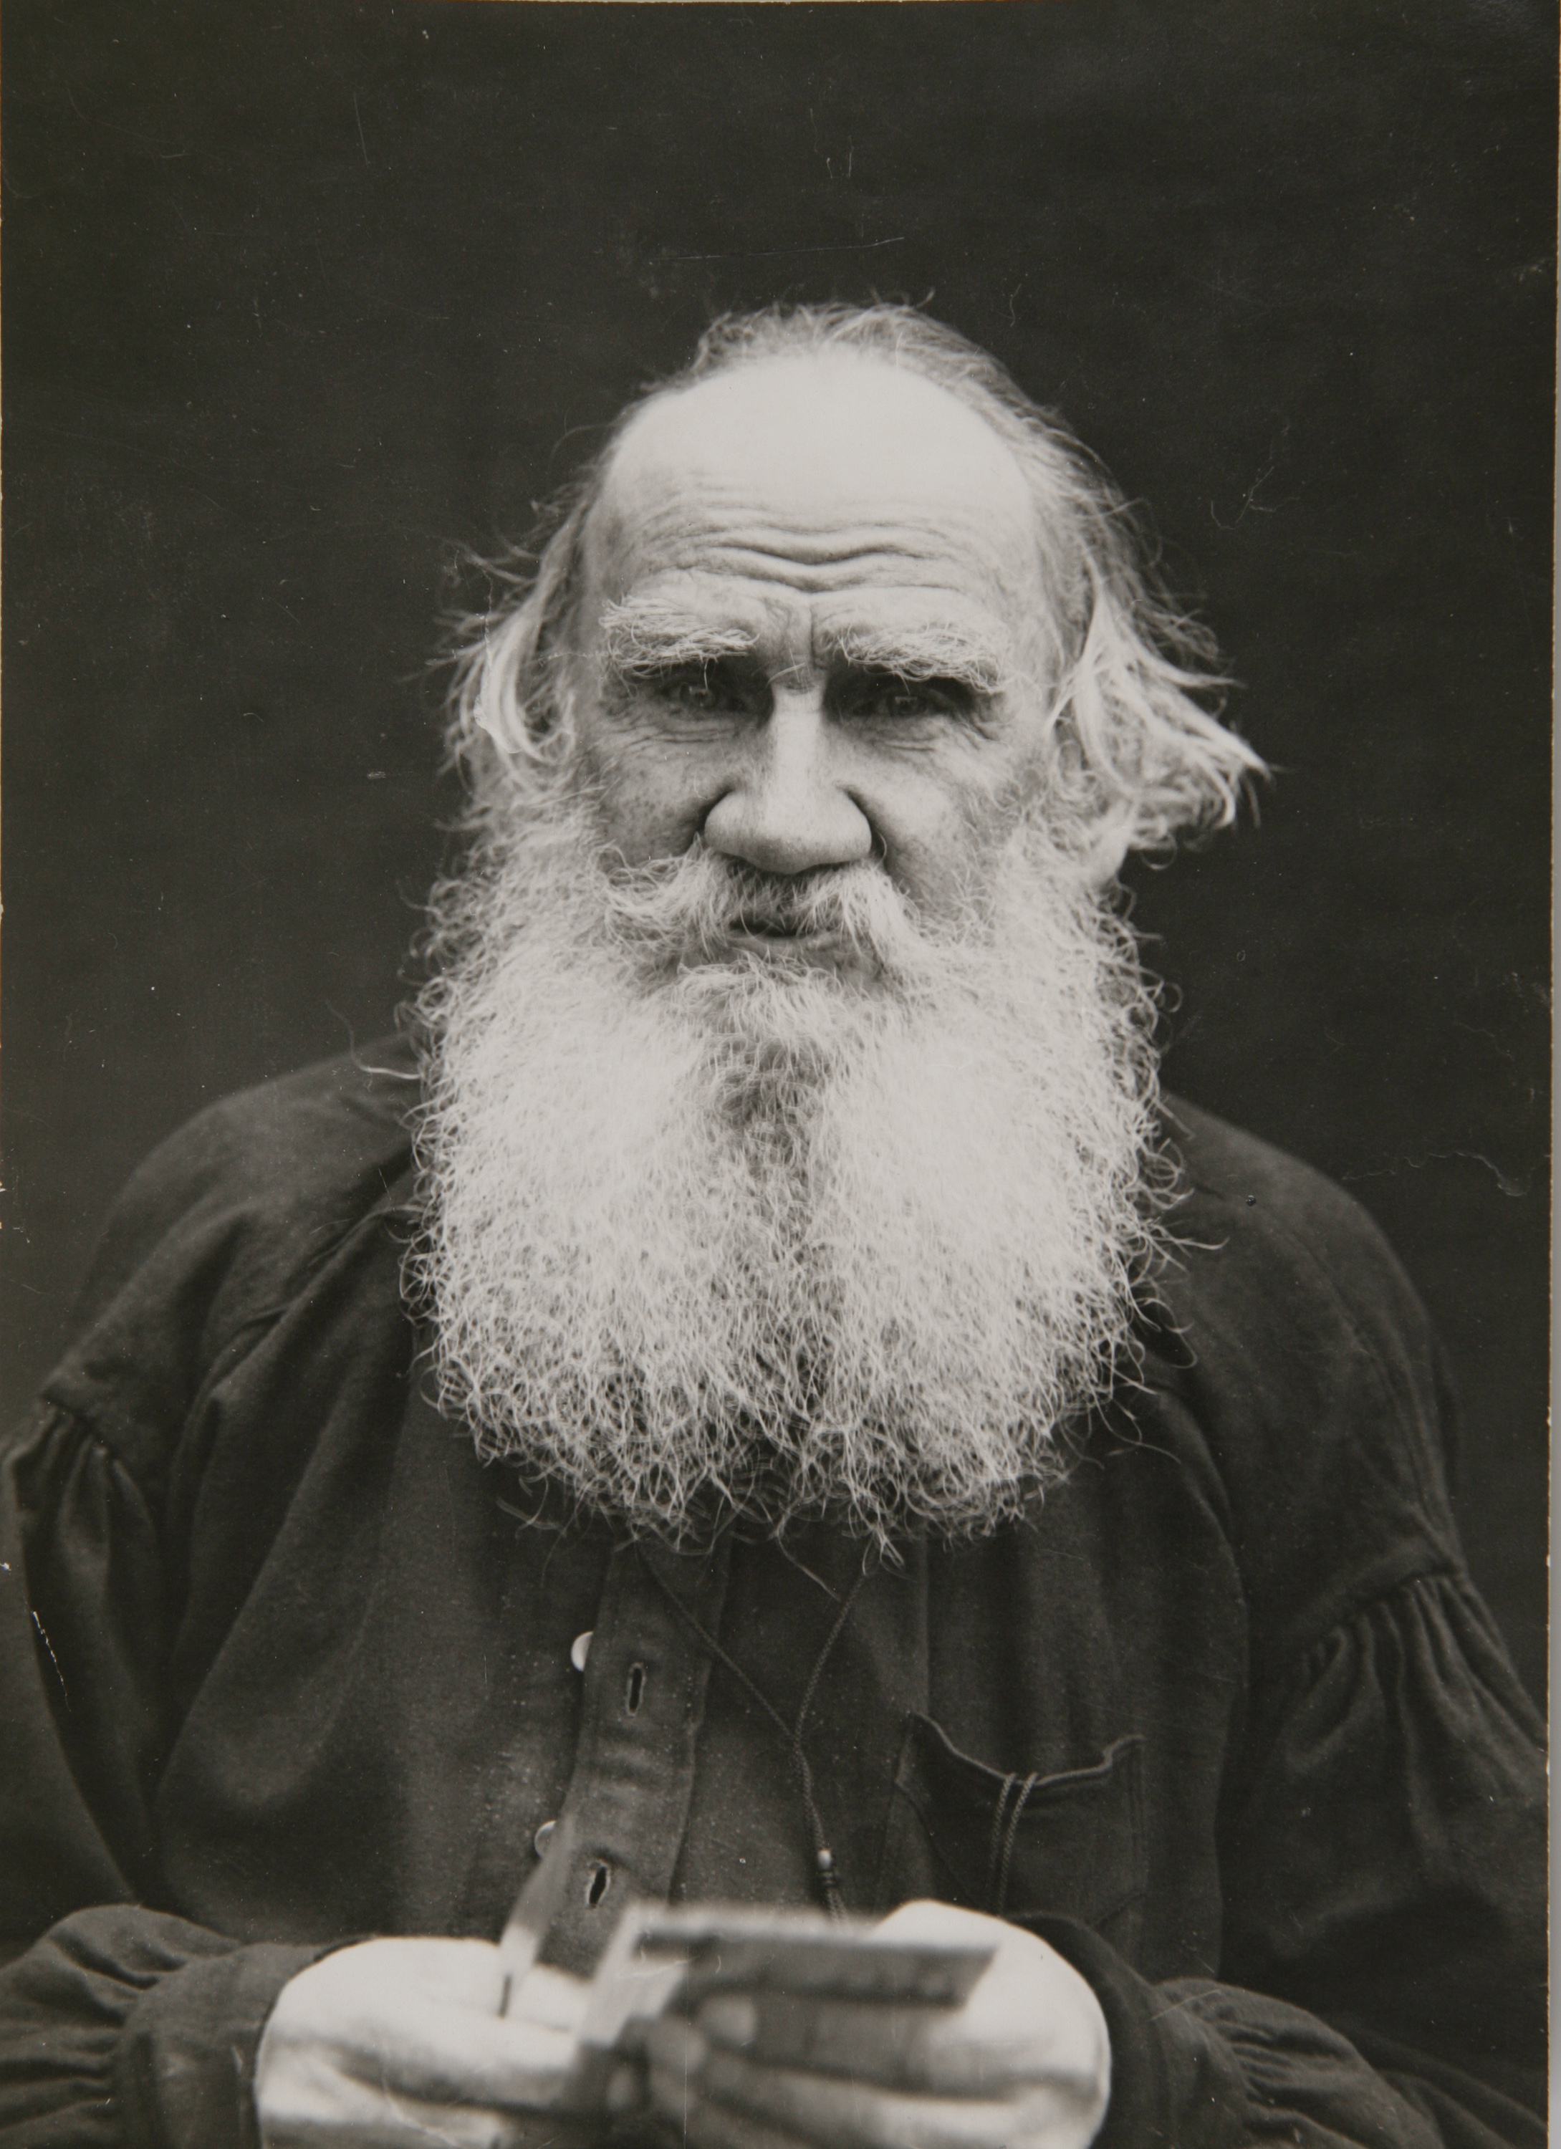
TOLSTOY

Slide 29
Пьер был неуклюж. Толстый, выше обыкновенного роста, широкий, с огромными красными руками, он, как говорится, не умел войти в салон и еще менее умел из него выйти, то есть перед выходом сказать что-нибудь особенно приятное. Кроме того, он был рассеян. Вставая, он вместо своей шляпы захватил треугольную шляпу с генеральским плюмажем и держал ее, дергая султан, до тех пор, пока генерал не попросил возвратить ее.
Л.Н. Толстой, «Война и мир» (I: I: 2) (English versions, Handout #1)

Slide 30
Vocabulary; word-to-world relationship
Tolstoy’s epic landscape: the dusty march
(quote #4 on the Tolstoy part of your handout)
Каждый день по небу ходили курчавые облака, изредка заслоняя солнце; но к вечеру опять расчищало, и солнце садилось в буровато-красную мглу. Только сильная роса ночью освежала землю. Остававшиеся на корню хлеба сгорали и высыпались. Болота пересохли. Скотина ревела от голода, не находя корма по сожженным солнцем лугам. Только по ночам и в лесах, пока еще держалась роса, была прохлада. Но по дороге, по большой дороге, по которой шли войска, даже и ночью, даже и по лесам, не было этой прохлады. Роса не заметна была на песочной пыли дороги, встолченной больше чем на четверть аршина. Как только рассветало, начиналось движение. Обозы, артиллерия беззвучно шли по ступицу, а пехота по щиколку в мягкой, душной, не остывшей за ночь, жаркой пыли. Одна часть этой песочной пыли месилась ногами и колесами, другая поднималась и стояла облаком над войском, влипая в глаза, в волоса, в уши, в ноздри и главное в легкие людям и животным, двигавшимся по этой дороге (XI:120).

Slide 31
Translation habits to avoid
(examples from the new Katz BK)
Какой-то does not have to be translated
“some sort of emotional and poignant note” (783)
“some sort of unexpected, almost frenzied voice” (768)
“some sort of threatening tremor in her voice” (885)
Watch your English:
“she shouted in a heartrending cry” (533 Katz)
“she cried, in a heart-rending voice” (Garnett 388)
“a bench on one of the two walls” (720)
“he looked like a very handsome young man.” (619)
Beware of literalisms:
“the hospital where Mitya was resting” (“lying”) (880)
Avoid duplicating repetitions in the original text:
“he had several hours, and that was much, much!” (830)
Beware pf adverbs:
A fact that surprised Mitya agonizingly (442)

Slide 32

SHALL WE GO ON?

Slide 33
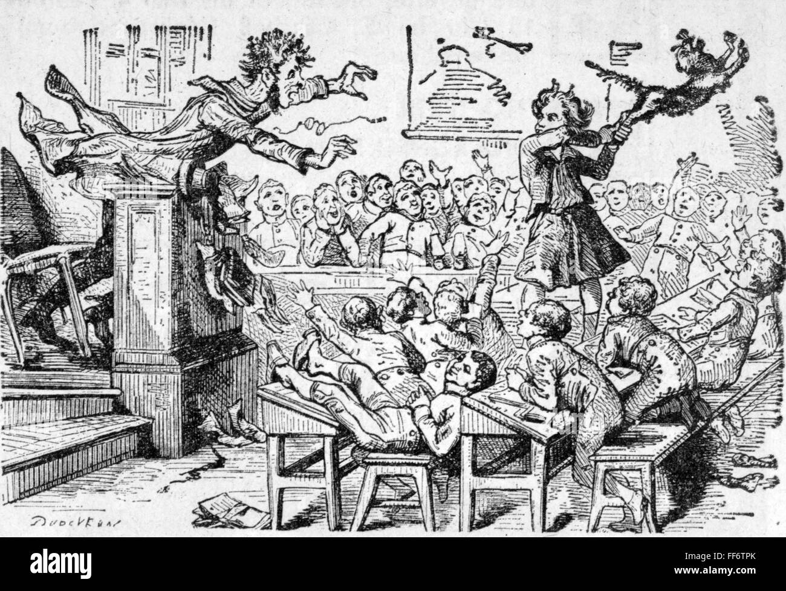
Thoughts, questions, tirades

Slide 34


