Slide 1
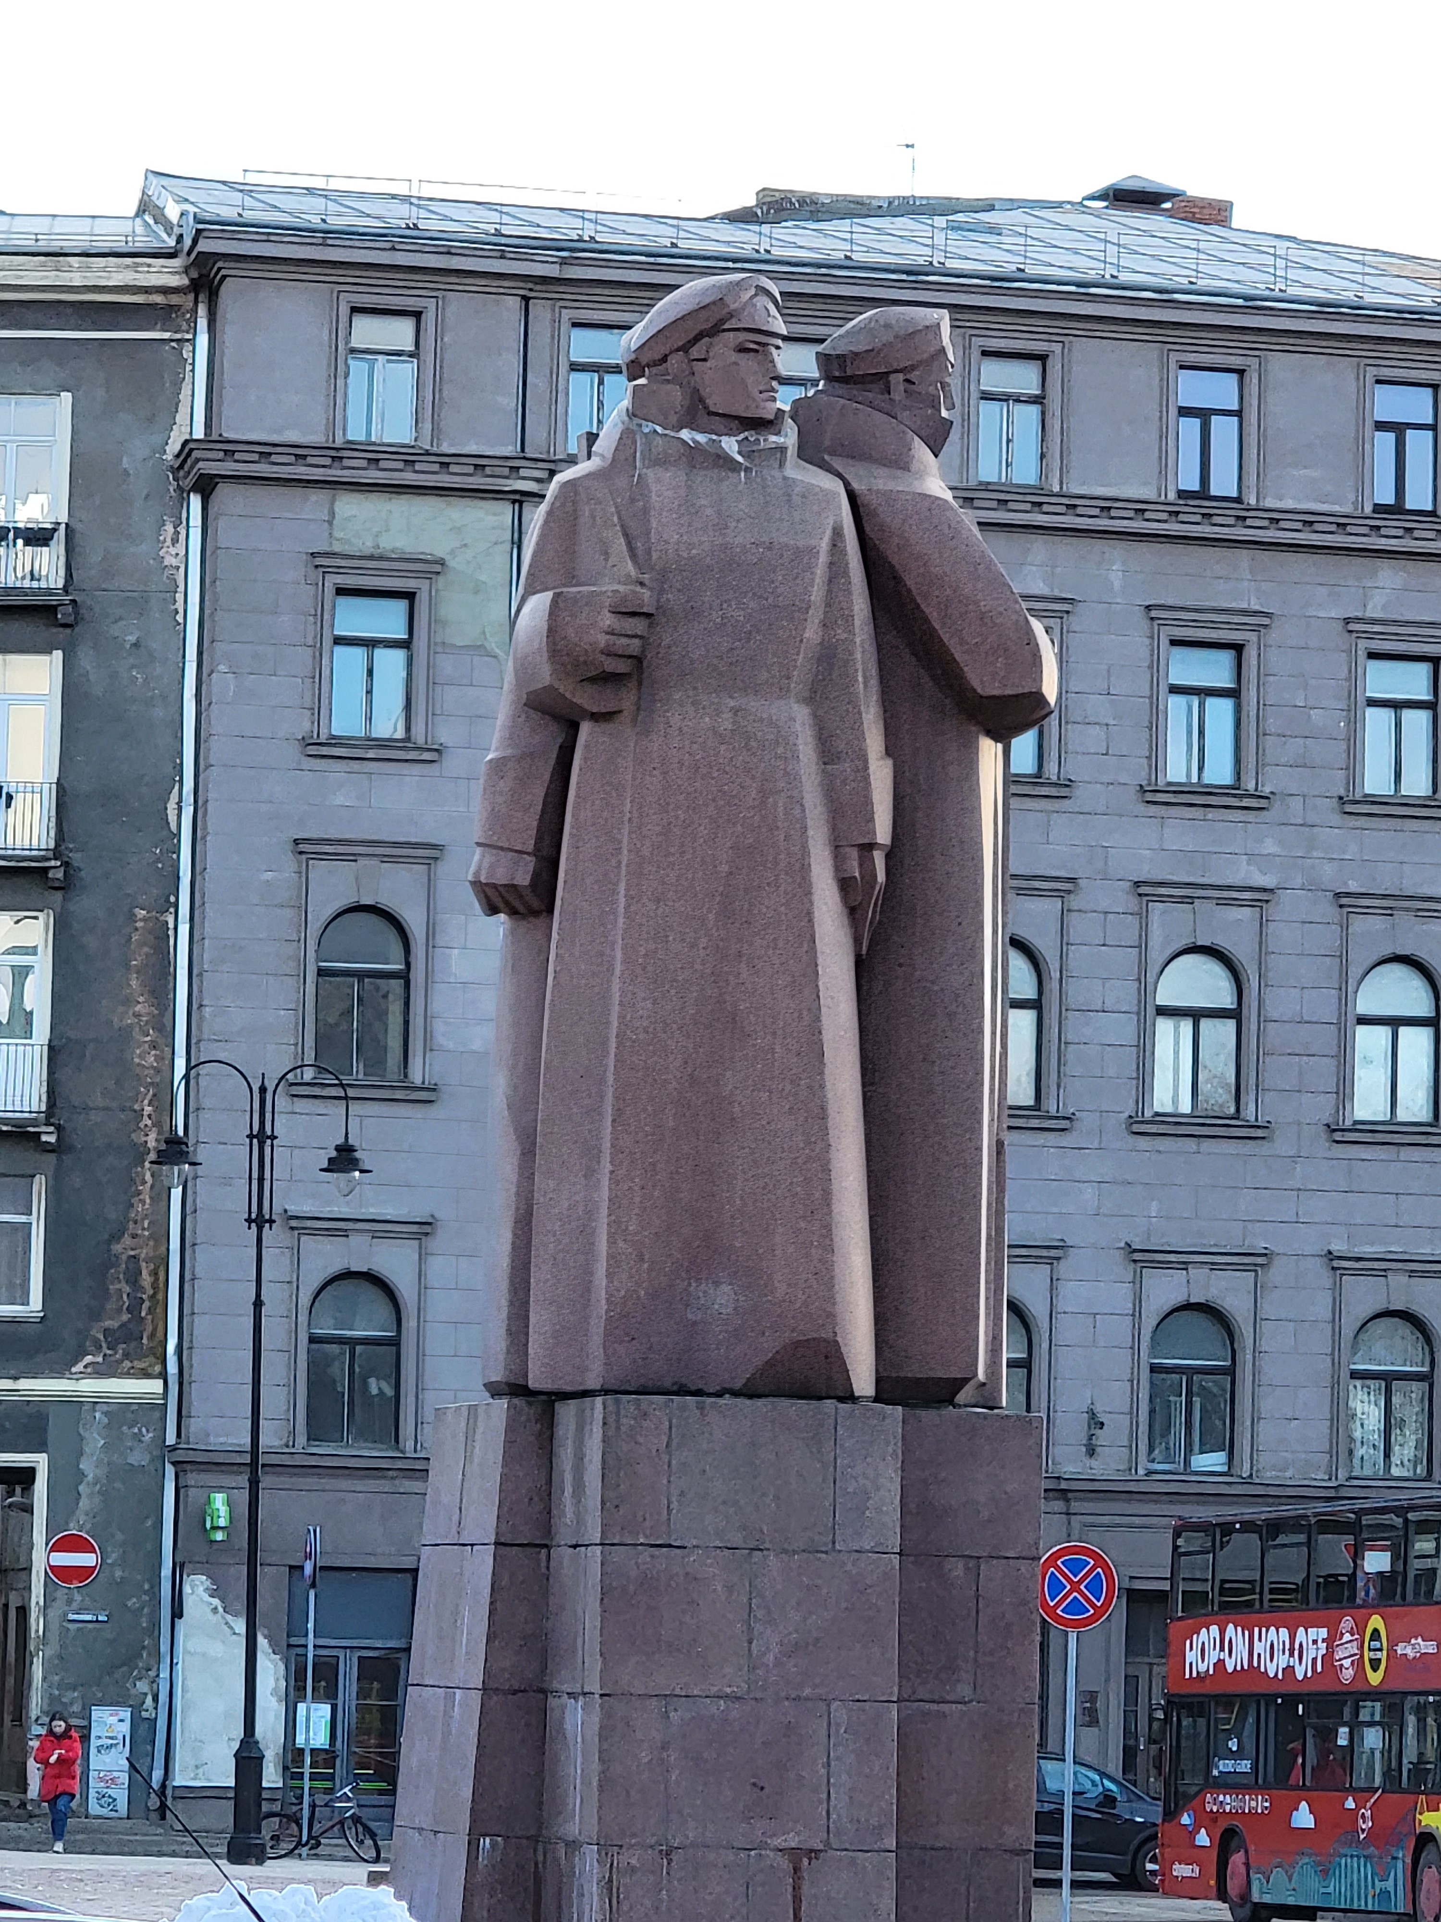
I can’t place the accent:
Identifying the characteristic traits of computer translation
John Riedl
Eugenia Tietz-Sokolskaya

Slide 2
Agenda
Goals
Key terms and concepts
Survey results
Group activity and discussion
Conclusions
Questions and comments
Notes:
We have to master our tools. We can’t let out tools master us. There is a sense that there is no room for linguists in the computer translation world. The engineers won’t ask our opinion. We have to engage them/

Slide 3
Why this presentation?
We are better editors if we understand the strengths and limitations of our “translators.”
We are better translators if we understand the strengths and limitations of our tools.
Linguists have an important role in the generative-AI conversation.
Notes:
We have to master our tools. We can’t let out tools master us. There is a sense that there is no room for linguists in the computer translation world. The engineers won’t ask our opinion. We have to engage them/

Slide 4
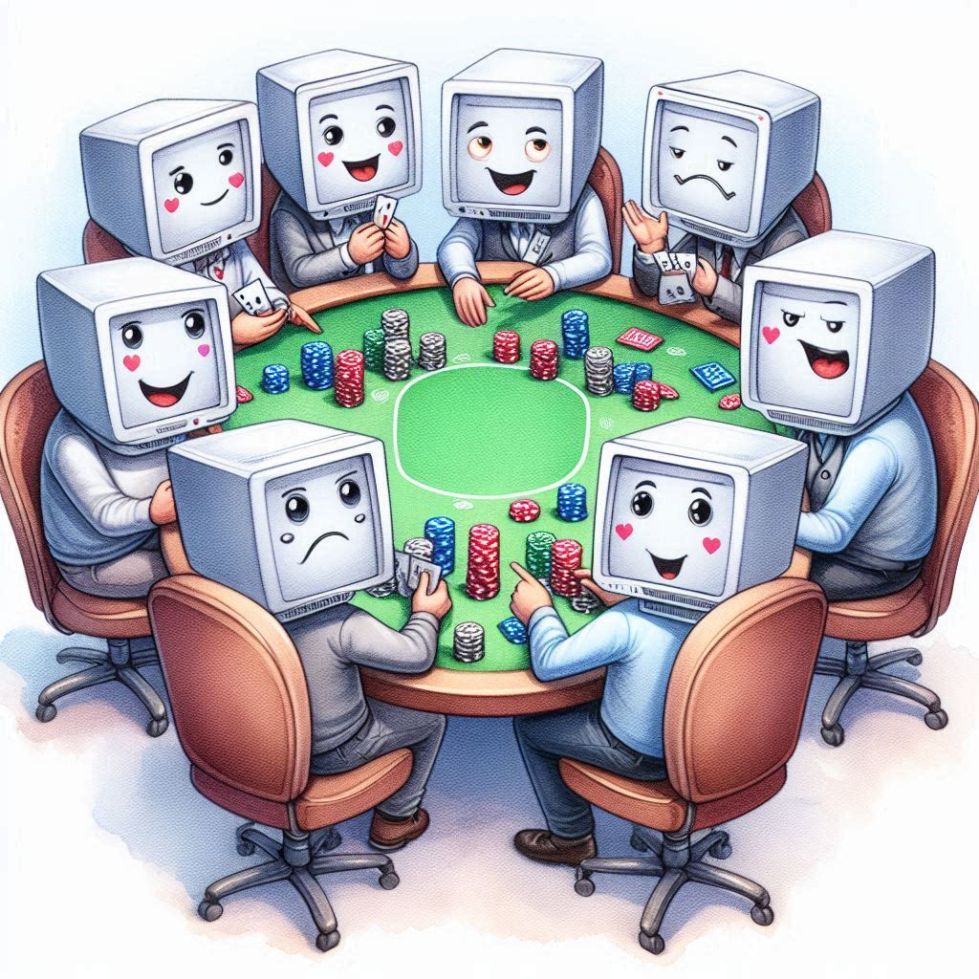
Goal
All translators have a “tell,” even computer translators.
Our goal is to look for NMT and generative AI’s tell.
Notes:
We have to master our tools. We can’t let out tools master us. There is a sense that there is no room for linguists in the computer translation world. The engineers won’t ask our opinion. We have to engage them/

Slide 5
NMT? AI? LLM?? – let’s define our terms
What is “AI” is often a matter of hype
NMT – neural machine translation
  A form of machine translation using a neural network, first developed ~2017
  Gradually replaced predecessor, statistical MT
  Encodes source meaning into a vector; predicts most likely text needed to represent that vector in the target (transformer model)
LLM – large language model
  An iteration of the transformer model with a larger training set and the ability to refer to multiple inputs (source, context, prompt) at once (multi-headed attention)
  Can be trained on one or multiple modes (text, code, image, audio, video)
Machine Learning
Statistical MT
NMT
Generative AI
Text Mode
Tool
Version
Notes:
Encoded piece by piece
Version refers to model architecture – continues to be trained on more data, so same version now is more advanced

Slide 6
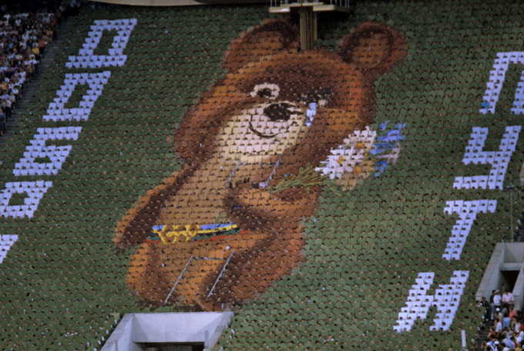

Attention in Action – 1980 Olympics Edition
На трибунах становится тише…
Тает быстрое время чудес.
До свиданья, наш ласковый Миша,
Возвращайся в свой сказочный лес.
Не грусти, улыбнись на прощание,
Вспоминай эти дни, вспоминай…
Пожелай исполненья желаний,
Новой встречи нам всем пожелай.
See how quiet it is on the stands there…
We would lengthen these days if we could.
But goodbye, dear old Misha, our brown bear,
Hasten back to your fairy-tale wood.
Don’t be sad, smile once more as we part now,
And remember these days, always do…
We shall meet once again – let us all vow –
And may all of our wishes come true.
Source: RIA Novosti archive, image #488322 / Sergey Guneev / CC-BY-SA 3.0, CC BY-SA 3.0, https://commons.wikimedia.org/w/index.php?curid=16486967
Notes:
Left: Russian closing ceremony song Right: official English translation (audio clip of first two lines)

Slide 7







Attention in Action – 1980 Olympics Edition
It's getting quieter in the stands....
The quick time of miracles is melting away. Goodbye, our affectionate Misha,
Come back to your fairy-tale forest.
Don't be sad, smile goodbye,
Remember these days, remember these days, remember these days...
Wishing you wishes come true,
♪ Wish us all a new meeting ♪
The stands are falling silent now...
The magical time quickly fades.
Goodbye, our gentle Misha,
Return to your enchanted woods.
Don't be sad, smile as we part,
Remember these days, remember...
Wish for our dreams to come true,
And wish us all a new meeting, too.
The stands are growing quiet and still,
The time of wonders fades from view.
Goodbye, dear Misha, with heart and will,
Return to your forest so peaceful, so true.
Don’t be sad—just smile as you go,
And cherish these moments, don't let them pass.
Wish that our dreams will blossom and grow,
And hope for a meeting again at last.
Notes:
Left: DeepL Translate (free version) Right: ChatGPT 4o. Source was correctly identified as the song from the 1980 Olympics closing ceremony.
Version 3 (after being asked to make it more serious, less childish):
The stands grow quiet, the echoes fade,
The time of wonders slips away.
Farewell, dear Misha, gentle and brave,
Return to your forest, where shadows play.
Do not grieve, but smile as you part,
And hold these days in memory's light.
Wish for our dreams to find their start,
And hope we'll meet again, one night.

Slide 8
In our study, we…
Selected 32 sentences from retired exam passages and classic texts.
Ran them through DeepL and ChatGPT 3.5 (ChatGPT 4o mini)
Compared them to one or more human translations.
Identified characteristic features (“tells”)

Slide 9
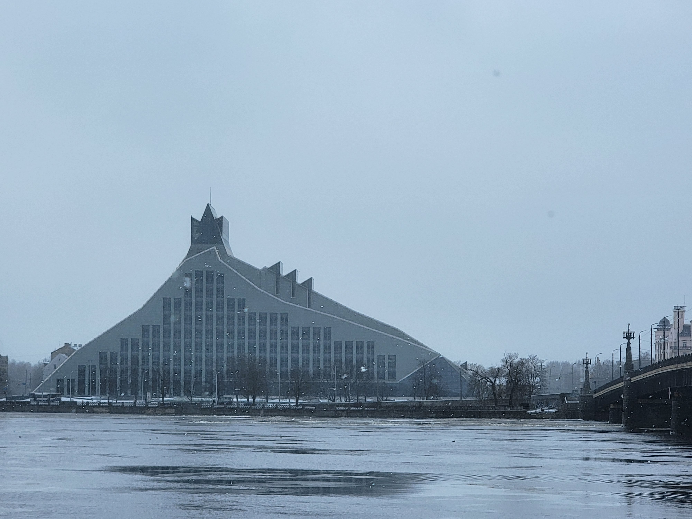
We also used our best resources…you
Sent a survey to the SLD (38 responses!)
Asked you to select the best translation
But what we didn’t tell you was…
                who or what did the translation.

Slide 10


Survey Results - Question 1
Однако технологии их использования имеют совершенно иную основу и базируются на научных знаниях.
However, the technologies involved in using them have a completely different foundation – they are based on scientific knowledge.
And the winner is…..
Votes
DeepL 9
ChatGPT 9
Humans 19
Human 2 1
Humans

Slide 11
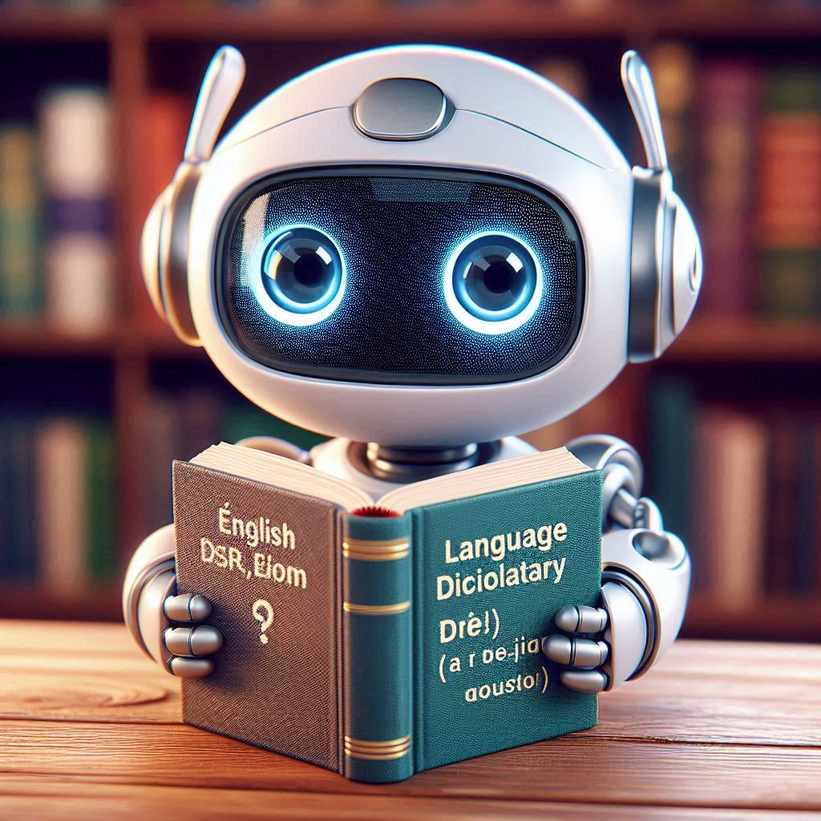
Survey Results - Question 2
Древнерусские представления о том, что новый год начинается 1 марта, выглядят куда логичнее – в марте дни становятся длиннее, природа просыпается – начинается настоящее обновление.
Ancient Russian beliefs that the New Year begins on March 1st seem much more logical—March brings longer days, nature awakens—signifying a true renewal.
And the winner is…..
Votes
DeepL 10
ChatGPT 18
Humans 10
ChatGPT

Slide 12
Survey Results - Question 3
Наступает поворот, перелом – новым годом он, правда, считался не всегда.
A time of change, a turning point is approaching; although it was not always considered the start of a new year.
And the winner is…
Votes
DeepL 1
ChatGPT 17
Humans 20
Humans

Slide 13
Takeaways
We chose translations that were not obviously computer translations and assumed we would get first impressions.
Based on this we can conclude:
    ChatGPT’s renditions will be grammatical and flow deceptively well but may not be accurate.
    DeepL is easier to peg as a computer translation.
    Human translators take liberties, which can be a blessing or a curse.
Is that the whole story? Let’s do one deep dive and look at some other characteristics.
Notes:
Human translators take liberties, which can be a blessing and a curse

Slide 14
Deep dive…
Наступает поворот, перелом
  A time of change, a turning point is approaching; (human)
Reverses the word order to subject-first
Creative solutions in “time of change,” “approaching”
Humans

Slide 15
Deep dive…
…новым годом он, правда, считался не всегда
  … although it was not always considered the start of a new year. (human)
Corrects the word order
Justified addition of “start”
Humans

Slide 16
Deep dive…
Наступает поворот, перелом
  It marks a turning point, a shift (ChatGPT)
Maintains word order, but adds a pronoun (“it”)
Поворот, перелом is no longer the subject
Why “marks”?
ChatGPT

Slide 17
Deep dive…
…новым годом он, правда, считался не всегда
  …although it wasn't always considered the New Year. (ChatGPT)
Corrects the word order
Capitalizes “New Year”
Contraction used appropriately
ChatGPT

Slide 18

Deep dive…
Наступает поворот, перелом
  There comes a turn, a turning point (DeepL)
No deviation from syntax
Adds dummy pronoun (“there”)
DeepL

Slide 19
Deep dive…
…новым годом он, правда, считался не всегда
  … the new year, however, it was not always considered. (DeepL)
Maintains source word order
No clarification on “new year”
“However” is a weak transition
DeepL

Slide 20
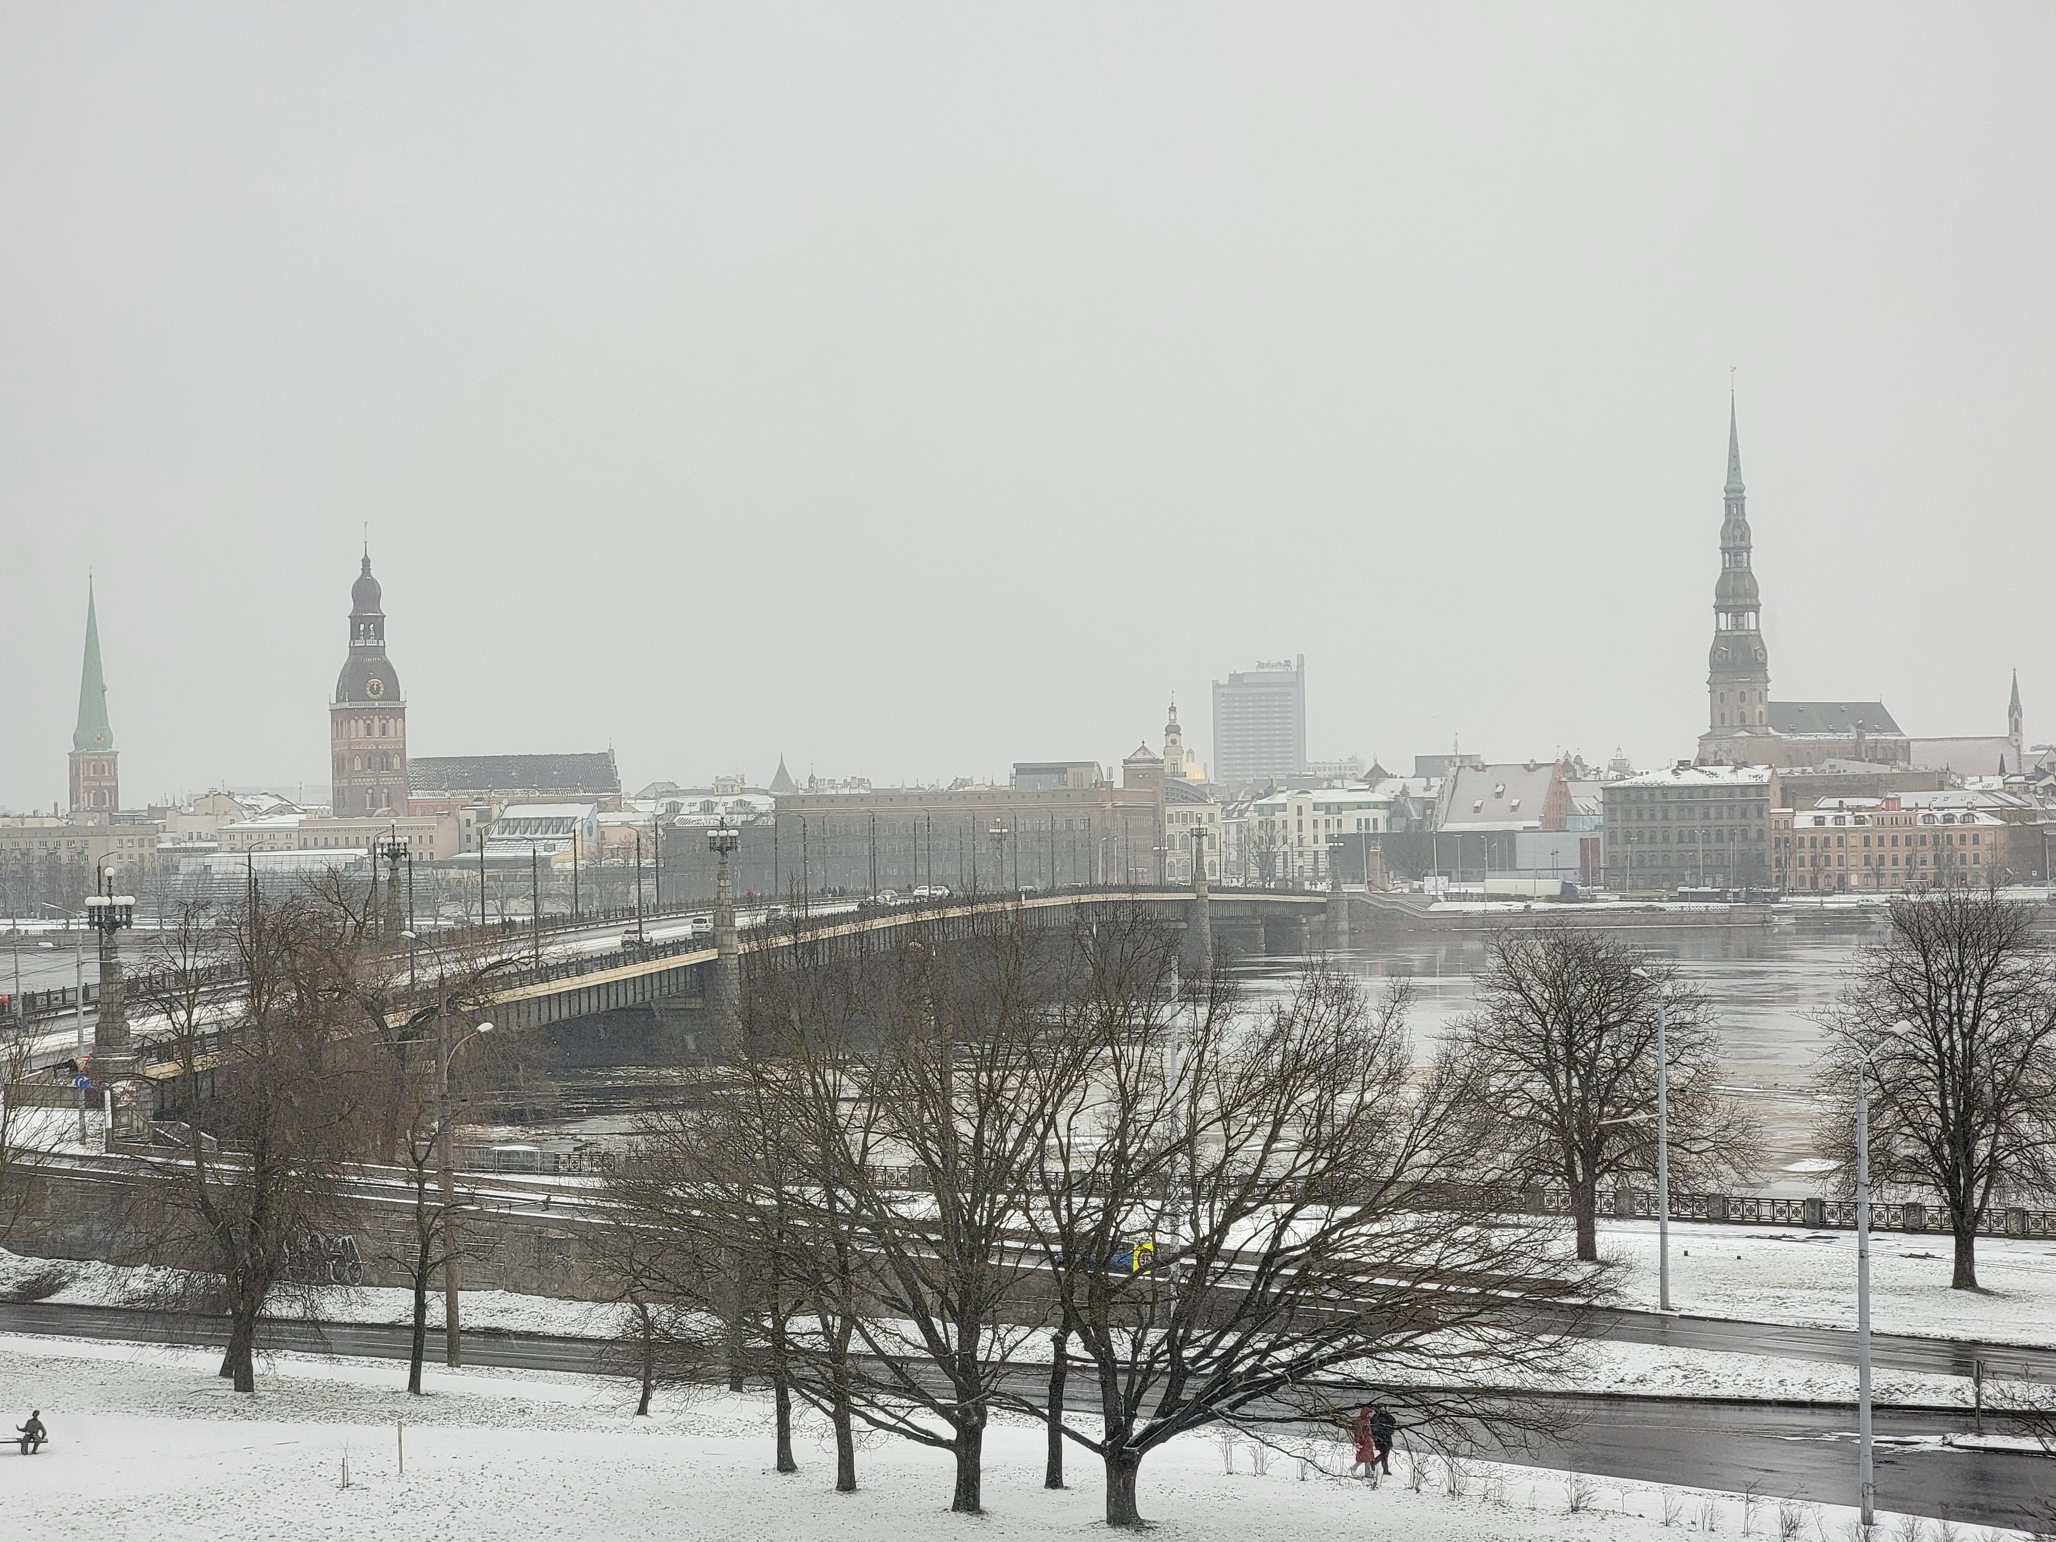
Activity
Take 5 minutes to decide who (what) did which translation.
Underline the tells (cohesion, fluency, syntax, terms)

Slide 21
Summary – What are the tells?
(two or three each)
ChatGPT
DeepL
Humans

Slide 22
Tells – Humans
Humans can achieve higher quality by:
  recasting or rewriting clauses.
  splitting or combining sentences.
  choosing subject-appropriate terms.
  substituting phrases for words and vice versa.
But humans may also:
  have spelling errors or inconsistencies.
  misuse collocations.
  struggle with syntax, especially articles.

Slide 23
Tells – LLMs
ChatGPT typically:
  produces text that reads like a human wrote it.
  sacrifices accuracy for readability.
  changes word forms for better flow when needed.
  keeps major punctuation marks intact but may reorder clauses or sentences.
  does well rendering cohesive devices and authorial tone.
  chooses terms that fit the context.

Slide 24
Tells – NMT
DeepL:
  sticks very close to the original syntax, even to the point of unreadability.
  may lose track of grammatical relationships.
  is more likely to choose a cognate or first dictionary definition than something that fits the context.
  for common or formulaic sentences, may recast clauses or remove or insert words.

Slide 25
So what?
MT capabilities have made amazing strides
  LLMs address many NMT shortcomings
  Improved models and training mean machine translations are becoming more fluent and accurate
  LLMs have huge potential and are here to stay
NMT and LLMs make mistakes
  And so do humans!
  Increasingly fluent target text masks potential accuracy issues
  These tools are not suited to all tasks
  In many contexts, human (expert) supervision is needed
AND
Notes:
Expand final point to include input on application and development of LLMs

Slide 26
Thank you for your attention…
Do you have any questions or comments?

